Slide 1
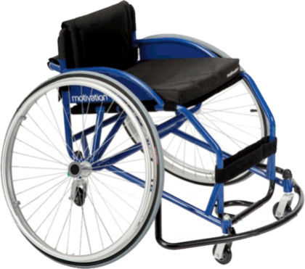
DAVID CONSTANTINE - MOTIVATION – MULTISPORT WHEELCHAIR
WORLD ASSOCIATION OF TECHNOLOGY TEACHERS https://www.facebook.com/groups/254963448192823/
www.technologystudent.com © 2023 V.Ryan © 2023
DAVID CONSTANTINE
David Constantine was a student in 1989, when he entered a competition to design a wheelchair (along with a colleague Simon Gue).
The wheelchair could be used in a range of terrains, such as those found in the third world/developing countries.
David had already been a wheelchair user for several years. The wheelchair had to be manufactured from locally sourced materials, which helped to ensure that it’s manufacture was sustainable and employed local technicians. The wheelchair had to be aﬀordable. They won the competition (the Frye Memorial Prize) and formed a non-proﬁt making organisation called ‘Motivation’, in 1991.
THE MULTISPORTS WHEELCHAIR
Form, aesthetics and particularly function, are applied to their designs. The organisation aims to raise the self- esteen of the disabled user. Motivation has sent designers, physiotherapists and engineers to developing countries, working with local companies to design and manufacture wheelchairs.
Each wheelchair is adjusted to ﬁt the individual user, at the point of distribution. The chair’s ‘empower’ the user to be mobile and to earn incomes, becoming active and valued members of society.
Motivation’s design philosophy, is one that aims to motivate the user, through the freedom and independence that their chairs deliver.
MULTISPORTS WHEELCHAIR
USEFUL LINK SCAN HERE
USEFUL LINK CLICK HERE
Link
V.Ryan © 2017
1. Describe the competition David Constantine entered in 1989.
2 marks
2. What is ‘Motivations’ design philosophy?
2 marks
3. Explain the importance of the Multisports Wheelchair to the user / client.
3 marks

