Slide 1
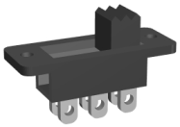
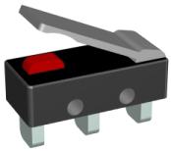
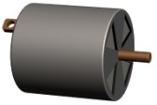
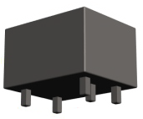
COMPONENTS SHEET
V.Ryan © 2009-2022 World Association of Technology Teachers
For each of the components ween below. Add the sketch / symbol / name for each component to complete the sheet.
https://technologystudent.com/elec1/switch2.htm
HELPFUL LINKS: https://technologystudent.com/elec1/switch3.htm
https://technologystudent.com/elec1/switch4.htm
INPUTS
OUTPUTS
DRAWING
SYMBOL
DRAWING
SYMBOL
SLIDE SWITCH
BUZZER
+
LED
BULB
PUSH SWITCH
M
RELAY
SOLENOID

