Slide 1
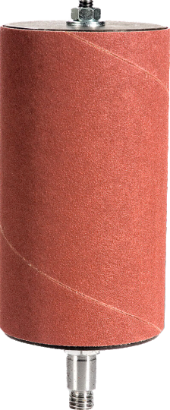
EXAMINATION QUESTIONS - BOBBIN SANDER / OSCILLATING SANDER
WORLD ASSOCIATION OF TECHNOLOGY TEACHERS https://www.facebook.com/groups/254963448192823/
www.technologystudent.com © 2022 V.Ryan © 2022
HELPFUL LINK: https://technologystudent.com/equip1/bobbin1.html
1. What is a Bobbin Sander ? What type of work can it perform? 6 marks
2. Complete the diagram of the bobbin sander by adding the missing labels.
7 marks
RYANMATIC
BOBBIN SANDER / OSCILLATING SANDER
Made in Keighley
V.Ryan © 2023
V.Ryan © 2023
V.Ryan © 2023

Slide 2
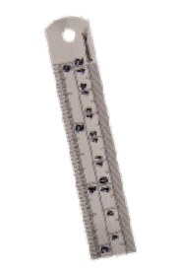
EXAMINATION QUESTIONS - BOBBIN SANDER / OSCILLATING SANDER
WORLD ASSOCIATION OF TECHNOLOGY TEACHERS https://www.facebook.com/groups/254963448192823/
www.technologystudent.com © 2022 V.Ryan © 2022
HELPFUL LINK: https://technologystudent.com/equip1/bobbin1.html
3. Complete the diagram below by adding the missing safety descriptions.
5 marks
RYANMATIC
Keighley, West Yorkshire
EXTRACTION UNIT
POWER BREAKER
V.Ryan © 2023

