Slide 1
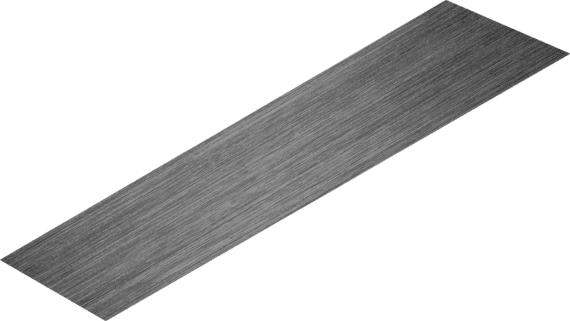
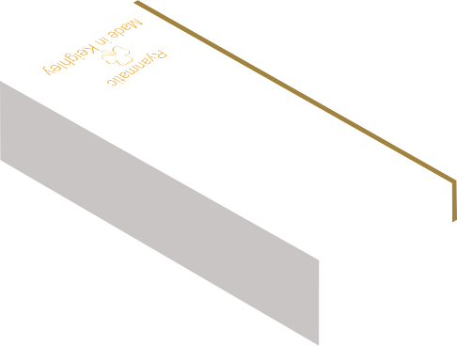
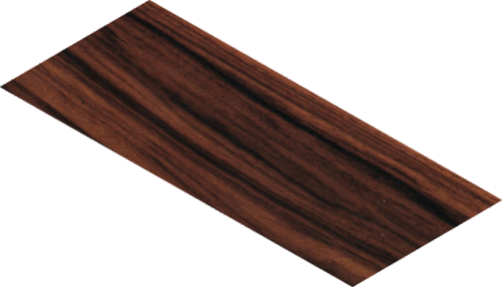
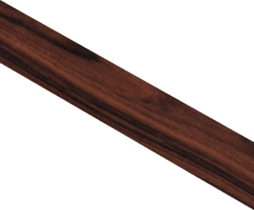
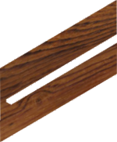
THIRD ANGLE ORTHOGRAPHIC DRAWING - TYPICAL WOODWORKING TRY SQUARE
WORLD ASSOCIATION OF TECHNOLOGY TEACHERS https://www.facebook.com/groups/254963448192823/
technologystudent.com © 2023 V.Ryan © 2023
HELPFUL LINKS: https://technologystudent.com/despro_flsh/third13.html
COMPLETE THE THIRD ANGLE ORTHOGRAPHIC PROJECTION OF THE WOODWORKERS TRY SQUARE. ADD AT LEAST EIGHT DIMENSIONS
(You are advised to study and handle a woodworkers try square)
Take the measurements / dimensions from the try square you have been given to study.
HELPFUL LINK
2
190mm
5
V.Ryan © 2023
50mm
10
25mm
125mm
DIA 8mm
BLADE
STOCK
PLAN VIEW
Ryanmatic
Made in Keighley
BRASS FACE
50mm
3
Ryanmatic
Made in Keighley
BASE LINE
50mm SIDE VIEW
THIRD ANGLE PROJECTION
FRONT VIEW

