Slide 1
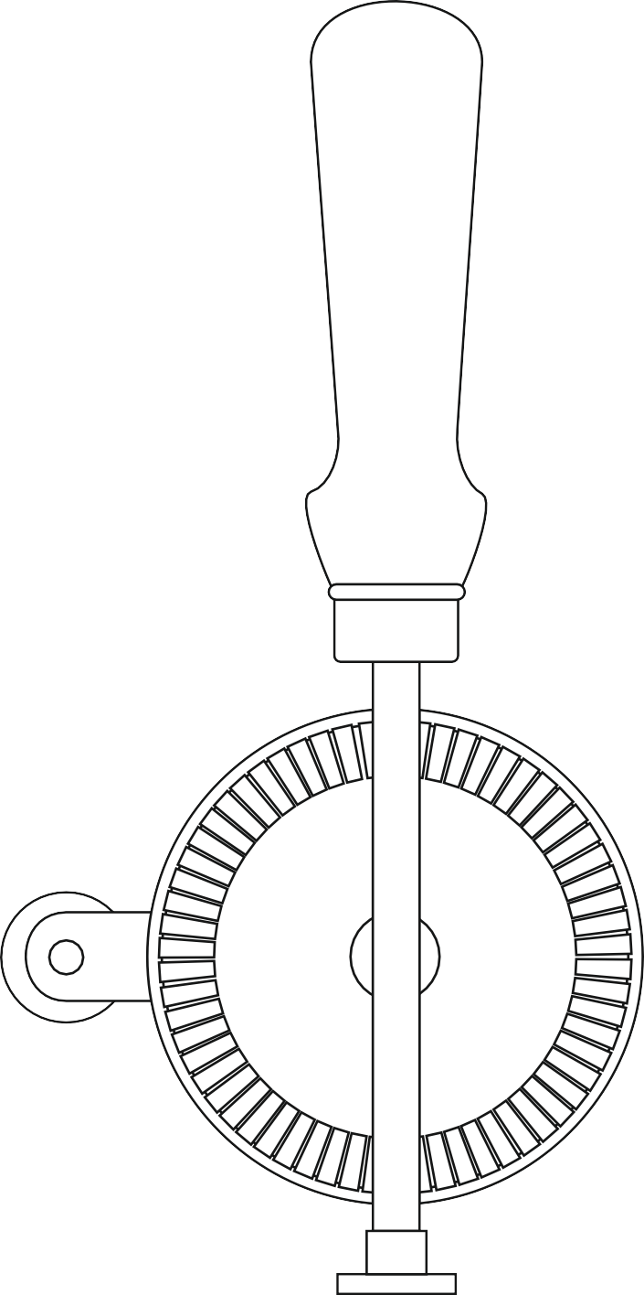
THIRD ANGLE ORTHOGRAPHIC DRAWING - TYPICAL HAND DRILL
WORLD ASSOCIATION OF TECHNOLOGY TEACHERS https://www.facebook.com/groups/254963448192823/
technologystudent.com © 2023 V.Ryan © 2023
HELPFUL LINKS: https://technologystudent.com/despro_flsh/third14.html
HELPFUL LINK
THREE VIEWS OF A TYPICAL HAND DRILL ARE SHOWN BELOW. COMPLETE THE SIDE VIEW BY ADDING THE MISSING PARTS. ADD EIGHT DIMENSIONS, ACROSS ALL THREE VIEWS. SELECT ONE OF THE VIEWS AND APPLY COLOUR AND SHADE.
(You are advised to study and handle a hand drill). Take the measurements / dimensions from the hand drill you have been given to study.
FRONT VIEW BACK VIEW SIDE VIEW
RYAN
Keighley
V.Ryan © 2023
V.Ryan © 2023
V.Ryan © 2023
THIRD ANGLE PROJECTION

