Slide 1
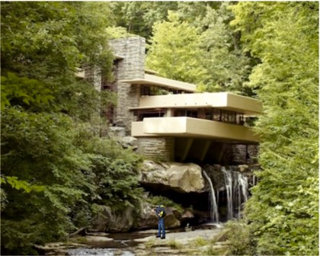
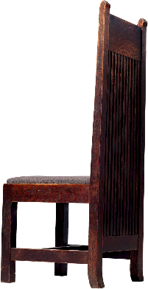
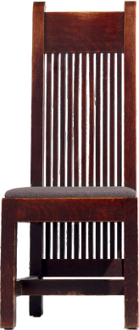
REVISION CARDS - FRANK LLOYD WRIGHT - DESIGNER AND ARCHITECT
WORLD ASSOCIATION OF TECHNOLOGY TEACHERS https://www.facebook.com/groups/254963448192823/
www.technologystudent.com © 2023 V.Ryan © 2023
FRANK LLOYD WRIGHT
Frank Lloyd Wright was one of the most prominent members of the Arts and Crafts movement.
He advanced the design of interiors and exteriors of buildings, establishing a sought after style. He believed in ‘organic architecture’ (a phrase coined by Wright), whereby the design of furniture within a building, its decor, the buildings exterior appearance and the environment it all sat in, were in harmony. The building and the landscape are blurred into one uniﬁed natural scene.
As an architect he designed houses, oﬃces, churches, schools, skyscrapers, hotels and museums.
The ‘Fallingwater’ house, constructed in 1935 in Pennsylvania, was designed for a successful Pennsylvanian family. Its ‘organic’ cantilever design, allows it to sit eﬀortlessly in its environment. The natural features of the landscape are integrated into its interior. This includes boulders from the site, which are an integral part of the sandstone ﬁreplace.
The chair seen opposite, is one of a set of four chairs designed by Wright in 1902, for the Ward W. Willits House in Illinois, which is identiﬁed as the ﬁrst outstanding ‘Prairie house style’, by Wright. His furniture is often characterised by straight lines and rectangular forms.
Wright is remembered as one of the USA’s most famous and inﬂuential designers / architects.
FALLINGWATER HOUSE 1935
USEFUL LINK SCAN HERE
USEFUL LINK CLICK HERE
Link
1. Who was Frank Lloyd Wright ?
2 marks
1. What is meant by the term ‘organic architecture’ ?
2 marks
3. Describe the ‘Fallingwater’ House. Why is it an example of organic architecture?
5 marks

