Slide 1
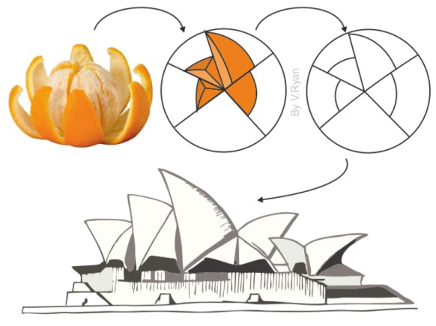
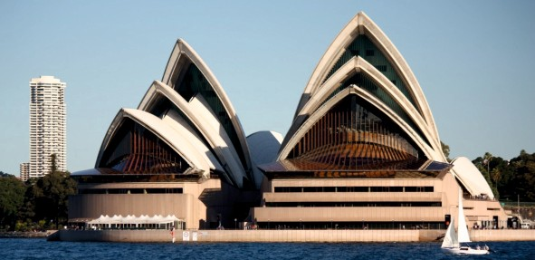
REVISION CARDS - JORN UTZON - SYDNEY OPERA HOUSE
WORLD ASSOCIATION OF TECHNOLOGY TEACHERS https://www.facebook.com/groups/254963448192823/
www.technologystudent.com © 2023 V.Ryan © 2023
JORN UTZON
Jorn Utzon was a relatively unknown Danish architect in the 1950s, until he won the competition to design the National Opera House in Sydney Australia, in 1956.
He studied architecture at the Copenhagen Royal Academy of Arts and much of his early work was in Sweden. He travelled widely and met many of the best known designers of the era. These included Mies van der Rohe and Charles Eames. In 1950 he opened his own Architectural business.
The design of the Sydney Opera House was inspired by nature, its forms, functions and colours.
Utzon was inﬂuenced in his designs by bird wings, the shape and form of clouds, shells, walnuts and palm trees.
He looked upon nature for guidance when designing, as nature over time combined both eﬃciency and beauty, hand in hand.
The roof structures of the Opera House are called ‘shells’. The design of the ‘shells’ was one of the most diﬃcult aspects of the building’s design. Jorn Utzon claimed that the ﬁnal design of the shells, was inspired by peeling an orange. It is said that the shells of the 14 separate roofs, form a sphere if combined.
Jorn Utzon was one of the pioneers in the use of prefabricated modular forms and designing for sustainability.
The Sydney Opera House was opened in 1973 by Queen Elizabeth
USEFUL LINK SCAN HERE
USEFUL LINK CLICK HERE
Link
1. Who was Jorn Utzon?
2 marks
2. What inﬂuenced Utzon when he designed the Sydney opera House?
2 marks
3. The roof structures are called ‘shells’. What inspired their design?
2 marks

