Slide 1
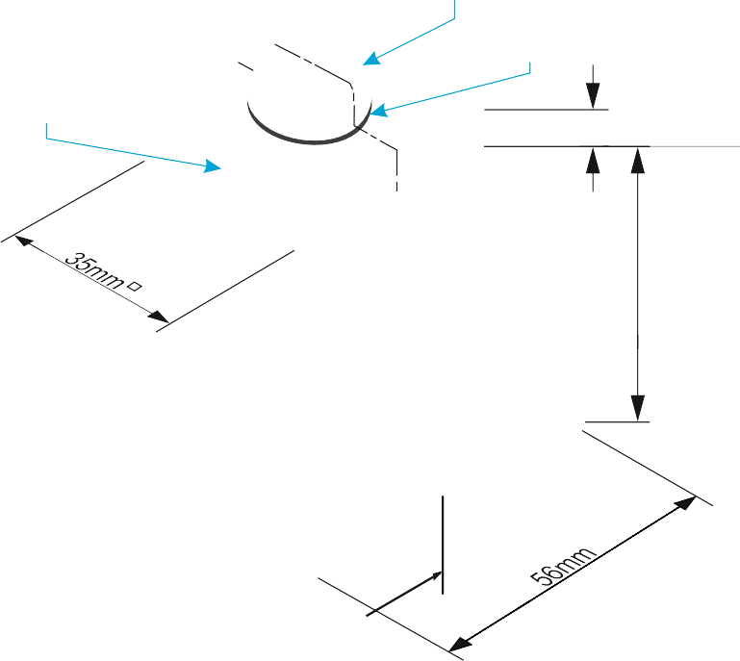
SECTIONAL VIEWS - THIRD ANGLE ORTHOGRAPHIC DRAWING
WORLD ASSOCIATION OF TECHNOLOGY TEACHERS https://www.facebook.com/groups/254963448192823/
technologystudent.com © 2023 V.Ryan © 2023
HELPFUL LINK: https://technologystudent.com/despro_3/sectional4.html
COMPLETE THE THREE VIEWS OF THE
PLAN VIEW
BLOCK AND BOLT SHOWN BELOW, INCLUDING THE SECTIONAL FRONT VIEW
ADD SIX DIMENSIONS
HELPFUL LINK
MACHINE BOLT
WASHER
A
STEEL PLATE
6
A
56mm
V.Ryan © 2022
A
BASE LINE
V.Ryan © 2023
A
THIRD ANGLE PROJECTION
SECTIONAL FRONT ELEVATION ON ‘AA’
SIDE VIEW

