Slide 1
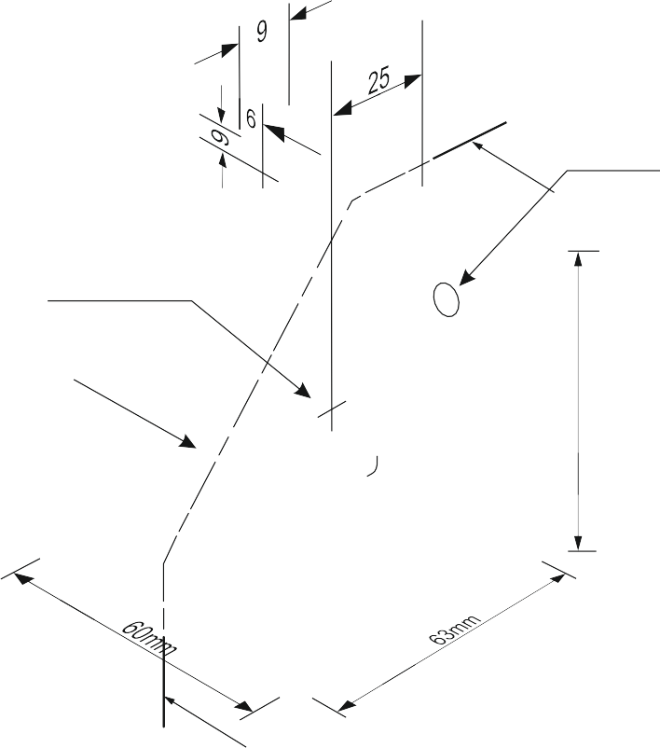
SECTIONAL VIEWS - THIRD ANGLE ORTHOGRAPHIC DRAWING
WORLD ASSOCIATION OF TECHNOLOGY TEACHERS https://www.facebook.com/groups/254963448192823/
technologystudent.com © 2023 V.Ryan © 2023
DRAW THE SECTIONAL SIDE VIEW AND ALSO THE FRONT VIEW OF THE CAST ALUMINIUM BRACKET.
FOLLOW THE DIMENSIONS SHOWN OPPOSITE. WHERE NECESSARY, ESTIMATE MEASUREMENTS.
R6mm
A
DIA 12mm
ADD SIX DIMENSIONS TO YOUR COMPLETED ORTHOGRAPHIC DRAWING
WEB
73mm
THIRD ANGLE PROJECTION
A
HATCHING NOT DRAWN ON A WEB, WHEN IT IS SECTIONED
ALONG ITS LENGTH
A
HELPFUL LINK
FRONT VIEW
SECTIONAL SIDE ELEVATION ON ‘AA’
HELPFUL LINK: https://technologystudent.com/despro_3/sectional6.html
A

