Slide 1
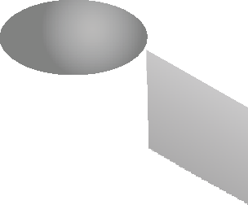
SOLIDS OF REVOLUTION - GEOMETRICAL DRAWING
WORLD ASSOCIATION OF TECHNOLOGY TEACHERS https://www.facebook.com/groups/254963448192823/ technologystudent.com © 2023 V.Ryan © 2023
HELPFUL LINK: https://technologystudent.com/despro_3/solid1.html
HELPFUL LINK
THE OBJECT BELOW IS A SOLID.
COMPLETE THE ‘SOLID OF REVOLUTION’, SHOWING THE CURVE PRODUCED BY THE ROUND AND THE CUBOID SECTIONS.
SOME OF THE GUIDELINES HAVE BEEN DRAWN FOR YOU.
a1
BOTTOM EDGE
a 2
a 2
DIA 48mm
a 2
a 2
100mm
48mm
A
a1
_{C} B
V.Ryan © 2023
THIRD ANGLE PROJECTION

