Slide 1
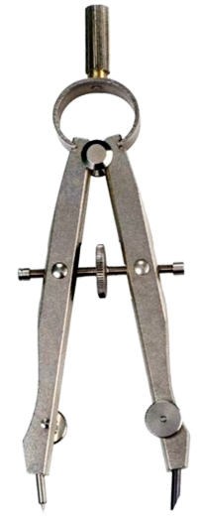
THIRD ANGLE ORTHOGRAPHIC DRAWING
WORLD ASSOCIATION OF TECHNOLOGY TEACHERS https://www.facebook.com/groups/254963448192823/
technologystudent.com © 2023
V.Ryan © 2023
HELPFUL LINK: https://technologystudent.com/despro_3/truelength1.html
DRAWING THE CIRCLE AT ITS ‘TRUE’ SIZE
COMPLETE THE DRAWING OF THE SQUARE PYRAMID, BY ADDING THE CIRCLE / HOLE TO THE FRONT VIEW.
THE ORIGINAL CIRCLE NEEDS PROJECTING ON TO THE FRONT VIEW. IT WILL NOT APPEAR AS A PERFECT CIRCLE, BECAUSE THE FRONT OF THE PYRAMID SLANTS AWAY FROM THE VIEWER.
HELPFUL LINK
A
A
B
CIRCLE CENTRE LINE
COMPASS POINT
BOW COMPASS
FRONT VIEW

