Slide 1
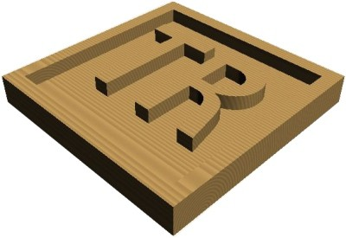
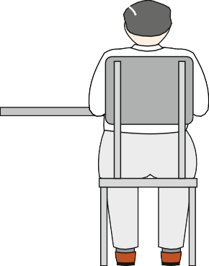
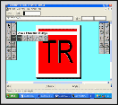
CAD/CAM - FROM DESIGN TO MANUFACTURE
WORLD ASSOCIATION OF TECHNOLOGY TEACHERS https://www.facebook.com/groups/254963448192823/
www.technologystudent.com © 2020 V.Ryan © 2020
USEFUL LINKS: https://technologystudent.com/cam/twod1.htm
The drawings below represent the various stages involved in the design and manufacture of a small plaque. The plaque has the initials of a customer / client, ‘engraved’ accurately, into its surface. CAD has been used to design the plaque and CAM to manufacture the final product. Write detailed notes alongside each drawing. Your notes should describe / explain each stage.
12 marks
USING CAD SOFTWARE
PROCESS DESIGN TO COORDINATES
COORDINATES
X, Y, Z
(18, 8, 23)
Z
X
Y

Slide 2
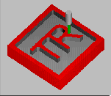
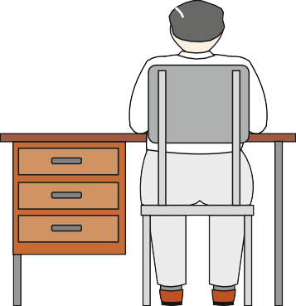
SAFETY - CNC AND MANUALLY OPERATED MACHINES
WORLD ASSOCIATION OF TECHNOLOGY TEACHERS https://www.facebook.com/groups/254963448192823/
www.technologystudent.com © 2020 V.Ryan © 2020
USEFUL LINKS: https://technologystudent.com/cam/twod1.htm
SIMULATE MANUFACTURE
MANUFACTURE USING A CNC
By V.Ryan
Boxford _{A3 HSR2}
3D HIGH - SPEED ROUTER
+
Z+
Z-
I/O
Z
-
X- Y+
Y- X+
%
BOXFORD

