Slide 1
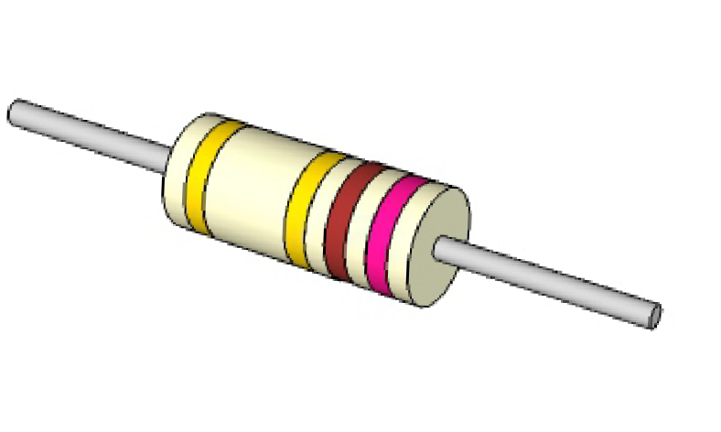
TEST INSTRUMENTS
V.Ryan © 2009-2023 World Association of Technology Teachers
HELPFUL LINK: https://technologystudent.com/elec1/metre1.htm
Test instruments (e.g. multimeters) can be used to measure a range of ‘values’. List the values each of the following meters measure:
AMMETER:
OHMMETER:
VOLTMETER:
What advantage has a multimeter over the three meters named above?
3. Explain the difference between an analogue and digital multimeters.
4. A incomplete basic drawing of a digital multimeter is seen opposite. It is being used to measure the resistance of a resistor. Add the missing parts.
18.7 ^{V}
V
C
O
U
L
R
T
R
S
E
N
O
5. In the space below, explain how a digital multimeter can be used to the measure the resistance of a resistor. You may wish to refer to the diagram opposite.
T
H
M
S
PROBES

