Slide 1
EXAMINATION QUESTIONS - WHAT IS SOLAR ENERGY?
WORLD ASSOCIATION OF TECHNOLOGY TEACHERS https://www.facebook.com/groups/254963448192823/ www.technologystudent.com © 2023 V.Ryan © 2023
HELPFUL LINKS: https://technologystudent.com/energy1/solar1.htm
1. Complete the paragraph on solar energy by adding the missing words. 9 marks
Solar is energy from the and without its presence all on earth would end. Solar energy has been looked upon as a serious source of energy for many years because of the amounts of energy that are made available, if harnessed by modern .
A simple example of the power of the sun can be seen by using a glass to
the suns rays on a piece of paper. Before long the paper ignites into .
vast
technology
flames
sun power freely life magnifying focus
2. In the space below, draw a diagram that represents the experiment with a magnifying glass, demonstrating the power of the sun. Label your diagram and add explanatory notes. 6 marks
DIAGRAM NOTES
3. How can a magnifying glass be used to demonstrate how the power of the sun heats water. Use a diagram and notes to answer this question. 6 marks
DIAGRAM NOTES

Slide 2
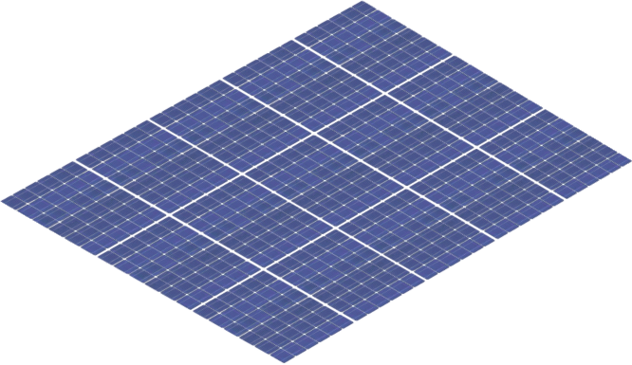
EXAMINATION QUESTIONS - WHAT IS SOLAR ENERGY?
WORLD ASSOCIATION OF TECHNOLOGY TEACHERS https://www.facebook.com/groups/254963448192823/ www.technologystudent.com © 2023 V.Ryan © 2023
HELPFUL LINKS: https://technologystudent.com/energy1/solar1.htm
4. A modern solar panel, for heating domestic water is shown opposite. Explain how it works. 6 marks
FLUID PIPES
SILVER REFLECTIVE SURFACE
ENERGY FROM THE SUN
MAGNIFYING GLASS FRONT
SIDE VIEW
FRONT VIEW
5. Describe the climate in which this technology works efficiently.
6. Complete the diagram of water heating solar panel, by adding the missing labels. 7 marks

