Slide 1
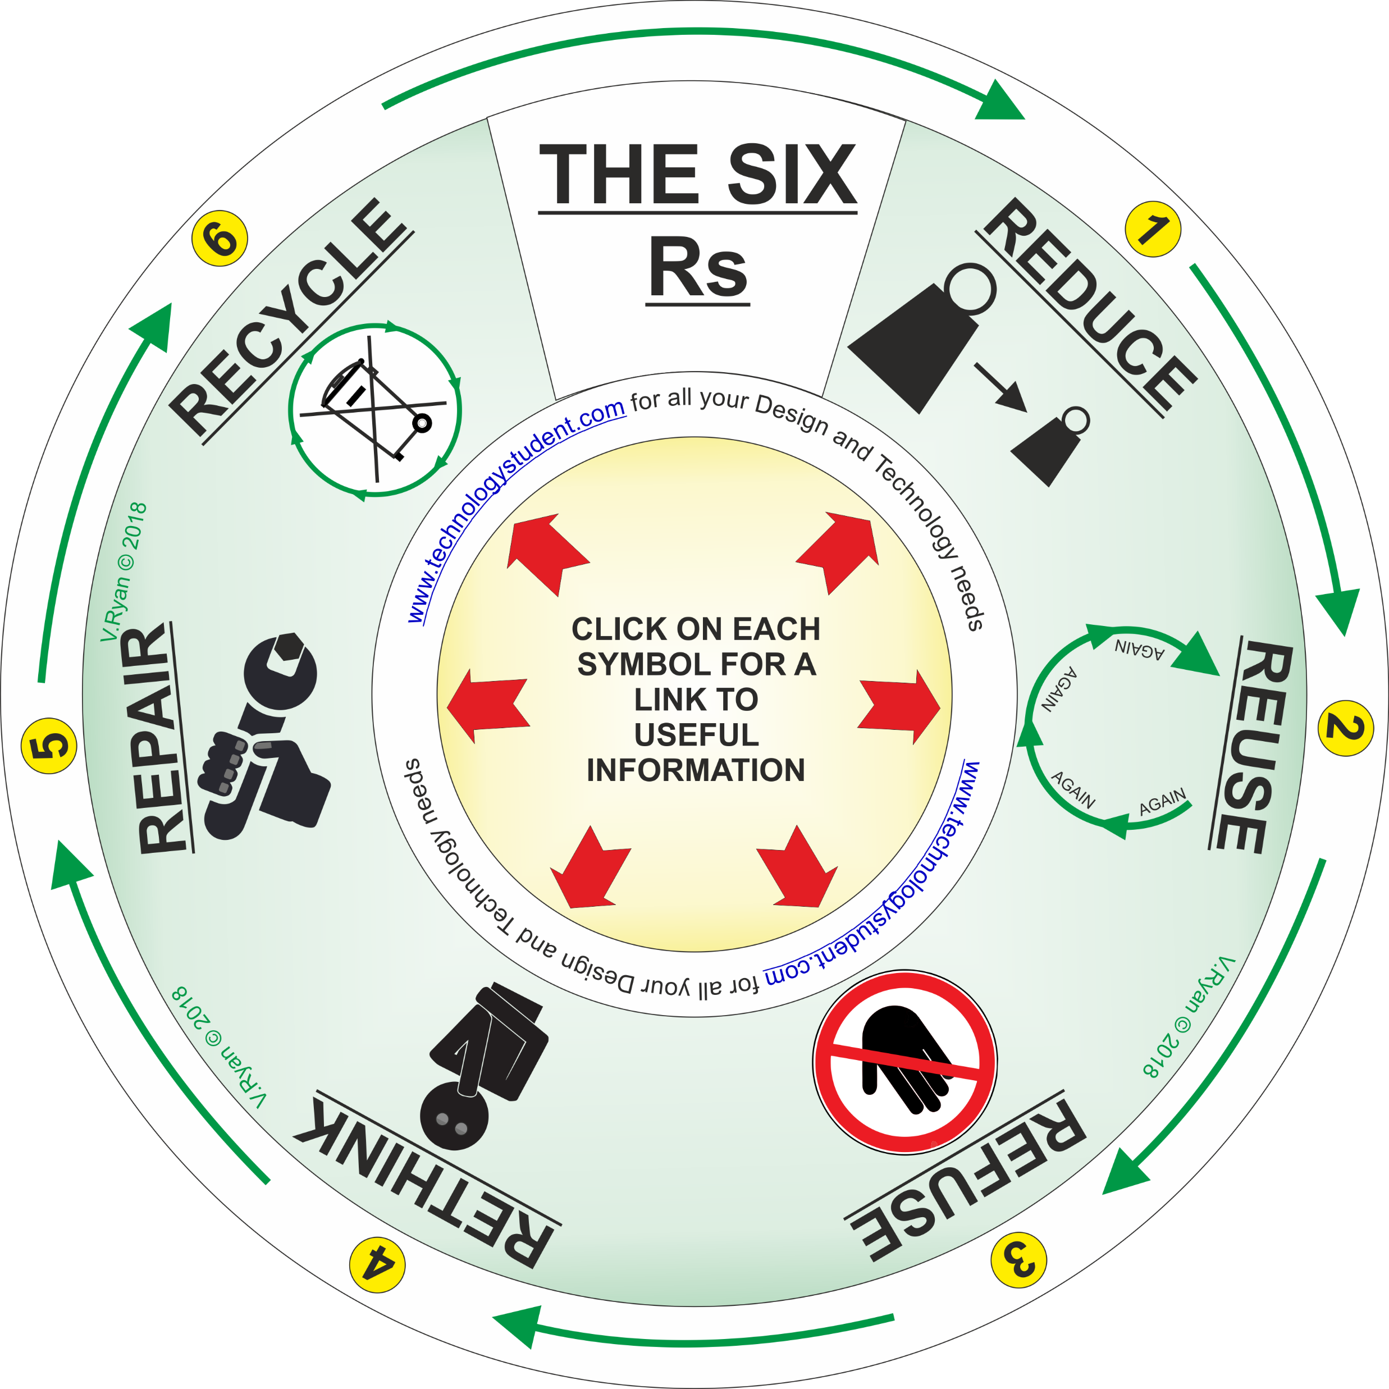
SIX Rs ‘LEARNING CIRCLE’
This SIX Rs ‘Learning Circle’, includes each area related to the environment and conservation. Each ‘R’ has been numbered.
Describe the meaning of each ‘R’, using the next slide for your answers.
Click on each symbol, for a link to useful information.
If you click on the circle, you will be able to rotate it, making it easier to read the 6Rs.

Slide 2
