Slide 1
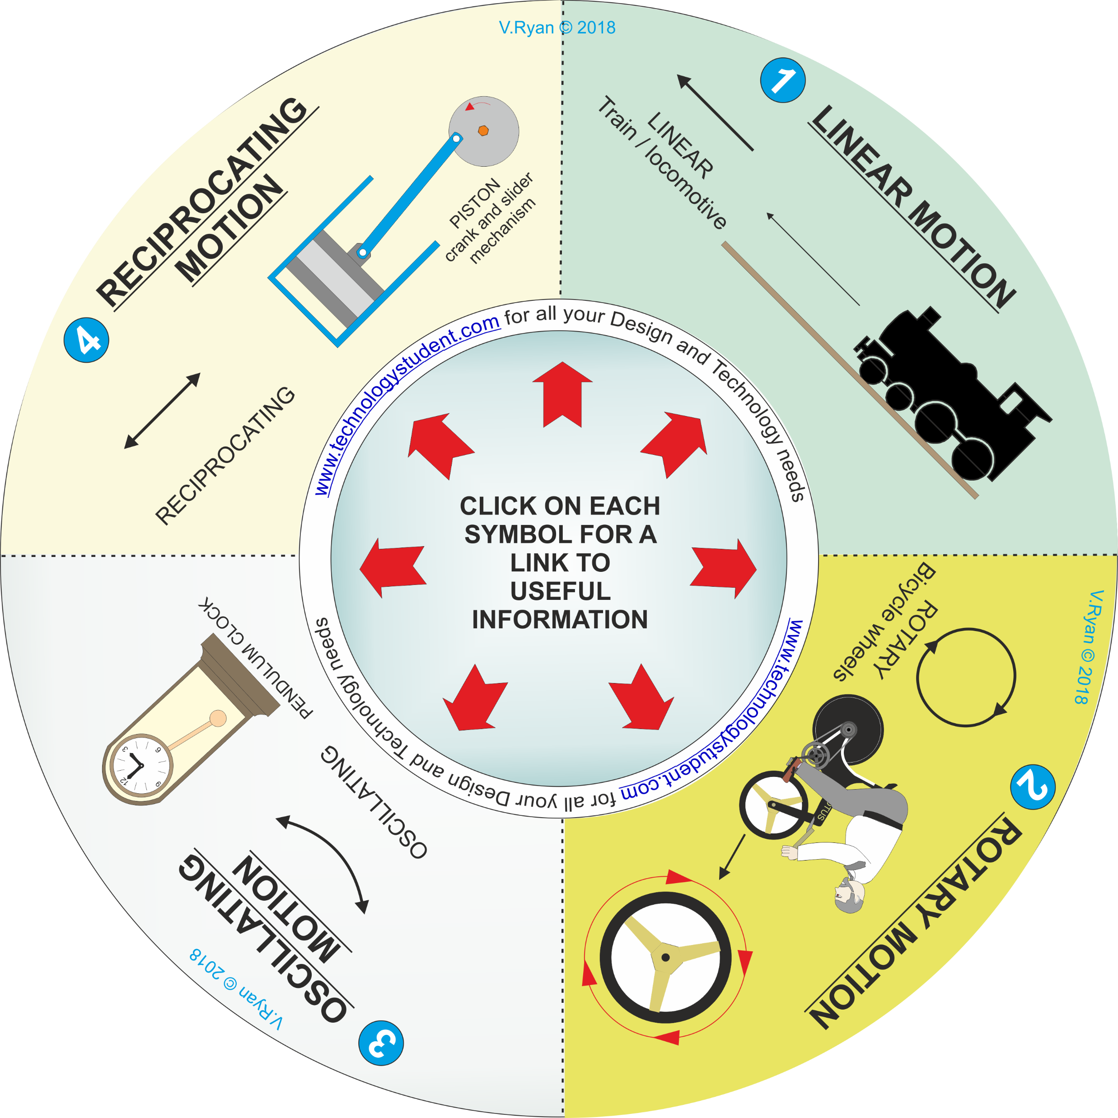
TYPES OF MOTION
‘LEARNING CIRCLE’
This ‘Learning Circle’, includes images representing types of ‘motion’. Each one has been numbered.
Click on each image, for a link to useful information.
Describe each type of motion, on the following slide. For each one, include a practical / real life example.
If you click on the circle, you will be able to rotate it, making it easier to view the images.

