Slide 1
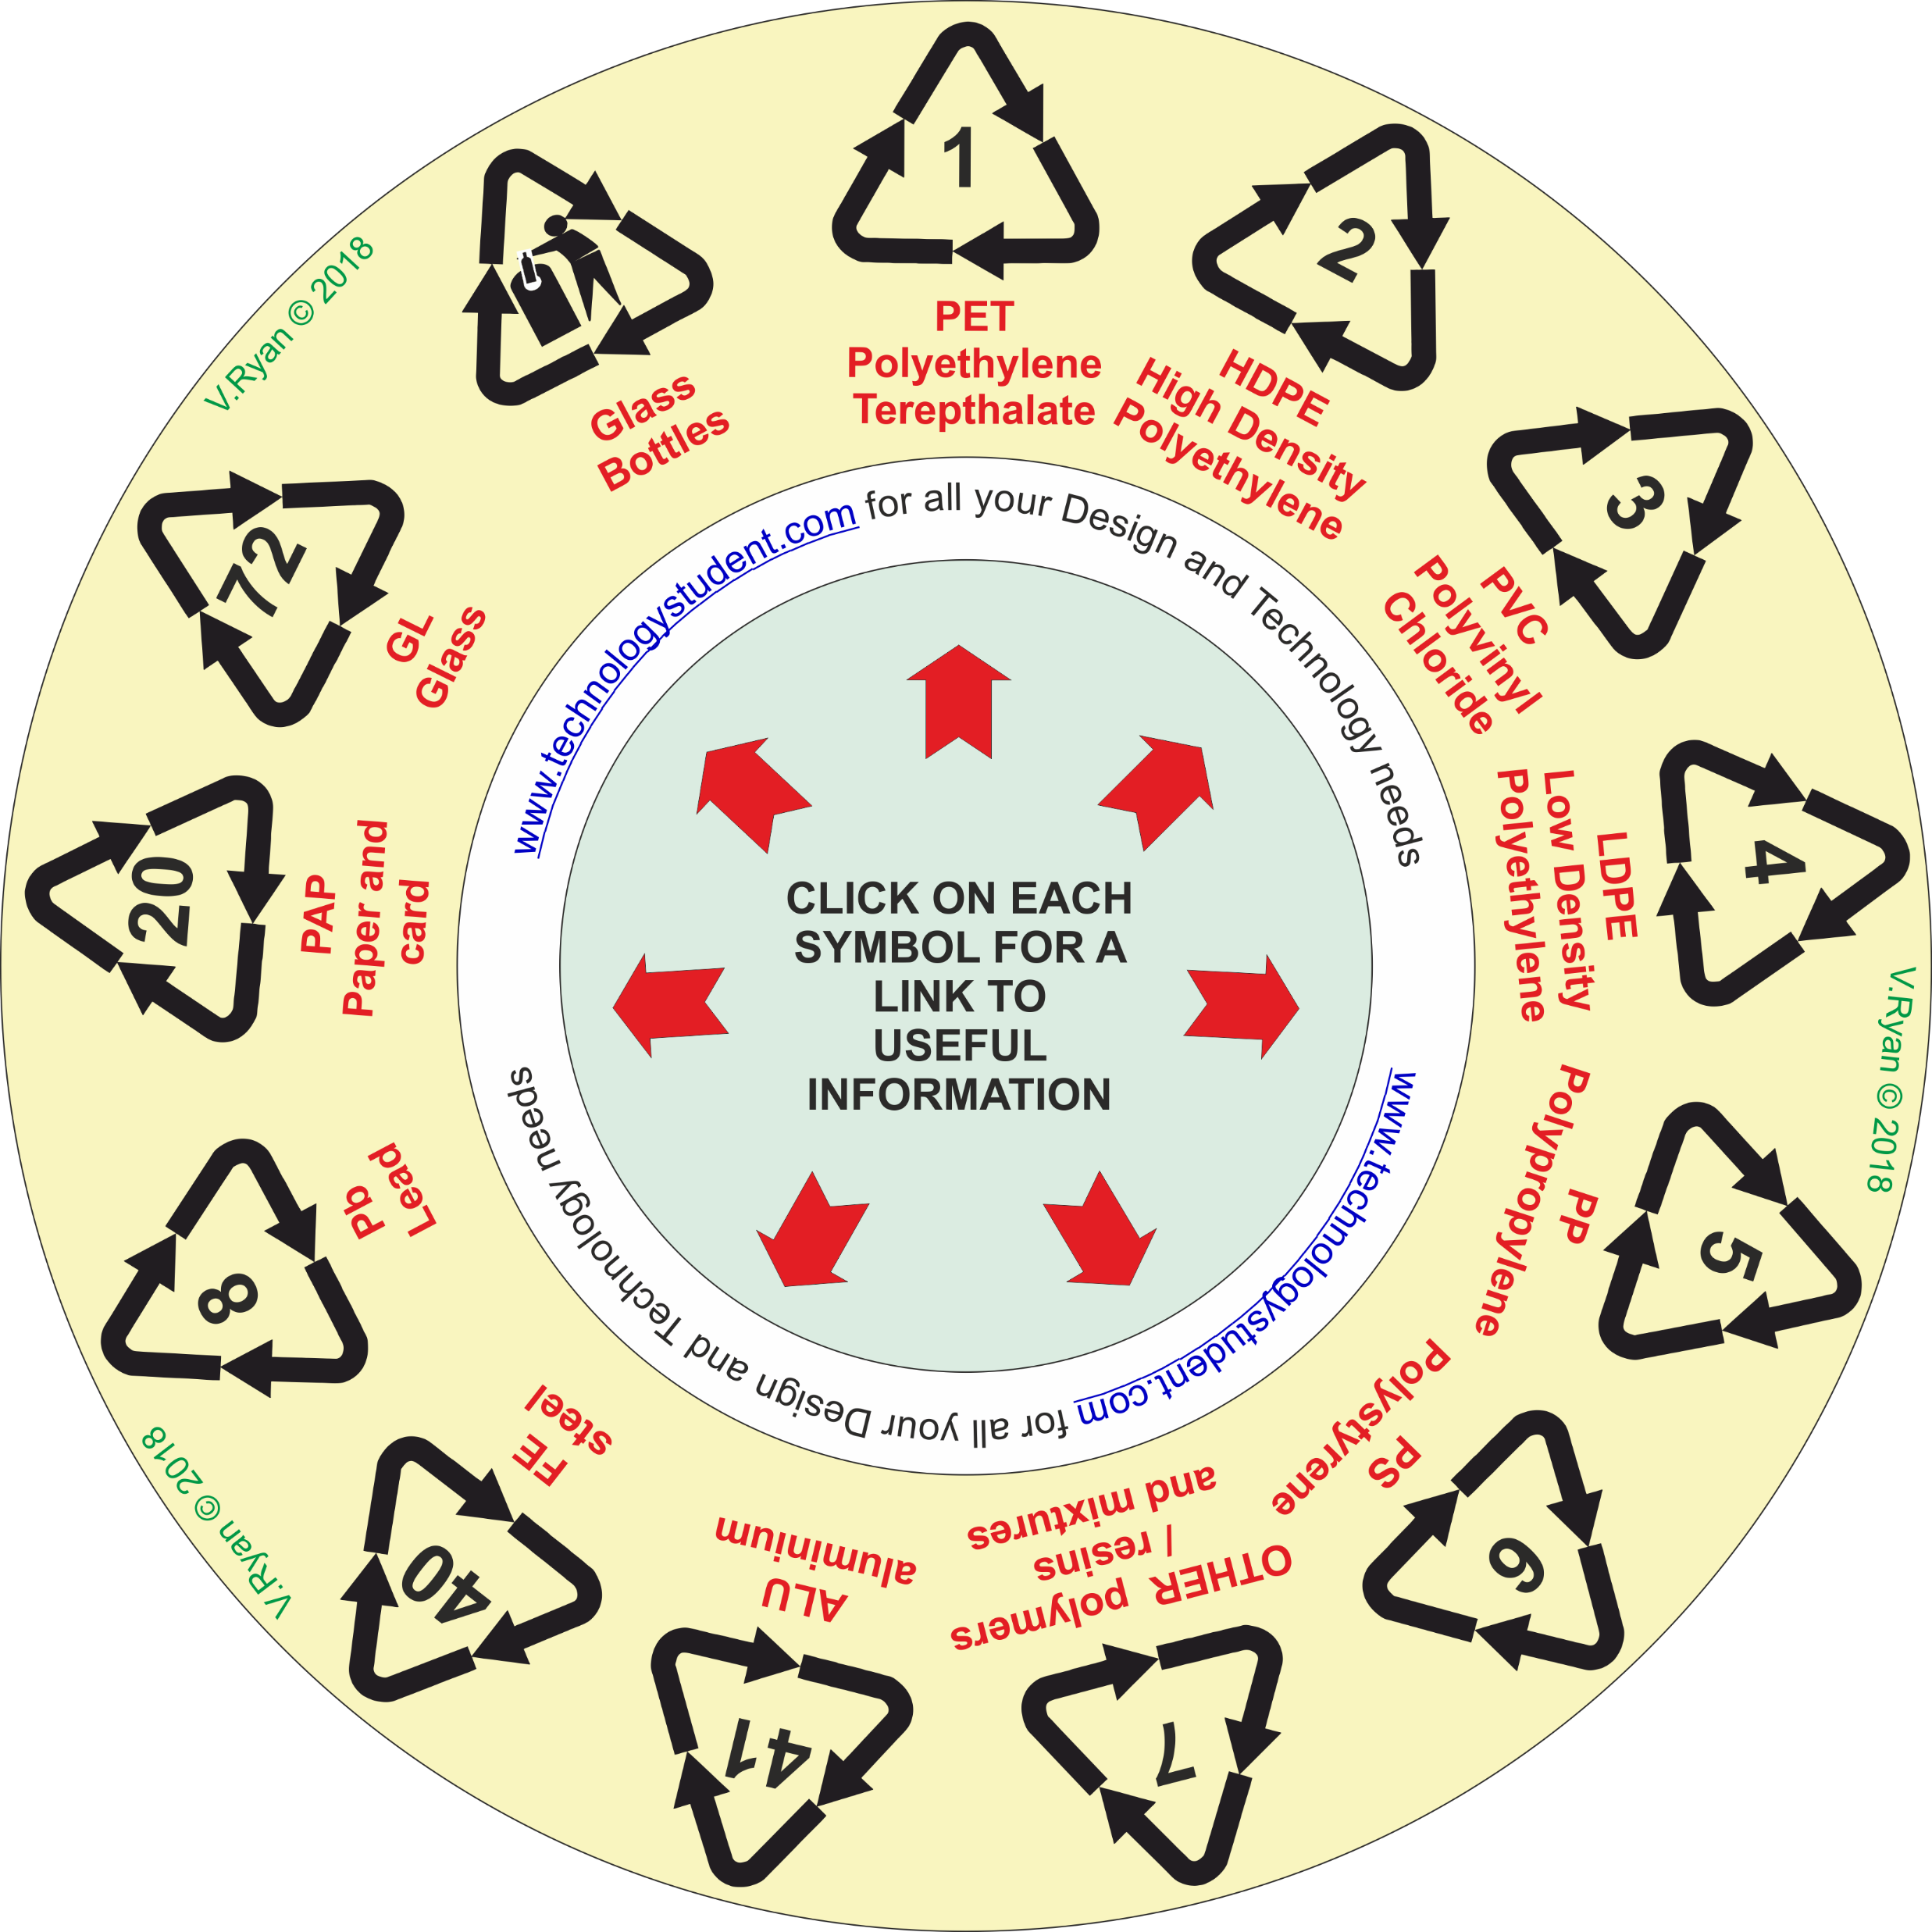
THE RECYCLING CIRCLE
This ‘Recycling Circle’ includes some important symbols / materials.
For each of the materials, describe its practical application.
Click on each symbol, for a link to useful information.
OR search the Internet for useful information.
If you click on the circle, you will be able to rotate it, making it easier to read the symbols.

