Slide 1
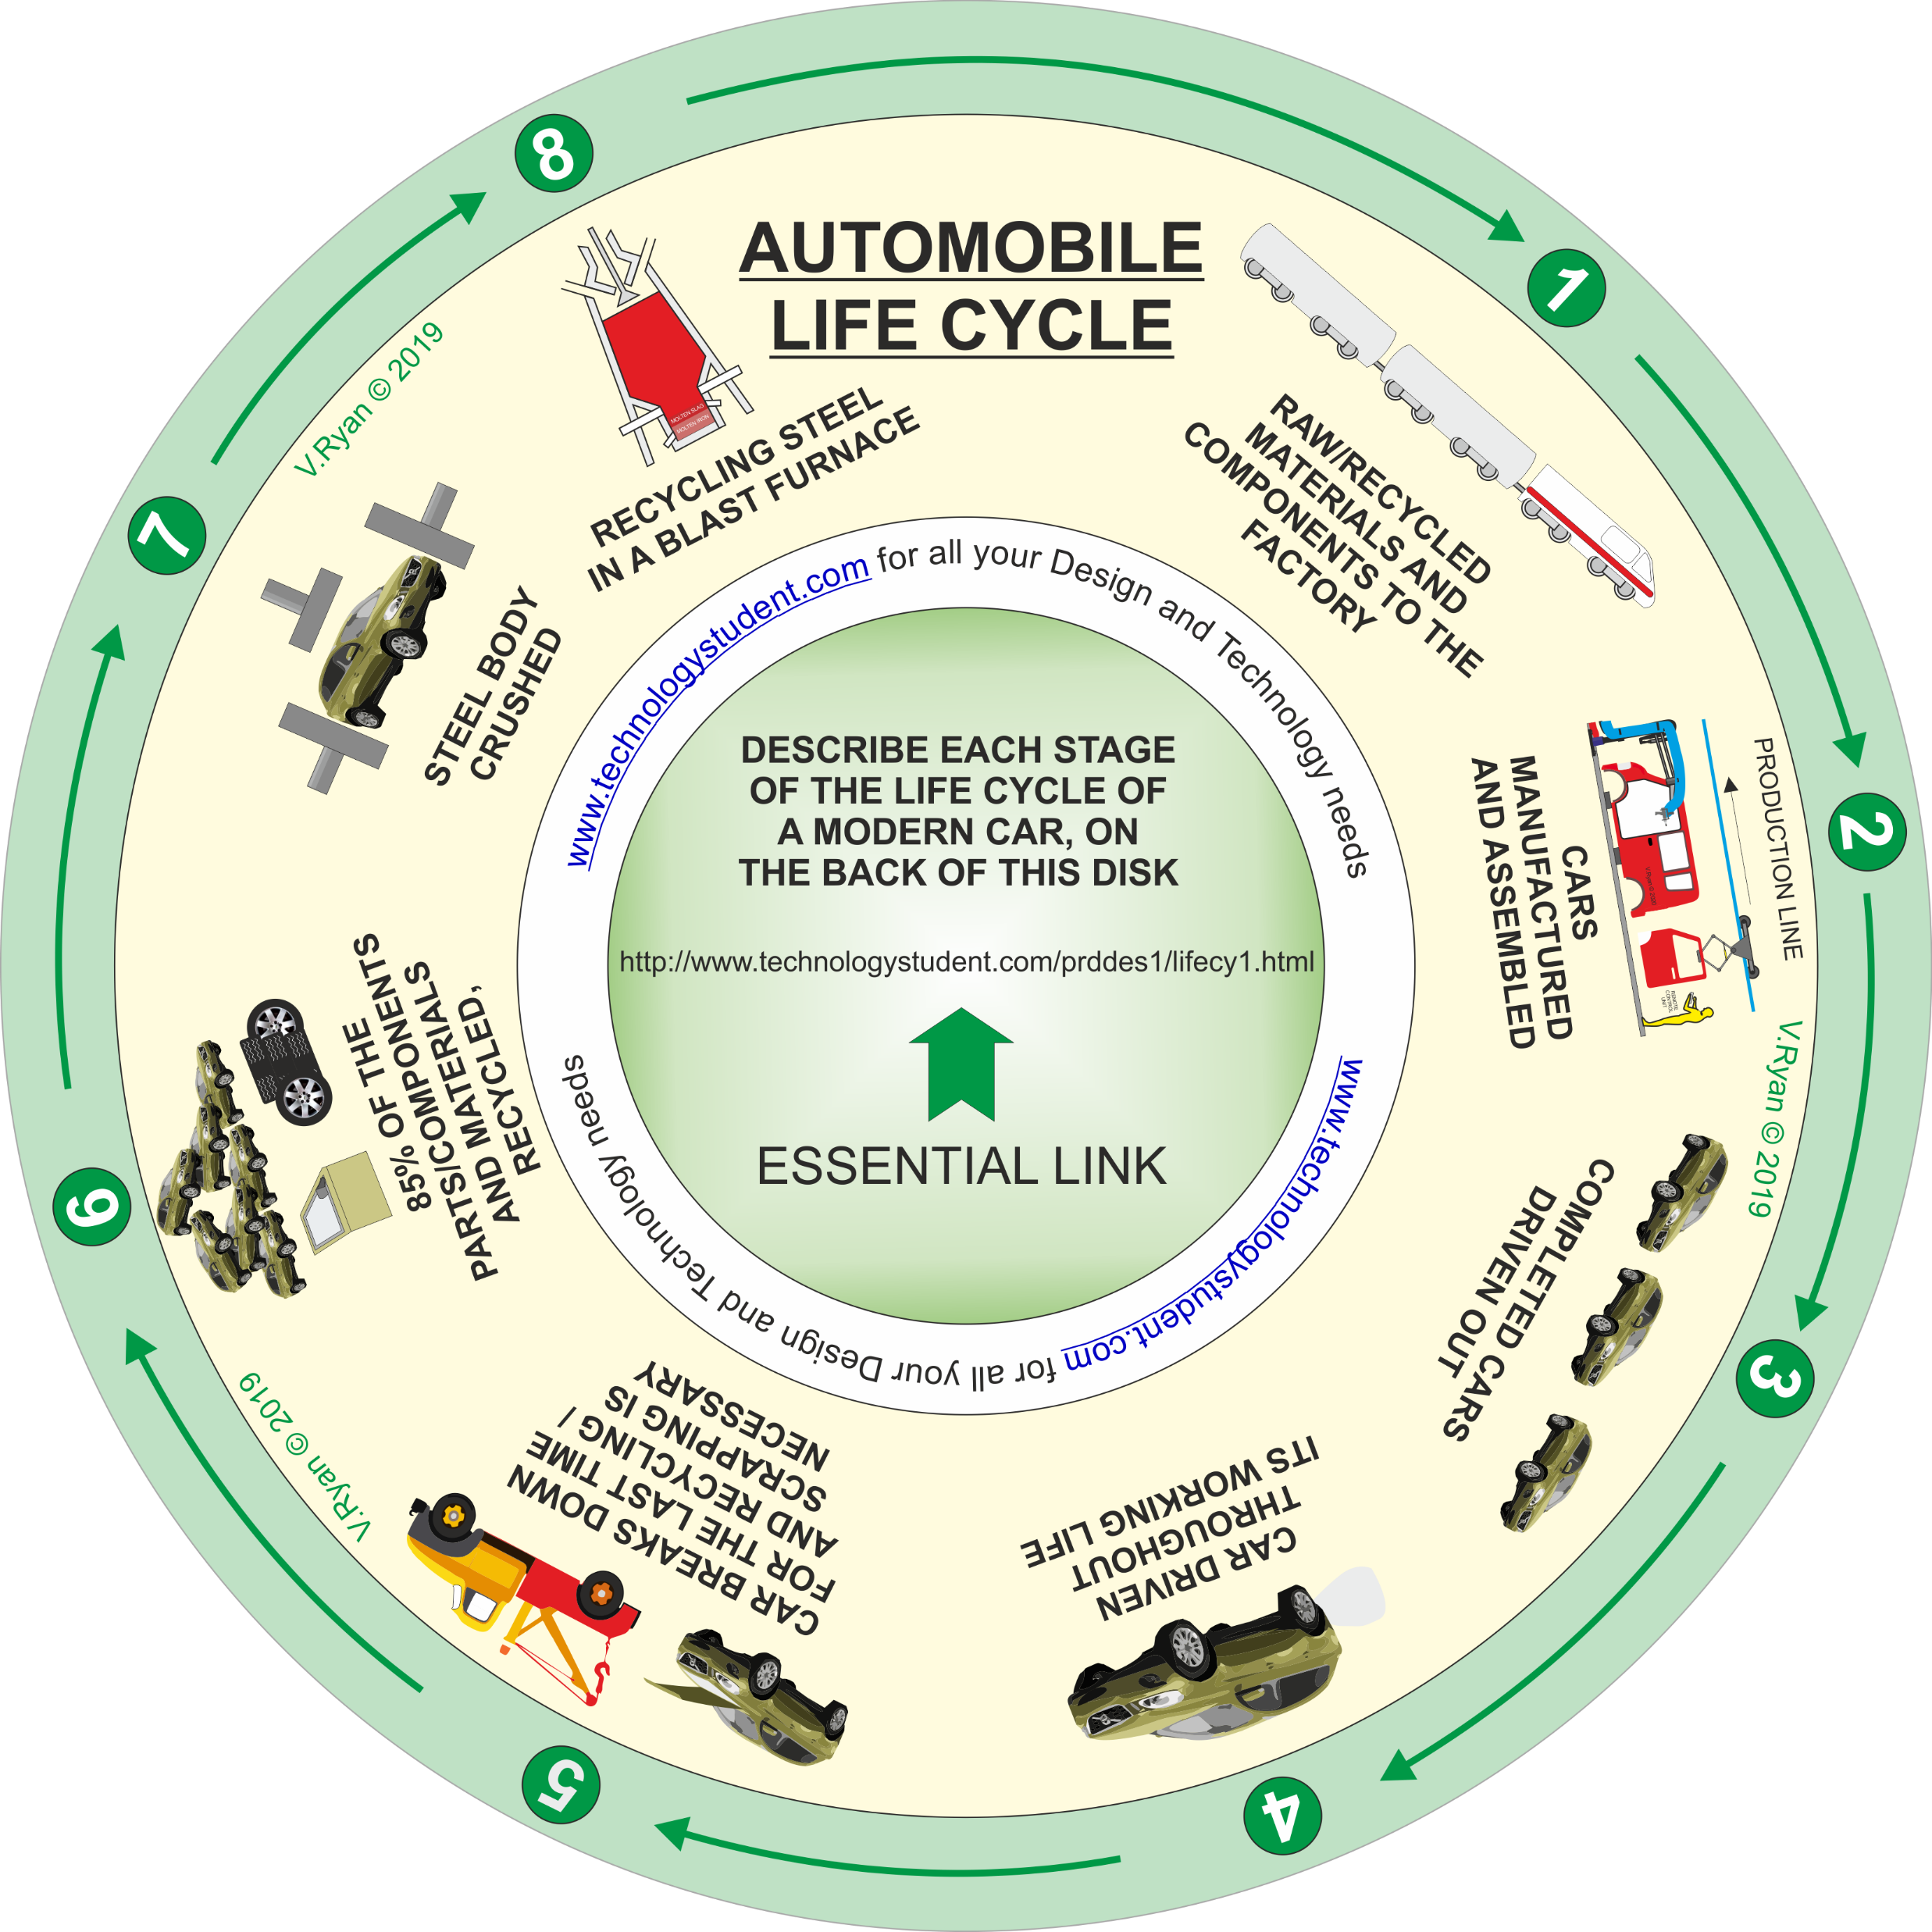
AUTOMOBILE LIFE CYCLE
‘LEARNING CIRCLE’
This life cycle ‘learning circle’, includes images representing each stage, of the life cycle of a modern car. Each stage has been numbered.
Click on each image, for a link to useful information.
Describe each stage of the life cycle of a modern car, on the following slides.
If you click on the circle, you will be able to rotate it, making it easier to read the symbols.

