Slide 1
Level 1/Level 2 GCSE (9–1)
DESIGN AND TECHNOLOGY - GCSE SAMPLE PAPER 2
Candidate Name | Centre Number |  |  |  |  | Candidate Number
COMPONENT 1
TIME ALLOWED - 1 hour 45 minutes
EQUIPMENT REQUIRED
Drawing and writing equipment, coloured pencils and a calculator
INSTRUCTIONS
You are to answer all questions.
WORLD ASSOCIATION OF TECHNOLOGY TEACHERS https://www.facebook.com/groups/254963448192823/
www.technologystudent.com © 2018 V.Ryan © 2018
This example examination paper can be duplicated and printed out if required but not edited in any way.
The links to www.technologystudent.com cannot be removed.
The PDF ﬁle can be stored on school / college systems and distributed electronically (NO EDITING ALLOWED)
PLEASE RESPECT THE COPYRIGHT - report infringers to techteacher@technologystudent.com Not be distributed at courses or by course instructors / consultants
WORLD ASSOCIATION OF TECHNOLOGY TEACHERS https://www.facebook.com/groups/254963448192823/
www.technologystudent.com © 2018 V.Ryan © 2018

Slide 2
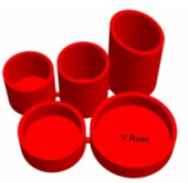

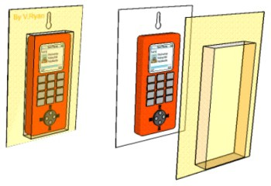
Section A - CORE
Answer all the questions in this section
1a. The table below is divided into three columns. Column ‘A’, shows an image of a product. Column ‘B’ identiﬁes the manufacturing process and Column ‘C’ names a material(s) suitable for the manufacturing process.
Complete the table below by adding the missing information. The ﬁrst answer has been completed for you.
(A) PRODUCT DESCRIPTION PROPERTY
WORLD ASSOCIATION OF TECHNOLOGY T |  | DESKTIDY INJECTION MOULDING EACHERS https://www.facebook.com/groups/2549634481928 | Thermoplastics such as polystyrene, nylon, polypropylene and polythene are ideal plastics for this type of manufacturing process. 23/ www.technologystudent.com © 2018 V.Ryan © 2018
 | HELPFUL LINK | http://www.technologystudent.com/prd | des1/rotate2.html
 |  | ‘PLASTIC’ TROPHY ROTATIONAL MOULDING | 1 mark
 | HELPFUL LINK | http://www.technologystudent.com/gp | rep07/vac2.html
 |  | BLISTER PACKAGING VACUUM FORMING | 1 mark

Slide 3
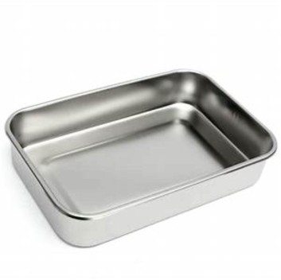
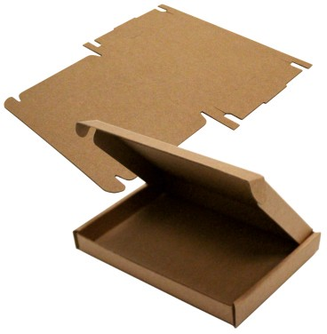

PRODUCT
DESCRIPTION
PROPERTY
 |  | HELPFUL LINK ht |  | tp://www.technologystudent.co | m/equip1/hypress1.htm
WORLD ASSOCIATION OF TECHNOLOGY |  |  |  | STEEL TRAY COMPRESSION MOULDING TEACHERS https://www.facebook.com/groups/2549634481928 | 1 mark 23/ www.technologystudent.com © 2018 V.Ryan © 2018
 | HELPFUL LINK |  |  | http://www.technologystudent.co | m/despro_ﬂsh/charity9.html
 |  |  |  | PACKAGING DIE CUTTING | 1 mark
 |  |  | HELPFUL LINK | http://www.technologystudent.c | om/rmprep09/inject1.html
 |  |  |  | WHEELIE BIN BLOW MOULDING | 1 mark

Slide 4


HELPFUL LINK http://www.technologystudent.com/joints/aroma1.html
WORLD ASSOCIATION OF TECHNOLOGY TEACHERS https://www.facebook.com/groups/254963448192823/ www.technologystudent.com © 2018 V.Ryan © 2018
1b. The manufacturer of the greetings card has included aroma pigments, in the form of a ‘scratch and sniﬀ’ patch.
SCRATCHABLE AROMA PATCH
(I) How could aroma pigments, applied to the scratch and sniﬀ patch, improve the appeal of the greetings card? 2 marks
HELPFUL LINK http://www.technologystudent.com/despro_ﬂsh/ﬂex2.html
(II) The greetings card is manufactured by a web-fed printer. What is web-fed printing? 2 marks

Slide 5
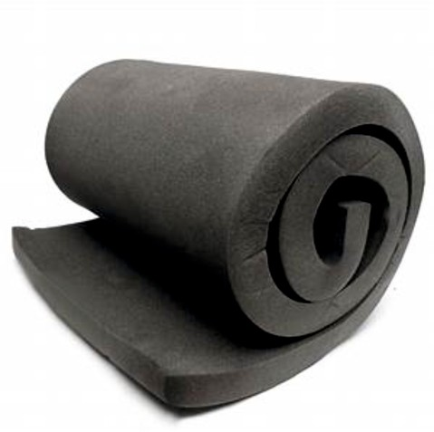

HELPFUL LINK http://www.technologystudent.com/joints/polyurethane2.html
WORLD ASSOCIATION OF TECHNOLOGY TEACHERS https://www.facebook.com/groups/254963448192823/ www.technologystudent.com © 2018 V.Ryan © 2018
2. The photograph shows a roll of foam, which will be used to manufacture cushions.
2a. Name a suitable polymer for the manufacture of this product? In your answer explain the physical properties that make it suitable. 2 marks
WORLD ASSOCIATION OF TECHNOLOGY TEACHERS
https://www.facebook.com/groups/254963448192823/
www.technologystudent.com © 2017 V.Ryan © 2017
HELPFUL LINK http://www.technologystudent.com/pdf14/maths_rec_prism1.pdf Page 2
2b. The manufacturer has switched suppliers and the foam is now supplied in the shape of a rectangular prism, NOT a roll of foam. What is the volume of the rectangular prism, shown below. 3 marks
H = 100mm

Slide 6
HELPFUL LINK http://www.technologystudent.com/joints_ﬂsh/nylon1.html
WORLD ASSOCIATION OF TECHNOLOGY TEACHERS https://www.facebook.com/groups/254963448192823/
www.technologystudent.com © 2018 V.Ryan © 2018
2c. The foam cushions will be covered with nylon, woven into a textiles materials List two physical properties of nylon. 2 marks
(i)
(ii)
HELPFUL LINK http://www.technologystudent.com/joints_ﬂsh/nylon2.html
2d. Brieﬂy describe how nylon is manufactured. 2 marks

Slide 7
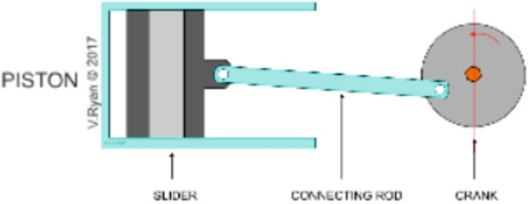
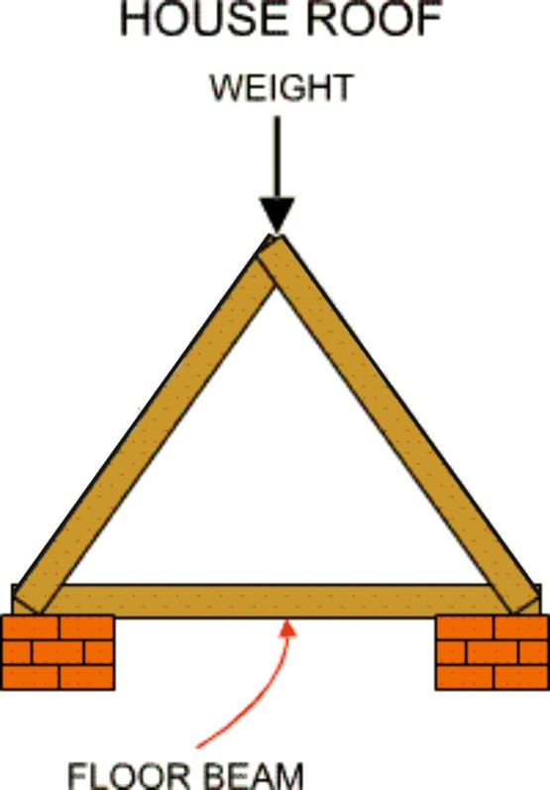
HELPFUL LINK http://www.technologystudent.com/forcmom/motion1.html
WORLD ASSOCIATION OF TECHNOLOGY TEACHERS https://www.facebook.com/groups/254963448192823/
www.technologystudent.com © 2018 V.Ryan © 2018
3a. The diagram below represents a type of movement.
(I) Name the movement.
1 mark
(I) Describe the movement.
1 mark
SLIDER CONNECTING CRANK ROD
HELPFUL LINK http://www.technologystudent.com/struct1/strut1.htm
3b. The diagram below, shows the structure holding up roof of a house. In terms of forces, label the struts and ties? 2 marks

Slide 8
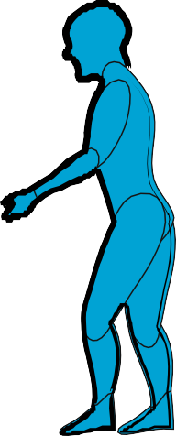
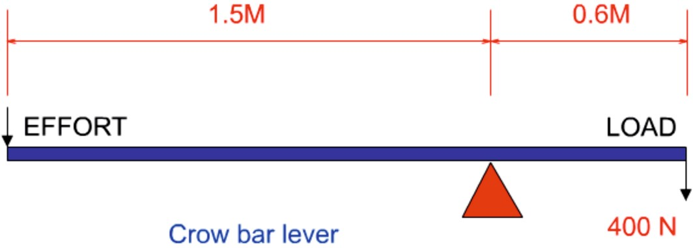
HELPFUL LINK http://www.technologystudent.com/forcmom/lever1.htm
3c. The diagram shows the practical application of a lever. Clearly identify the EFFORT, LOAD and FULCRUM 3 marks
EFFORT LOAD FULCRUM
1
TON
HELPFUL LINK http://www.technologystudent.com/forcmom/force2.htm
3d. The simpliﬁed diagram below, represents a crow-bar being used to move a 400n load. What EFFORT is required to move the load? 4 marks

Slide 9
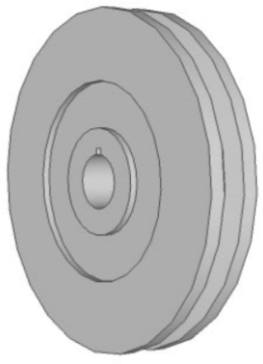
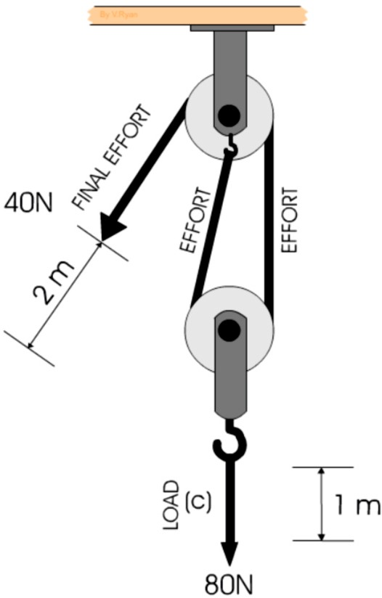
HELPFUL LINK http://www.technologystudent.com/gears1/pulley1.htm
4a. Why does a pulley wheel have a grooved edge?
1 mark
A GROOVED PULLEY WHEEL
WORLD ASSOCIATION OF TECHNOLOGY TEACHERS https://www.facebook.com/groups/254963448192823/
www.technologystudent.com © 2018
V.Ryan © 2018
HELPFUL LINK http://www.technologystudent.com/gears1/pulley9.htm
4b. A simple pulley system is seen opposite. Calculate the velocity ratio 2 marks
4c. What is the eﬃciency of the pulley system?
2 marks

Slide 10
HELPFUL LINK http://www.technologystudent.com/pdf14/ratios1.pdf Page 13
WORLD ASSOCIATION OF TECHNOLOGY TEACHERS https://www.facebook.com/groups/254963448192823/
www.technologystudent.com © 2018 V.Ryan © 2018
4d. The total amount of renewable energy produced in 2016 was 90 Terawatt hours (Twh).
The ratio of hydroelectricity compared to other renewable energy forms was 1:12.
What amount of energy was produced through hydroelectricity ? 3 marks
HYDROELECTRICITY : OTHER RENEWABLE FORMS
1 : 12
EXPLANATION:
4e. If total amount of renewable energy produced in 2016 was 100 Terawatt hours (Twh) AND the ratio of hydroelectricity compared to other renewable energy forms was 1:9.
What amount of energy was produced through hydroelectricity ? 3 marks
HYDROELECTRICITY : OTHER RENEWABLE FORMS
1 : 9
EXPLANATION:

Slide 11
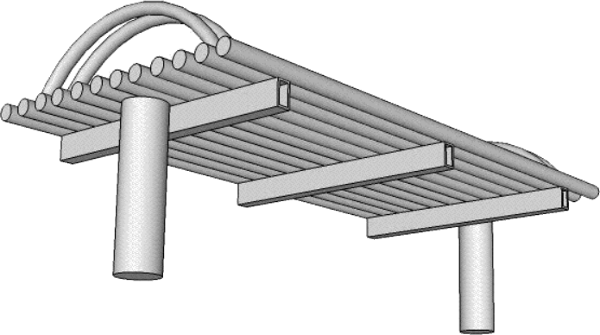
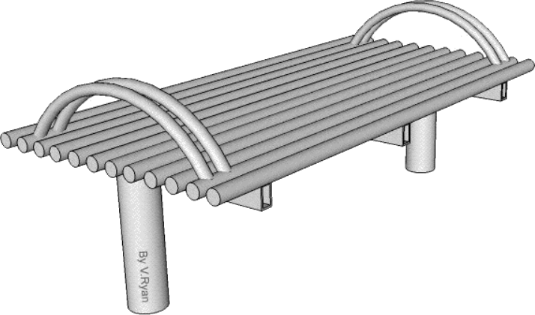

SECTION B – METALS
Answer ALL questions
WORLD ASSOCIATION OF TECHNOLOGY TEACHERS https://www.facebook.com/groups/254963448192823/
www.technologystudent.com © 2018
V.Ryan © 2018
HELPFUL LINK http://www.technologystudent.com/joints/steelbnch1.html
5. The Illustrations show a solution for a steel public bench.
STEEL TUBE
SOLID STEEL
900mm
450mm

Slide 12
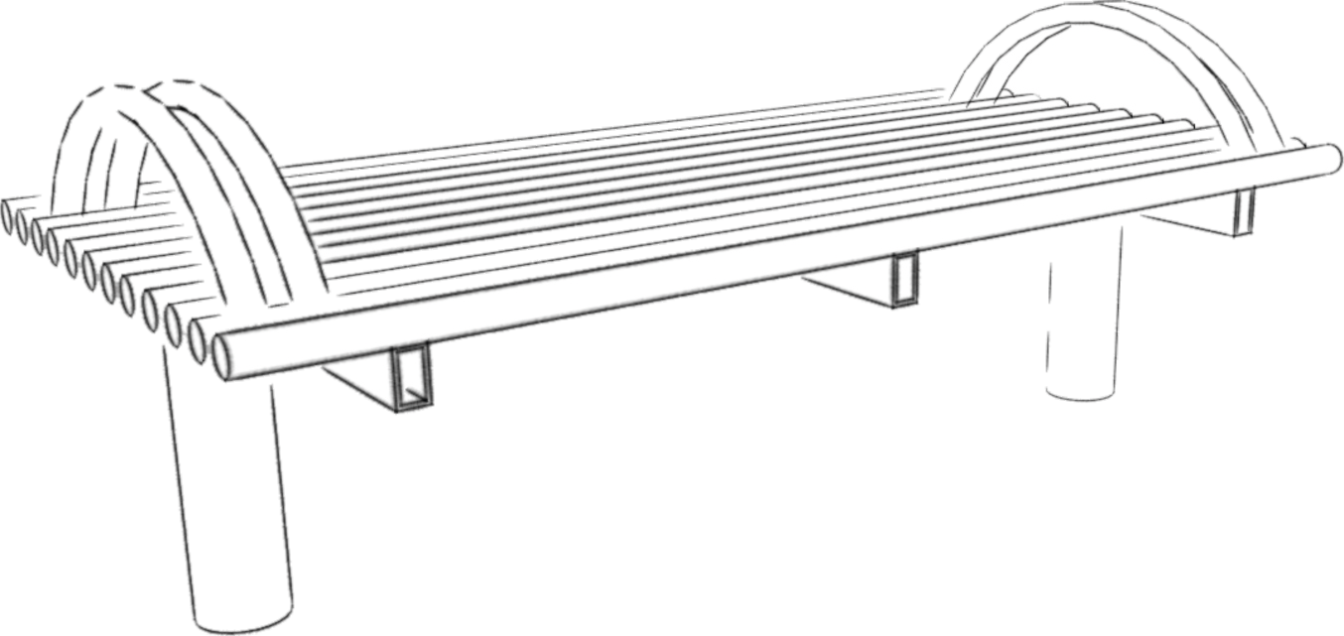
_{HELPFUL LINKS} http://www.technologystudent.com/joints/steelbnch1.html http://www.technologystudent.com/joints/steelbnch2.html
WORLD ASSOCIATION OF TECHNOLOGY TEACHERS https://www.facebook.com/groups/254963448192823/
www.technologystudent.com © 2018 V.Ryan © 2018
5a. The steel bench needs to be improved to include the following speciﬁcation points.
The steel bench must:
(I) Have a support for the user’s back.
(I) Be interlockable / stackable with other units of the same design.
(iii) The steel bench must weigh less, than suggested by the original design.
Use notes and/or sketches to show how the public seat could be modiﬁed to satisfy the addition speciﬁcation points, listed above.
Produce clear drawings / sketches, using the outline of the original design to show how the additional speciﬁcation points can be satisﬁed.
6 marks

Slide 13
_{HELPFUL LINKS} http://www.technologystudent.com/joints_ﬂsh/metal6.html http://www.technologystudent.com/joints_ﬂsh/revcard_metal5.html
5b. The steel bench must be available in a range of durable colours as shown below. This is achieved through a process called Powder Coating.
SAMPLE POWDER COATING COLOUR FINISHES
WORLD ASSOCIATION OF TECHNOLOGY TEACHERS https://www.facebook.com/groups/254963448192823/ www.technologystudent.com © 2018 V.Ryan © 2018
In the space below explain / describe the powder coating process. 4 marks

Slide 14
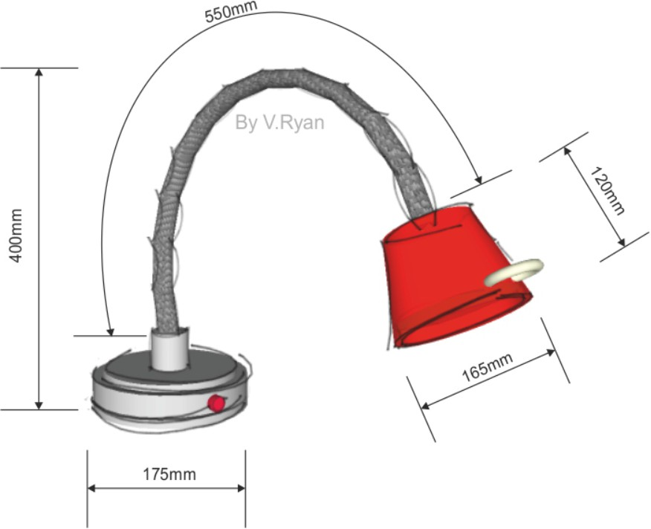
HELPFUL LINK http://www.technologystudent.com/joints/mater2.html
WORLD ASSOCIATION OF TECHNOLOGY TEACHERS https://www.facebook.com/groups/254963448192823/
www.technologystudent.com © 2018 V.Ryan © 2018
6a. Carefully study the adjustable ‘table top lamp’. The base is made from chromed, solid steel.
add th link pa
SOLID STEEL BASE
Write two reasons why chromed solid steel is suitable for the base of the lamp.
2 marks
(I)
(II)

Slide 15
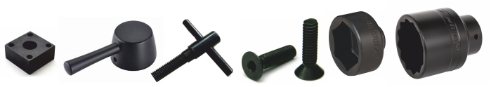
HELPFUL LINK http://www.technologystudent.com/joints_ﬂsh/metal10.html
WORLD ASSOCIATION OF TECHNOLOGY TEACHERS https://www.facebook.com/groups/254963448192823/
www.technologystudent.com © 2018 V.Ryan © 2018
6b. The steel components seen below have been ‘chemically blacked’ using a chemical blacking solution.
Use notes and/or sketches to explain/describe the process of chemical blacking.
Use clear sketches and notes in your answer.
4 marks

Slide 16
HELPFUL LINK http://www.technologystudent.com/joints_ﬂsh/metal3.html
WORLD ASSOCIATION OF TECHNOLOGY TEACHERS https://www.facebook.com/groups/254963448192823/ www.technologystudent.com © 2018 V.Ryan © 2018
6c. The components have been machined, prior to being chemically blacked. What is a machined ﬁnish?
2 marks

Slide 17
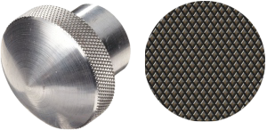
HELPFUL LINK http://www.technologystudent.com/joints_ﬂsh/metal3.html
6d. The component seen below has a knurled pattern ﬁnish. In the space below, explain the knurling process. Use both notes and sketches. 6 marks
WORLD ASSOCIATION OF TECHNOLOGY TEACHERS
https://www.facebook.com/groups/254963448192823/
www.technologystudent.com © 2018 V.Ryan © 2018

Slide 18
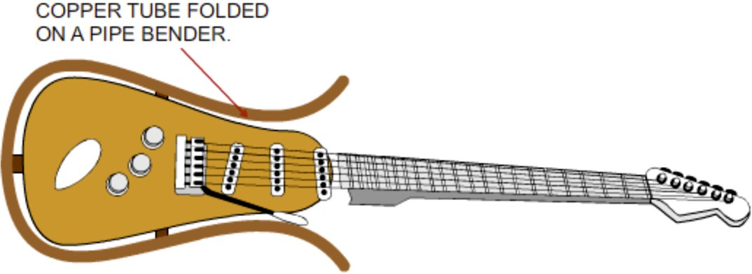
HELPFUL LINK http://www.technologystudent.com/equip_ﬂsh/pipe1.html
WORLD ASSOCIATION OF TECHNOLOGY TEACHERS https://www.facebook.com/groups/254963448192823/
www.technologystudent.com © 2018 V.Ryan © 2018
7. The electric guitar shown below, has a decorative copper tube, shaped to follow the contours of the guitar body. A pipe bender has been used to shape the copper tube.
7a. In the space below, draw a pipe bender and explain how it could be used to manufacture the shaped copper tube. 4 marks
7b. Name another piece of equipment that could be used to shape the copper tube.
1 mark

Slide 19
HELPFUL LINK http://www.technologystudent.com/pdf14/maths4.pdf Page 14
WORLD ASSOCIATION OF TECHNOLOGY TEACHERS https://www.facebook.com/groups/254963448192823/
INTERNAL
www.technologystudent.com © 2018 V.Ryan © 2018
DIA = 90mm
7c. A piece of steel tube can be seen opposite. The external and internal diameters can be read from the diagram.
What is the area of the surface at one end of the steel? 5 marks
FORMULA
AREA = πr ²
π (pi) = 3.14
EXTERNAL DIA = 120mm
Treat the surface at the end of the tube as two circles and ﬁnd the area of each one:
EXTERNAL DIAMETER INTERNAL DIAMETER
Then, subtract the area of the internal circle from the area of the external circle, to ﬁnd the total surface area of the tube.
The total surface area of one end of the tube is
WORLD ASSOCIATION OF TECHNOLOGY TEACHERS
https://www.facebook.com/groups/254963448192823/
www.technologystudent.com © 2017 V.Ryan © 2017

Slide 20
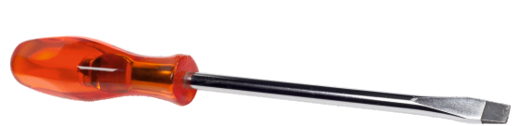
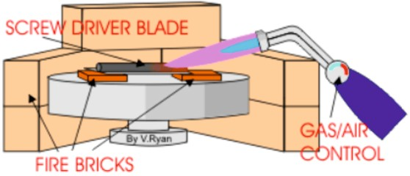
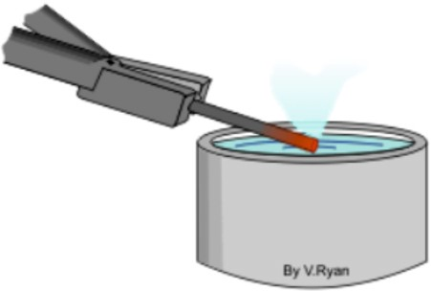
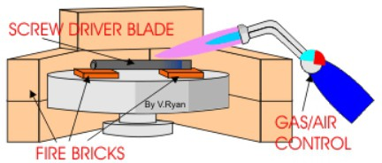
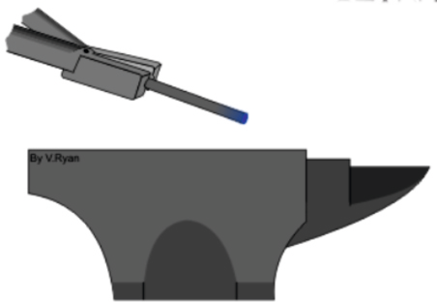
HELPFUL LINK http://www.technologystudent.com/equip1/heat1.htm
WORLD ASSOCIATION OF TECHNOLOGY TEACHERS https://www.facebook.com/groups/254963448192823/
www.technologystudent.com © 2018 V.Ryan © 2018
7. The screwdriver shown opposite has been manufactured in a school workshop. The steel blade has been through the heat treatment process called hardening and tempering.
7d. Complete the stages explaining the hardening and tempering process (below). The ﬁrst stage has been completed, as an example. 6 marks
STAGE ONE:
The screw driver blade is heated, slowly at ﬁrst, warming up the whole blade. Then the heat is concentrated on the area at the end of the blade. This gradually becomes ‘red’ hot.
STAGE TWO:
STAGE THREE:
STAGE FOUR:

Slide 21

HELPFUL LINK http://www.technologystudent.com/joints_ﬂsh/metal8.html
WORLD ASSOCIATION OF TECHNOLOGY TEACHERS https://www.facebook.com/groups/254963448192823/
www.technologystudent.com © 2018 V.Ryan © 2018
8. The products show below have been electroplated, to give them a ‘quality’ ﬁnish.
8a. Using notes and a sketch(s), describe the electroplating process, used on the products above.
9 marks (4 marks - notes and 5 marks - sketch(s))
NOTES:
SKETCH(S)

Slide 22
HELPFUL LINK http://www.technologystudent.com/joints/alloys1.html
WORLD ASSOCIATION OF TECHNOLOGY TEACHERS https://www.facebook.com/groups/254963448192823/
8b. What is an alloy? 3 marks
www.technologystudent.com © 2018 V.Ryan © 2018
8c. Alloying agents (such as chromium, vanadium and nickel) enhance the properties of the parent metal. Complete the table, by adding Properties and Uses, for each alloying agent. 6 marks
ALLOYING AGENT | PROPERTIES | USES
CHROMIUM
VANADIUM
NICKEL

Slide 23
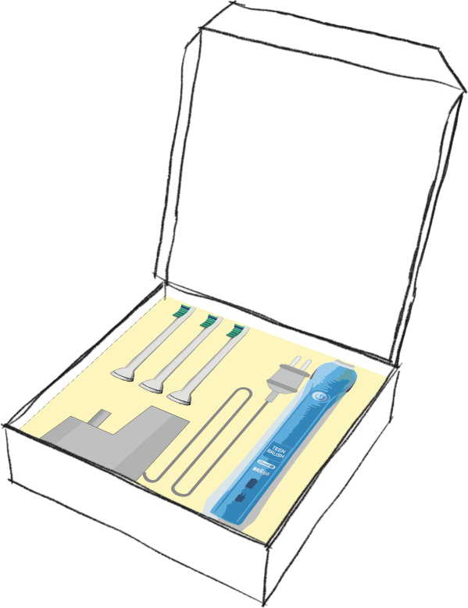
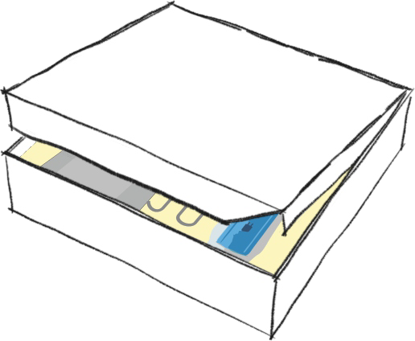
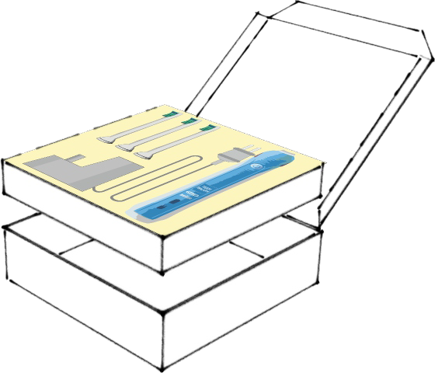
SECTION B – PAPER AND BOARDS
Answer ALL questions
WORLD ASSOCIATION OF TECHNOLOGY TEACHERS https://www.facebook.com/groups/254963448192823/
www.technologystudent.com © 2018 V.Ryan © 2018
5. A design solution for packaging of a toothbrush set, is shown below. The aim is to encourage younger people to clean their teeth thoroughly (improving oral hygiene and general health).
100 % recycleable Lightweight
Environmentally friendly material.
Materials supplied from a certiﬁed sustainable source.
Supplied in ﬂat sheet form and folded to form the 3D version.

Slide 24
HELPFUL LINK
http://www.technologystudent.com/prddes1/perfpk5.html
http://www.technologystudent.com/despro2/drink7.htm
WORLD ASSOCIATION OF TECHNOLOGY TEACHERS https://www.facebook.com/groups/254963448192823/
www.technologystudent.com © 2018 V.Ryan © 2018
5a. The packaging for a toothbrush set needs improving, so that it meets the additional speciﬁcation points:
The packaging must:
Have a clear ‘window’, allowing potential customers to view the products inside the packaging.
The packaging must have a folding handle, allowing the customer to carry the product to the checkout.
The packaging must be environmentally friendly, displaying recycling logos, a logo associated to the use of sustainable materials AND a logo that shows that the contents satisfy British and European Standards.
Use notes and/or sketches to show how the packaging could be modiﬁed to satisfy the addition speciﬁcation points, listed above
Produce clear drawings / sketches, using the outline of the original design, to show how the additional speciﬁcation points can be met.
6 marks

Slide 25


HELPFUL LINK http://www.technologystudent.com/despro_3/qcodes1.html
WORLD ASSOCIATION OF TECHNOLOGY TEACHERS https://www.facebook.com/groups/254963448192823/ www.technologystudent.com © 2018 V.Ryan © 2018
5b. Quick Response Codes are usually seen on packaging (see example below). What is a QR Code? 4 marks

Slide 26

HELPFUL LINK http://www.technologystudent.com/designpro/prtpro4.htm
6a. The image on the T Shirt seen opposite, has been ‘printed’ through a process called ‘screen printing’. This process is also often used on card / board products.
Explain the screen printing process. Include both notes and a sketch(s) in your answer 4 marks
SKETCH(S)
NOTES:

Slide 27

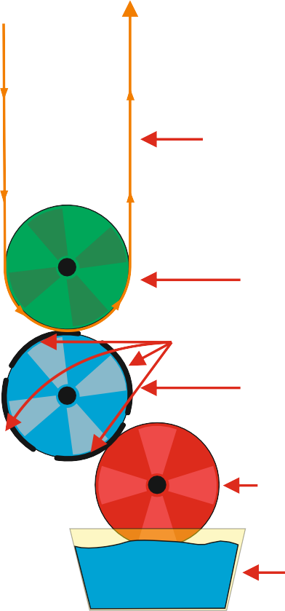
HELPFUL LINK http://www.technologystudent.com/despro_ﬂsh/ﬂexographic1.html
WORLD ASSOCIATION OF TECHNOLOGY TEACHERS https://www.facebook.com/groups/254963448192823/
www.technologystudent.com © 2018 V.Ryan © 2018
6b. These products have received their illustrations and decoration through ﬂexographic printing (also called ‘Flexo’).
Explain the ﬂexographic printing process shown opposite. 2 marks
WEB-FED PRINTED MATERIAL (SUBSTRATE)
E.G. PACKAGING
IMPRESSION ROLL
PRINT PLATES
PRINT CYLINDER
ANILOX ROLL
INK
6c. Explain two advantages of the ﬂexographic printing process. 2 marks

Slide 28
HELPFUL LINK http://www.technologystudent.com/rmprp07/glidr2.html
6d. When the packaging is manufactured, the various shapes are cut out, as a ﬂat net
/ development. How is this achieved? In the space below, name a suitable process, draw a labelled diagram to represent the process and add notes that explain the process. Total of 8 marks
PROCESS NAME:
(1 mark)
LABELLED DIAGRAM
WORLD ASSOCIATION OF TECHNOLOGY TEACHERS https://www.facebook.com/groups/254963448192823/
www.technologystudent.com © 2018 V.Ryan © 2018
(4 marks)
NOTES: (3 marks)

Slide 29
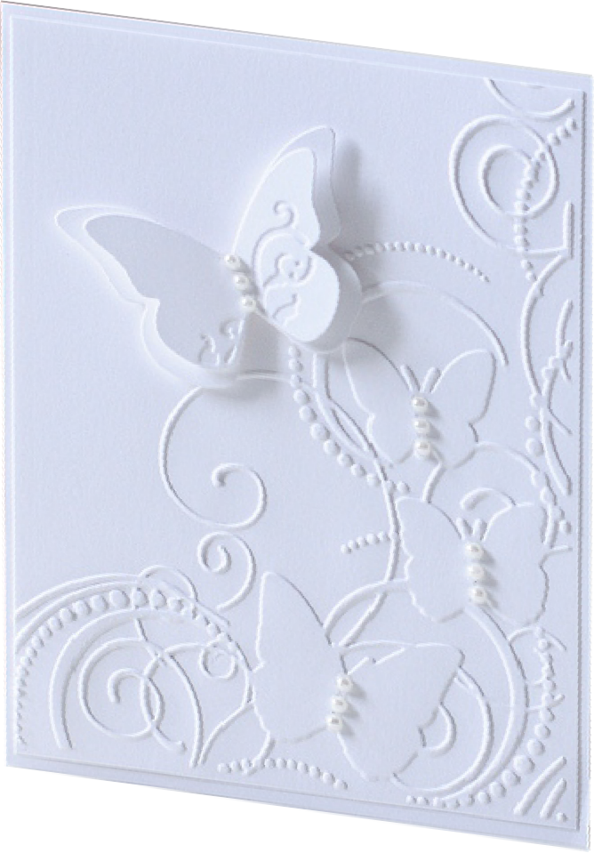
_{HELPFUL LINKS} http://www.technologystudent.com/despro2/prneﬀ4.htm http://www.technologystudent.com/despro2/stamp24.htm
6e. Greeting cards and quality writing paper, often have areas that have been embossed. This gives the card / paper a more luxurious feel, when it is handled. Embossing is also visually appealing (see the example).
In the space below, explain the embossing process. Use notes and sketches in your answer.
Total of 5 marks
WORLD ASSOCIATION OF TECHNOLOGY TEACHERS
https://www.facebook.com/groups/254963448192823/ www.technologystudent.com © 2018 V.Ryan © 2018
EMBOSSED AREA
LABELLED SKETCH ( 3 marks)
NOTES (2 marks):

Slide 30


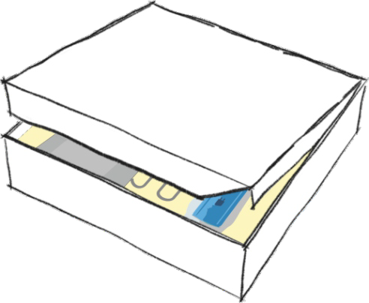
HELPFUL LINK http://www.technologystudent.com/pdf14/maths3.pdf Page 8
WORLD ASSOCIATION OF TECHNOLOGY TEACHERS https://www.facebook.com/groups/254963448192823/
www.technologystudent.com © 2018 V.Ryan © 2018
7. A rectangular transparent window is to be added to the lid of the packaging seen in question 5.
The window allows the customer to view some of the products inside the package.
7a. Calculate the area of piece A (the entire lid) 2 marks
7b. Calculate the area of piece. B (the window only) 3 marks
200mm
A
B
150mm
300mm
400mm
WORLD ASSOCIATION OF TECHNOLOGY TEACHERS
https://www.facebook.com/groups/254963448192823/
www.technologystudent.com © 2017
V.Ryan © 2017

Slide 31



HELPFUL LINK http://www.technologystudent.com/despro2/drink14.htm
WORLD ASSOCIATION OF TECHNOLOGY TEACHERS https://www.facebook.com/groups/254963448192823/
www.technologystudent.com © 2018 V.Ryan © 2018
8a. Two symbols, often seen on card packaging are seen below. What do they represent?
2 marks ( 1 mark per answer)
(I)
(II)
HELPFUL LINK http://www.technologystudent.com/despro2/drink14.htm
8b. The logo shown opposite is sometimes printed on packaging.
Explain the meaning of this logo. 4 marks

Slide 32
HELPFUL LINK http://www.technologystudent.com/designpro/model1.htm
WORLD ASSOCIATION OF TECHNOLOGY TEACHERS
https://www.facebook.com/groups/254963448192823/
www.technologystudent.com © 2018 V.Ryan © 2018
9a. Designers make models throughout the design and development of a product? Why is model making important? 2 marks
HELPFUL LINKS
http://www.technologystudent.com/prddes1/modmat1.html http://www.technologystudent.com/prddes1/modemat2.html
9b. Name two model making materials used by designers and describe the characteristics that make them suitable for model making. 3 marks
Modelling Material:
Characteristics:
WORLD ASSOCIATION OF TECHNOLOGY TEACHERS
https://www.facebook.com/groups/254963448192823/
www.technologystudent.com © 2018 V.Ryan © 2018

Slide 33
HELPFUL LINKS
http://www.technologystudent.com/prddes1/biopola.html http://www.technologystudent.com/prddes1/biopol3.html
WORLD ASSOCIATION OF TECHNOLOGY TEACHERS https://www.facebook.com/groups/254963448192823/
www.technologystudent.com © 2018 V.Ryan © 2018
9c. Biodegradable inks are slowly increasing in popularity, for the printing of text and illustrations on packaging.
(I) What are biodegradable inks? 1 mark
(II) What are the advantages of biodegradable inks?
3 marks

Slide 34
HELPFUL LINK http://www.technologystudent.com/despro2/crdpap2.htm
WORLD ASSOCIATION OF TECHNOLOGY TEACHERS https://www.facebook.com/groups/254963448192823/
www.technologystudent.com © 2018 V.Ryan © 2018
10a. A range of paper and boards exist. Complete the table below by describing each material and giving a practical application. The ﬁrst row has been completed for you.
Total of 9 marks
MATERIAL | DESCRIPTION
CORRUGATED BOARD | This type of board is often used for packaging large electrical items. These large boxes (often brown in colour) protect the contents from damage. Corrugated board is strong because it is composed of a top and bottom layer and in between there is a triangulated section. A triangular section is very strong compared to its weight.
DUPLEX BOARD 3 marks
TRACING PAPER 3 marks
FOIL LINED BOARD 3 marks

Slide 35
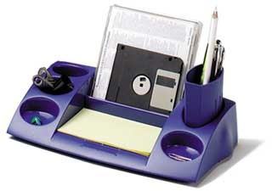

SECTION B – POLYMERS
Answer ALL questions
WORLD ASSOCIATION OF TECHNOLOGY TEACHERS https://www.facebook.com/groups/254963448192823/
www.technologystudent.com © 2018
V.Ryan © 2018
OFFICE DESKTOP ORGANISER
THIRD ANGLE PROJECTION
200mm
300mm
200mm
The desktop organiser is manufactured from a suitable polymer
It is drop resistant, relatively unbreakable.
The organiser will help the client complete tasks such as writing, drawing and general office work.
Manufactured from recycled material.
Lightweight but very strong.
Manufactured in a range of colours. The cost to the customer is £7.50.

Slide 36
HELPFUL LINK http://www.technologystudent.com/despro_ﬂsh/mats_proj8.html
WORLD ASSOCIATION OF TECHNOLOGY TEACHERS https://www.facebook.com/groups/254963448192823/
www.technologystudent.com © 2018 V.Ryan © 2018
5a. The oﬃce desktop organiser, needs to be improved to include the following speciﬁcation points.
The desktop organiser must:
Have an ergonomically designed handle, so that it can be transported from table to table, with ease.
The desktop organiser must store an increased range of stationary equipment;
Pens, pencils, ruler, scissors, glue, paper clips, compass, protractor, calculator, stapler, mobile phone etc....
The organiser must have an area that is a safe resting place for a hot drink.
Use notes and/or sketches to show how the Desktop Organiser could be modiﬁed to satisfy the addition speciﬁcation points, listed above
Produce clear drawings / sketches, using the outline of the original design to show how the additional speciﬁcation points can be met.
6 marks

Slide 37
HELPFUL LINK http://www.technologystudent.com/joints/petevac4.html
WORLD ASSOCIATION OF TECHNOLOGY TEACHERS https://www.facebook.com/groups/254963448192823/
www.technologystudent.com © 2018 V.Ryan © 2018
5b. Name a suitable material for the manufacture of the desktop organiser.
1 mark
HELPFUL LINK http://www.technologystudent.com/joints/petevac4.html
5c. The desktop organiser is manufactured through a process called injection Moulding. Describe injection moulding. 3 marks
HELPFUL LINK http://www.technologystudent.com/joints/petevac4.html
5d. In the space below, draw a labelled diagram that represents the injection Moulding process. 4 marks

Slide 38
HELPFUL LINK http://www.technologystudent.com/joints/petevac4.html
WORLD ASSOCIATION OF TECHNOLOGY TEACHERS https://www.facebook.com/groups/254963448192823/
www.technologystudent.com © 2018 V.Ryan © 2018
5e. Why is the material you named in question 5b, suitable for the manufacture of this desktop organiser. 2 marks
HELPFUL LINK http://www.technologystudent.com/joints/ldpe1.html
5f. Name another material that would be suitable for the desktop organiser and explain why it is suitable. 2 marks
NAME:
WHY SUITABLE:
5g. in the space opposite, sketch the recycling symbol for material you named in question 5b. 2 marks

Slide 39
HELPFUL LINK http://www.technologystudent.com/despro_ﬂsh/tpe1.html
WORLD ASSOCIATION OF TECHNOLOGY TEACHERS https://www.facebook.com/groups/254963448192823/
www.technologystudent.com © 2018 V.Ryan © 2018
6a. The desktop organiser manufacturer is considering using TPEs. What are Thermoplastic Elastomers (TPEs)? 2 marks
6b. What are the general properties of TPEs?
2 marks
6c. Describe some uses of TPEs.
2 marks

Slide 40

HELPFUL LINK http://www.technologystudent.com/despro_ﬂsh/tpe3.html
WORLD ASSOCIATION OF TECHNOLOGY TEACHERS https://www.facebook.com/groups/254963448192823/
www.technologystudent.com © 2018 V.Ryan © 2018
6d. Why is a thermoplastic Elastomer (TPE) suitable for the manufacture of the TV remote control seen opposite?
Make reference to General Properties, Product function, aesthetics, and product manufacture in your written answer.
5 marks

Slide 41


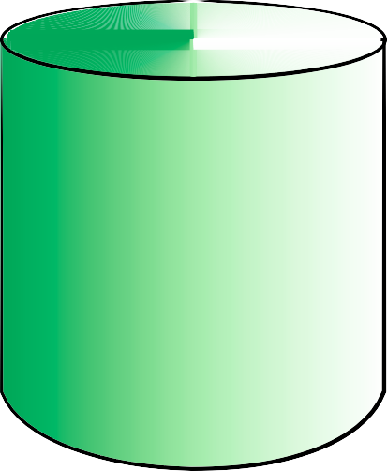
HELPFUL LINK http://www.technologystudent.com/pdf14/maths_cylinder1.pdf Page 6
WORLD ASSOCIATION OF TECHNOLOGY TEACHERS https://www.facebook.com/groups/254963448192823/
www.technologystudent.com © 2018 V.Ryan © 2018
7a. The solid polymer object seen below, has been manufactured on an engineering centre lathe. It is one solid piece. Calculate the total volume. 5 marks
HEIGHT= 30mm
RADIUS= 20mm
A
FORMULA
v = πr ²h
volume = pi x radius² x height
π (pi) = 3.14
HEIGHT= 90mm
RADIUS= 40mm
B
In order to calculate the entire volume of the engineered solid, it is treated as two separate parts. Part A is the smaller cylinder and part B is the larger cylinder.

Slide 42

HELPFUL LINK http://www.technologystudent.com/joints/poly3.html
WORLD ASSOCIATION OF TECHNOLOGY TEACHERS https://www.facebook.com/groups/254963448192823/
8a. The carrier bag seen opposite is manufactured from polylactide (PLA), an environmentally friendly polymer.
www.technologystudent.com © 2018
V.Ryan © 2018
Write four reasons why this material is suitable for the carrier bag. Justify each ‘reason’.
Total of 8 marks ( 1 mark per reason, 1 mark per justiﬁcation)
(i)
(ii)
(iii)
(iv)

Slide 43
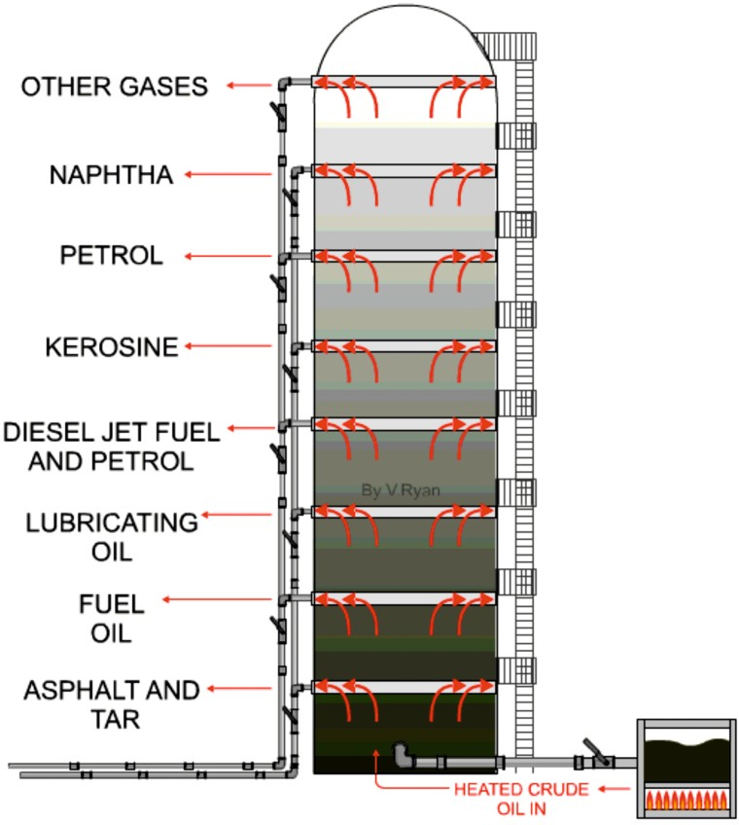
HELPFUL LINK http://www.technologystudent.com/joints/plastic3.html
WORLD ASSOCIATION OF TECHNOLOGY TEACHERS https://www.facebook.com/groups/254963448192823/
www.technologystudent.com © 2018 V.Ryan © 2018
9a. Most polymers are manufactured from reﬁned crude oil, using a process called
distillation. Brieﬂy describe this process. 4 marks
HELPFUL LINK http://www.technologystudent.com/designpro/plastic1.htm
9b. What are thermosetting plastics? 3 marks

Slide 44
HELPFUL LINK http://www.technologystudent.com/prddes1/enviro3.html
WORLD ASSOCIATION OF TECHNOLOGY TEACHERS https://www.facebook.com/groups/254963448192823/
www.technologystudent.com © 2018 V.Ryan © 2018
10a. Large supermarkets are aware of the damage plastics cause to the environment. How are supermarkets changing the way they use plastics, so that they are viewed by the customer, as being environmentally friendly? 9 marks

Slide 45
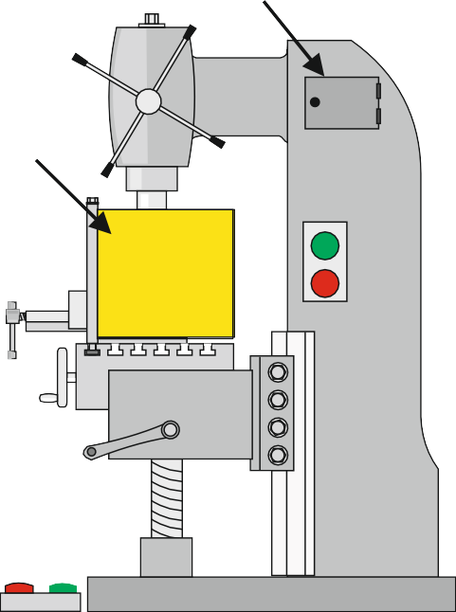
SECTION B – SYSTEMS
Answer ALL questions
WORLD ASSOCIATION OF TECHNOLOGY TEACHERS https://www.facebook.com/groups/254963448192823/
www.technologystudent.com © 2018 V.Ryan © 2018
5. A metal cutting milling machine has two ON/OFF switches, either will allow the cutter to run. The first switch is on the side of the machine (B) and the second is a foot operated switch (A).
The machine has two micro-switches (one on the ‘door and one on the guard) if any of these are released the cutter will stop. The first micro-switch is on a guard, if this is opened the machine will stop. The second micro-switch is on a door which allows access to the moving mechanism of the milling machine. If this is opened the machine will stop.
MICRO-SWITCH TWO
MICRO-SWITCH ONE
DOOR
GUARD
ON OFF
SWITCH B
OFF ON SWITCH A
LOGIC CIRCUIT
ON / OFF SWITCES
_{A} 1
1
B
OR
0
1
AND
1
1 ₀
AND
MICRO-SWITCHES
A B
MACHINE OFF
1 ₁
AND
1
EMERGENCY STOPS
_{A} 1
1
B
OR
NOT
0

Slide 46
HELPFUL LINKS http://www.technologystudent.com/elec1/digq2.htm
WORLD ASSOCIATION OF TECHNOLOGY TEACHERS https://www.facebook.com/groups/254963448192823/
www.technologystudent.com © 2018 V.Ryan © 2018
5a. The logic circuit needs to include the following speciﬁcation points.
The circuit must:
(I) Include two emergency stop switches, found on the walls of the workshop, either capable of stopping all machines in the workshop.
(I) The machine must stop if a guard or machine door is opened.
(iii) Either of the ON / OFF switches must activate / deactivate the machine.
Use notes and/or sketches to show how the circuit could be modiﬁed to satisfy the speciﬁcation points, listed above
Complete the logic circuit/diagram (adding suitable gates and their logic outputs), using the circuit diagram below, showing how the speciﬁcation points can be met. 6 marks
The micro-switches are normally logic ‘1’ (true, high, on) when pressed. Draw the logic diagram for this machine.
ON / OFF SWITCES
_{A} 1 B₀
1
OR
1
1 ₀
AND
MICRO-SWITCHES
AND
MACHINE OFF
1 ₁
AND
1
1
A B
EMERGENCY STOPS
_{A} 1 B₀
1
OR
NOT

Slide 47
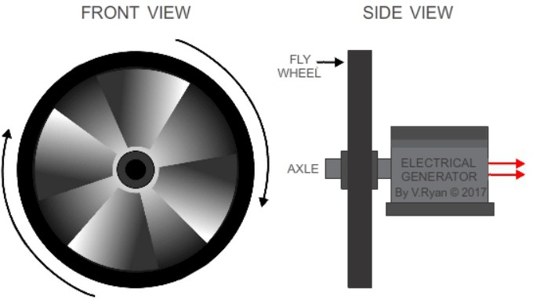
HELPFUL LINK http://www.technologystudent.com/energy1/ﬂywheel1.html
WORLD ASSOCIATION OF TECHNOLOGY TEACHERS https://www.facebook.com/groups/254963448192823/
www.technologystudent.com © 2018 V.Ryan © 2018
5b. Flywheels are one eﬃcient way of storing energy. In simple terms, explain how a ﬂywheel works. 2 marks
5c. Describe one modern practical application of a ﬂywheel system.
2 marks

Slide 48
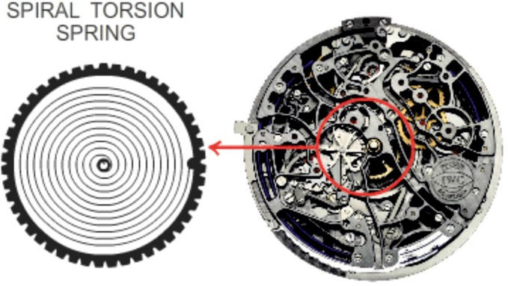
HELPFUL LINK http://www.technologystudent.com/energy1/storage1.html
WORLD ASSOCIATION OF TECHNOLOGY TEACHERS https://www.facebook.com/groups/254963448192823/
www.technologystudent.com © 2018
V.Ryan © 2018
6a. Springs have a variety of uses. They are often seen in expensive ‘mechanical’ / wind-up (analog) watches, such as seen opposite. How does the spiral torsion spring contribute to the movement of the hands?
1 mark
HELPFUL LINK http://www.technologystudent.com/energy1/storage1.html
6b. Describe one way in which springs have been applied to a system, that can store excess electrical energy and release it when required. Include notes and a simple diagram. 3 marks

Slide 49
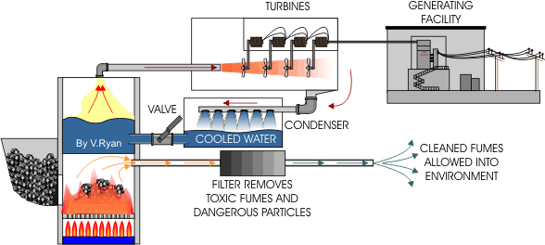
_{HELPFUL LINK} http://www.technologystudent.com/enerﬂsh/COAL2.html http://www.technologystudent.com/pdf14/POSTER_elec1.pdf
7a. The diagram below outlines the production of electricity and its distribution. Explain each of the three aspects of the overall process. 4 marks
FUEL AND FURNACE
TURBINES AND GENERATING FACILITY
DISTRIBUTION TO NATIONAL GRID

Slide 50

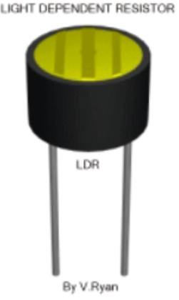
HELPFUL LINK http://www.technologystudent.com/pics/picgen1.html
WORLD ASSOCIATION OF TECHNOLOGY TEACHERS https://www.facebook.com/groups/254963448192823/
www.technologystudent.com © 2018 V.Ryan © 2018
8a. A typical PIC microcontoller, connected to a computer, is shown below. What is the full terminology for PIC ? 1 mark
PIC=
8b. PIC microcontrollers are programmed via computer software. Other than programming, how is the software used? 4 marks
HELPFUL LINK http://www.technologystudent.com/elec1/ldr1.htm
8c. LDRs are often used as inputs to PIC microcontrollers. How does the resistance of an LDR change, depending on the light level? 3 marks

Slide 51
HELPFUL LINK http://www.technologystudent.com/sysprp7/sysq7.html
WORLD ASSOCIATION OF TECHNOLOGY TEACHERS https://www.facebook.com/groups/254963448192823/
www.technologystudent.com © 2018 V.Ryan © 2018
9. Trains are often controlled by traffic lights. These tell the train driver when to stop and when it is safe to move the train forwards. The lights are controlled by the outputs of a microcontroller circuit (seen below). The table shows the operating cycle.
LIGHT A | LIGHT B
GREEN | RED
AMBER | RED + AMBER
RED | GREEN
AMBER + RED | AMBER
18 17 16 15 14 13 12 11 10
1 2 3 4 5 6 7 8 9
PICAXE 18
OUTPUTS
7 6 5 4 3 2 1 0
RED
RED
AMBER
AMBER
GREEN
GREEN
A
B
Outputs 0 to 5 are used to control the sequence of lights
9a. Complete the table below to show the output bit pattern required to run the traffic lights for one cycle. Begin with light A on GREEN and light B on RED. 5 marks
OUTPUT BIT
7 | 6 | 5 | 4 | 3 | 2 | 1 | 0

Slide 52
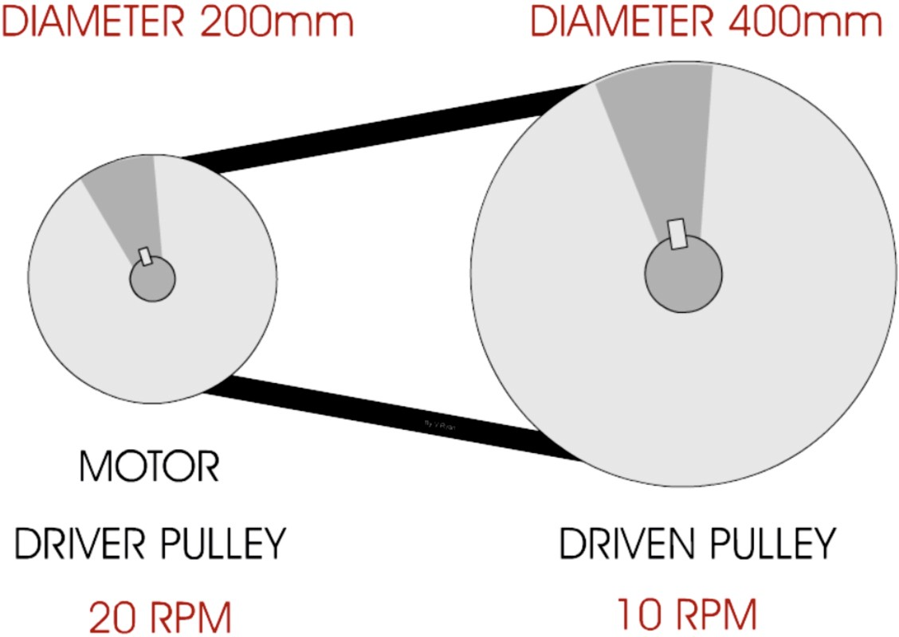
HELPFUL LINK http://www.technologystudent.com/gears1/pulley2.htm
WORLD ASSOCIATION OF TECHNOLOGY TEACHERS https://www.facebook.com/groups/254963448192823/
www.technologystudent.com © 2018 V.Ryan © 2018
10a. Pulleys, such as the combination shown below, are regularly used in machines and mechanical devices.
A
B
(I) Calculate the Velocity Ratio of the pulley system. Include all your working out
2 marks
(ii). Calculate the RPM of pulley ‘B’. Include all your working out.
3 marks

Slide 53
HELPFUL LINK http://www.technologystudent.com/pcb/solder1.htm
WORLD ASSOCIATION OF TECHNOLOGY TEACHERS https://www.facebook.com/groups/254963448192823/
www.technologystudent.com © 2018 V.Ryan © 2018
11a. The process of soldering circuits in a school workshop, involves using a soldering iron. Explain each stage of the soldering process, adding notes and sketches (sketches - only if required). The ﬁrst stage has been completed for you. 6 marks
NOTES SKETCHES
1. Inspect the tip to make sure that it is not past good operation. If it looks in bad condition it will not help you solder a good joint.

Slide 54
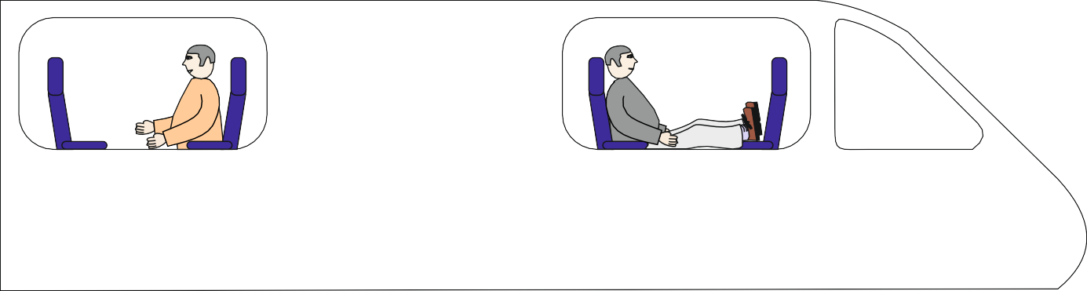
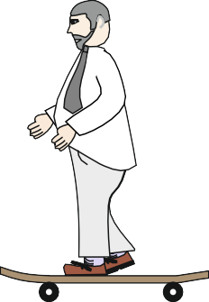
HELPFUL LINK http://www.technologystudent.com/sysprp7/sysq15.html
WORLD ASSOCIATION OF TECHNOLOGY TEACHERS https://www.facebook.com/groups/254963448192823/
www.technologystudent.com © 2018 V.Ryan © 2018
WORLD ASSOCIATION OF TECHNOLOGY TEACHERS https://www.facebook.com/groups/254963448192823/
www.technologystudent.com © 2017 V.Ryan © 2017
The drawing shows one of the passenger doors to a train. The passenger doors will only open when the train is stationary at the platform. A sensor circuit controls the opening and closing of doors which open automatically when a passenger approaches.
12a. Name a suitable sensor for this procedure. 1 mark
12b. The incomplete circuit for the operation of the doors is seen below. Complete the circuit by adding the components required to represent your sensor. 3 marks
+ 9v
POWER SWITCH CLOSED
FIXED
RESISTOR
A
RL
M
1K
V
0v
12c. Describe one safety feature the door control system should have. 1 mark

Slide 55
HELPFUL LINK http://www.technologystudent.com/sysprp7/sysq16.html
WORLD ASSOCIATION OF TECHNOLOGY TEACHERS https://www.facebook.com/groups/254963448192823/
www.technologystudent.com © 2017 V.Ryan © 2017
12d. The sensor circuit has been replaced with a programmable microcontroller circuit. In the space below, complete the flow chart that represents the programming for the opening and closing of the doors.
Alongside the flow chart, explain each stage.
4 marks
START
TRAIN STOPS AT
PLATFORM
TRAIN STOPPED ? ^{NO}
YES

Slide 56
HELPFUL LINK http://www.technologystudent.com/prddes_2/global1.html
WORLD ASSOCIATION OF TECHNOLOGY TEACHERS https://www.facebook.com/groups/254963448192823/
www.technologystudent.com © 2018 V.Ryan © 2018
13. Most electronic products are ﬁnanced, manufactured and distributed through a system called Globalisation.
13a. In general terms, what is globalisation? 4 marks
13b. Describe / explain some of the disadvantages of globalisation.
5 marks

Slide 57
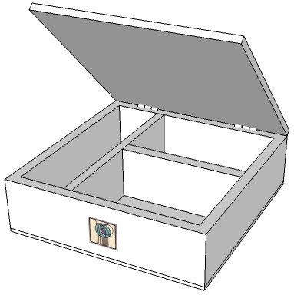
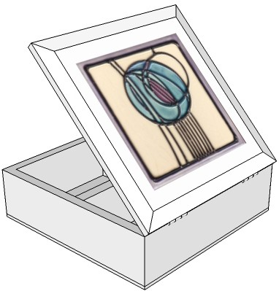
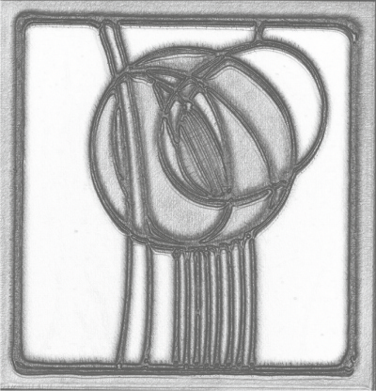
SECTION B – TIMBERS
Answer ALL questions
WORLD ASSOCIATION OF TECHNOLOGY TEACHERS https://www.facebook.com/groups/254963448192823/
www.technologystudent.com © 2018
V.Ryan © 2018
Bits and Bobs Storage (timbers)
SIMPLE BUTT JOINTS
240mm
150mm
300mm
300mm
This storage box is available in a variety of natural woods. Traditional jointing methods have be used during its manufacture. It has a quality ﬁnish and can be locked for security.

Slide 58
_{HELPFUL LINKS} http://www.technologystudent.com/despro_ﬂsh/handle1.html http://www.technologystudent.com/joints/charles18.html http://www.technologystudent.com/joints/charles20.html
WORLD ASSOCIATION OF TECHNOLOGY TEACHERS https://www.facebook.com/groups/254963448192823/
www.technologystudent.com © 2018 V.Ryan © 2018
5a. The storage box, needs to be improved to include the following speciﬁcation points.
The storage box must:
(I) Have an ergonomically designed handle, to enable easy transport.
(I) Their must be divides within the storage unit, to store diﬀerent types of ‘small’ items.
(iii) The corner joints of the storage unit, need to be upgraded so that they are strong and can withstand ‘knocks’.
Use notes and/or sketches to show how the storage box could be modiﬁed to satisfy the addition speciﬁcation points, listed above
Produce clear drawings / sketches, using the outline of the original design and the space alongside, to show how the additional speciﬁcation points can be met.
6 marks
ORIGINAL DESIGN SKETCHING AREA

Slide 59
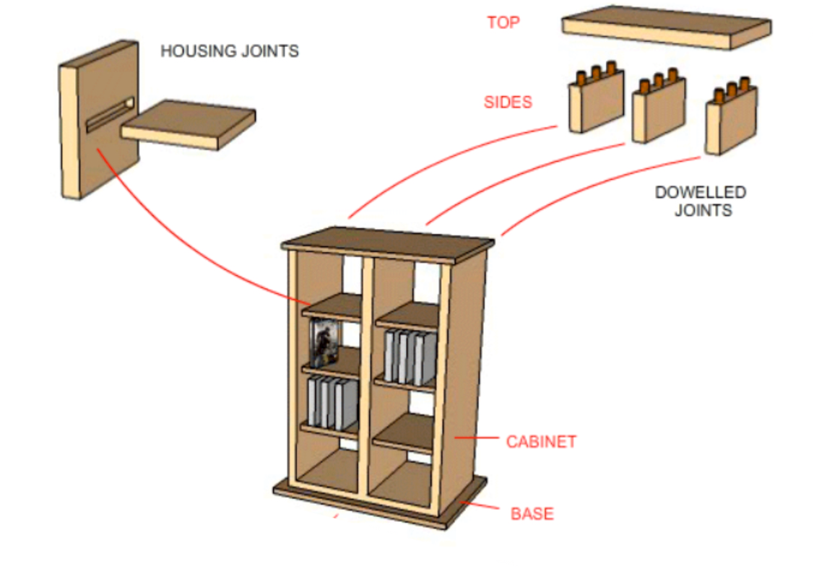
HELPFUL LINK http://www.technologystudent.com/rmprp07/stor1.html
WORLD ASSOCIATION OF TECHNOLOGY TEACHERS https://www.facebook.com/groups/254963448192823/
www.technologystudent.com © 2018 V.Ryan © 2018
5b. The DVD storage unit is manufactured from Pine or any other suitable natural wood, as requested by the customer.
(I) Explain why a plain housing joint is suitable for the DVD storage unit.
2 marks
(II) Explain why dowelled joints are suitable for the top and sides.
2 marks

Slide 60
HELPFUL LINK http://www.technologystudent.com/despro_ﬂsh/ﬁnish2.html
WORLD ASSOCIATION OF TECHNOLOGY TEACHERS https://www.facebook.com/groups/254963448192823/
www.technologystudent.com © 2018 V.Ryan © 2018
5c. The panels / sides of the DVD storage unit are to be varnished, producing a high quality ﬁnish.
(I) Using notes and sketches, describe the stages involved in ‘sanding’ / ‘glass papering’, the surface of the ‘wood’ panels / sides, in preparation for varnish. 4 marks
HELPFUL LINK http://www.technologystudent.com/despro_ﬂsh/ﬁnish3.html
(II) How can varnish be applied to natural wood, ensuring a good ﬁnish? 2 marks

Slide 61
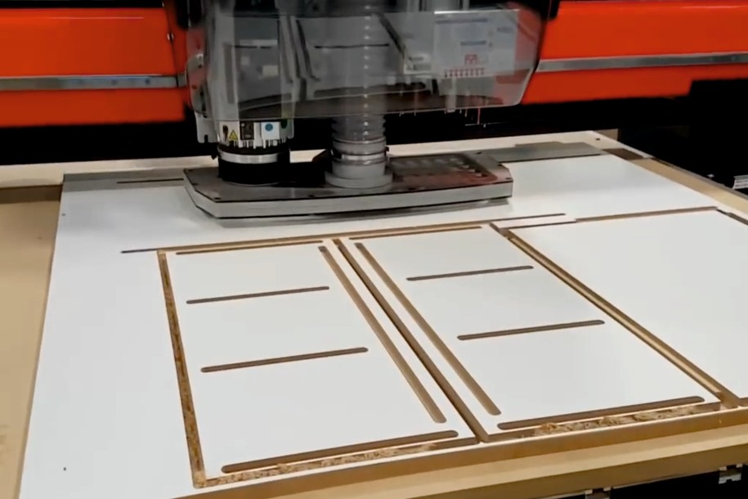
_{HELPFUL LINKS} http://www.technologystudent.com/cam/cnccut1.html http://www.technologystudent.com/cam/cncman4.htm
WORLD ASSOCIATION OF TECHNOLOGY TEACHERS https://www.facebook.com/groups/254963448192823/
www.technologystudent.com © 2018 V.Ryan © 2018
6a. A retailer has ordered a large number of natural wood DVD storage units, manufactured by a CNC Router, as seen below.
(I) What is the meaning of CNC.
1 mark
(II) Describe 2 advantages of using CAM in the manufacture of large numbers of this product. 2 marks
(III) Describe 3 disadvantages of using CAM in the manufacture of large numbers of this product. 3 marks

Slide 62
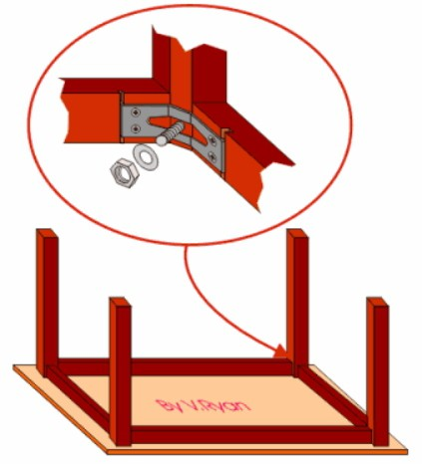
HELPFUL LINKS http://www.technologystudent.com/joints/tableft1.htm
WORLD ASSOCIATION OF TECHNOLOGY TEACHERS https://www.facebook.com/groups/254963448192823/
7. The table seen opposite is a piece of ‘knock-down’ furniture, held together by a common ‘knock-down’ joint.
www.technologystudent.com © 2018
V.Ryan © 2018
7a. What is the name of the knock- down joint? 1 mark
HELPFUL LINKS http://www.technologystudent.com/despro_ﬂsh/mats_join1.html
7b. The table is to be updated, with the joints being permanently glued together. In the space below, name and sketch a suitable joint that can replace the knock-down joint. 4 marks

Slide 63

HELPFUL LINK http://www.technologystudent.com/pdf14/maths_cones1.pdf Page 3
WORLD ASSOCIATION OF TECHNOLOGY TEACHERS
https://www.facebook.com/groups/254963448192823/
www.technologystudent.com © 2018 V.Ryan © 2018
8a. The cone seen below has been turned on a woodworking lathe. Calculate the volume of the cone. 5 marks
If the height (h) is 70mm and the radius is 50mm
FORMULA
v=1/3 πr²h
h (HEIGHT) 70mm
_{v=} πr²h
the same as
3
r=50mm
pi (π) is 3.14

Slide 64
HELPFUL LINK http://www.technologystudent.com/joints/plywood1.html
WORLD ASSOCIATION OF TECHNOLOGY TEACHERS https://www.facebook.com/groups/254963448192823/
www.technologystudent.com © 2018 V.Ryan © 2018
9a. Explain why plywood can be described as a composite material. Include both notes and a sketch(s) in your answer 4 marks
9b. What are the advantages of using plywood over other natural woods? 2 marks

Slide 65
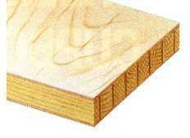
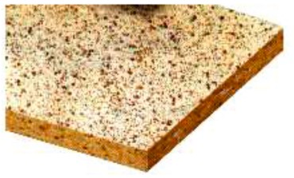
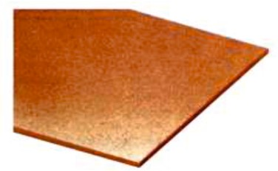
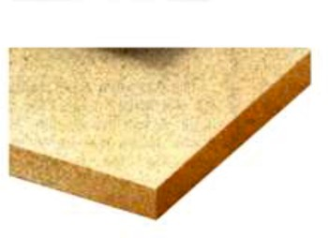
HELPFUL LINK http://www.technologystudent.com/designpro/mboard1.htm
10a. List one standard size of a wood based composite board: 1 mark
10b. A number of wood based boards are listed below. Write a description of each board, alongside its name / picture. 8 marks in total
BOARD | DESCRIPTION
BLOCKBOARD 2 marks
CHIPBOARD 2 marks
HARDBOARD 2 marks
MEDIUM DENSITY FIBREBOARD (MDF) 2 marks

Slide 66


HELPFUL LINKS http://www.technologystudent.com/joints/sustain1.html
11a. What is a sustainable forest and why are sustainable forests important?
3 marks
11b. The logo shown opposite is sometimes printed on timber and packaging.
Explain the meaning of this logo. 3 marks
11c. The logo shown opposite is sometimes printed on timber and packaging.
Explain the meaning of this logo. 3 marks

Slide 67
ADD YOUR OWN TEXTILES SPECIFIC EXAMINATION QUESTIONS

