Slide 1
DESIGN AND TECHNOLOGY - GCSE SAMPLE PAPER 1
COMPONENT 1
Candidate Name | Centre Number |  |  |  |  | Candidate Number
TIME ALLOWED - 2 HOURS
For examiner's use only
Section A | 1 |  | 10
 | 2 |  | 10
 | 3 |  | 15
 | 4 |  | 20
 | 5 |  | 20
Section B | 6 - 10 |  | 25
Total |  |  | 100
EQUIPMENT REQUIRED
Drawing and writing equipment, coloured pencils and a calculator
INSTRUCTIONS
You are to answer all questions 1 to 5. Select ONE question from Section B
This example examination paper can be duplicated and printed out if required but not edited in any way.
The links to www.technologystudent.com cannot be removed.
The PDF ﬁle can be stored on school / college systems and distributed electronically (NO EDITING ALLOWED)
PLEASE RESPECT THE COPYRIGHT - report infringers to techteacher@technologystudent.com Not be distributed at courses or by course instructors / consultants
WORLD ASSOCIATION OF TECHNOLOGY TEACHERS https://www.facebook.com/groups/254963448192823/
www.technologystudent.com © 2018 V.Ryan © 2018

Slide 2
Section A
Answer all the questions in this section
HELPFUL LINK http://www.technologystudent.com/pdf14/ratios1.pdf Page 12
1. The question is about alternative energy.
1a. A local wind farm produces 4 terawatt hours of electricity over a year. At the same time, a solar farm produced 0.5 terawatt hours of electrical power. What is the ratio Wind farm : Solar Power ? 4 marks
WIND FARM
4
: SOLAR POWER
: 0.5
EXPLANATION:
HELPFUL LINK http://www.technologystudent.com/energy1/wind8.htm
1b. Write two advantages of using wind power to produce electricity. 2 marks
1c. Write two disadvantages of using wind power to produce electricity.
2 marks

Slide 3
HELPFUL LINK http://www.technologystudent.com/prddes1/carenviron5.html
1d. Some car manufacturers regard the use of carbon neutral energy sources (alternative energy) as being important. Describe an example of this approach. 2 marks

Slide 4
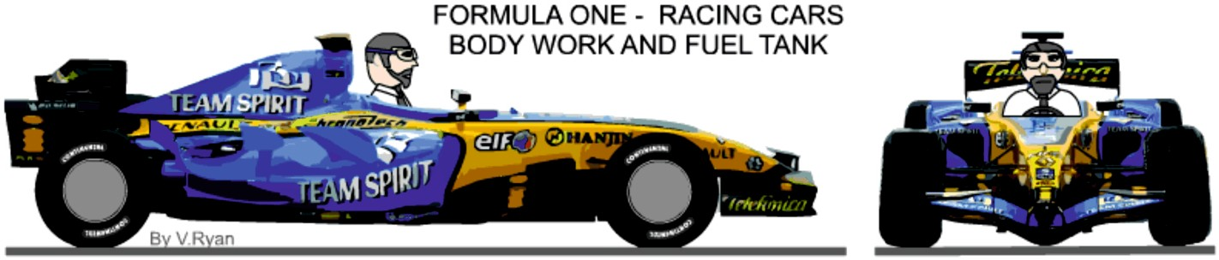
HELPFUL LINK http://www.technologystudent.com/joints/photchrom1.html
2. This question is regarding smart materials
2a. What are photochromic inks. Your answer must include a reference to a practical application of photochromic ink. 3 marks
HELPFUL LINK http://www.technologystudent.com/joints/kevlar1.html
2b. Explain why a composite material is the most suitable for the bodywork of this Formula One racing car. Name the a suitable composite material in your answer.
2 marks

Slide 5
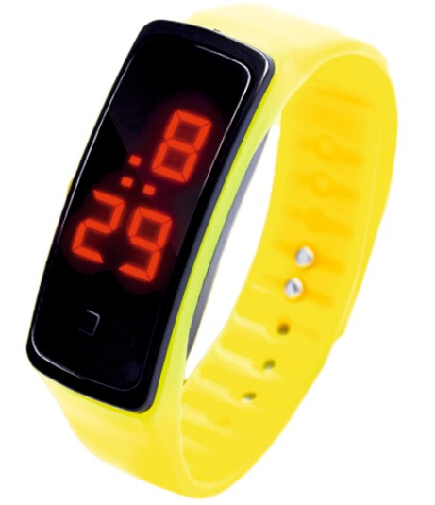
HELPFUL LINK http://www.technologystudent.com/joints_ﬂsh/phosphor1.html
2c. The digital sports watch / timer is typical of many similar devices today. The wrist band includes a phosphorescent pigment.
Explain the reason(s) for the inclusion of a phosphorescent pigment, in the wrist band material. 2 marks
HELPFUL LINK http://www.technologystudent.com/joints_ﬂsh/phosphor1.html
2d. Describe another product that includes phosphorescent pigment and explain its inclusion. 3 marks
Product:
Description and explanation:

Slide 6

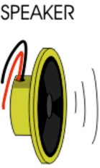

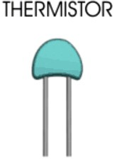

HELPFUL LINK http://www.technologystudent.com/pics/intputs1.htm
3. This question is regarding electronics, programmable circuits and mechanisms.
3a. Using a tick or a cross, identify each of the components, as either an ‘input’ or an ‘output’. 4 marks
COMPONENT | INPUT | OUTPUT
HELPFUL LINK http://www.technologystudent.com/gears1/gears5.htm
3b. Calculate the Velocity Ratio (Gear Ratio) for the spur gears seen opposite. Include your working out. 4 marks
A
60 TEETH
B
30 TEETH
DRIVEN (LOAD)
DRIVER (EFFORT)

Slide 7
HELPFUL LINK http://www.technologystudent.com/gears1/gears1.htm
3c. What is a driver gear wheel? 1 mark
What is a driven gear wheel? 1 mark
HELPFUL LINK http://www.technologystudent.com/pics/picgen1.html
3d. Name one piece of software that is used to programme a PIC microcontroller.
1 mark
3e. How is a PIC circuit physically connected to a computer, for programming?
1 mark
3f. What is a PIC microcontroller ( Programmable Interface Controller?) and what can it do? 3 marks

Slide 8
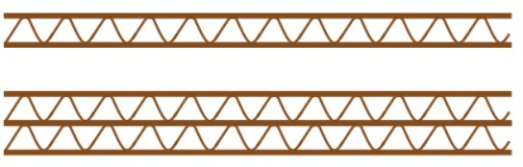
HELPFUL LINK http://www.technologystudent.com/despro_ﬂsh/charity9.html
4. These questions are about materials
4a. Study the images of two diﬀerent types of corrugated card. Name each type.
2 marks
HELPFUL LINK http://www.technologystudent.com/despro_ﬂsh/laminate2.html
4b. What is laminated card? 1 mark
4c. Name two products that have laminated card packaging?
2 marks
HELPFUL LINK http://www.technologystudent.com/despro2/crdpap2.htm
4d. What is grid paper ? Include a practical use. 2 marks
4e. What is layout paper ? Include a practical use.
2 marks

Slide 9
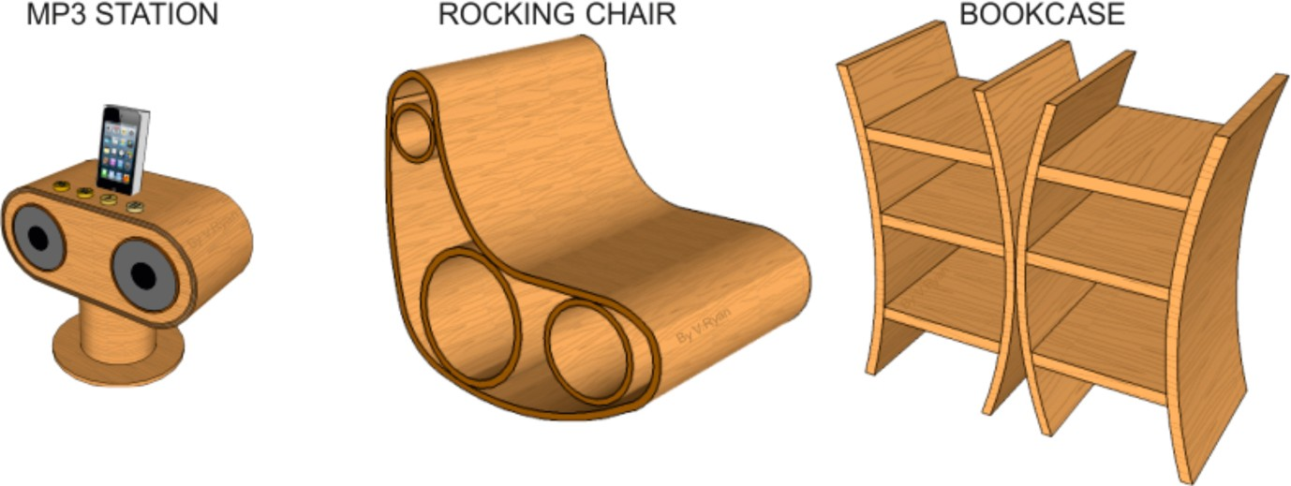
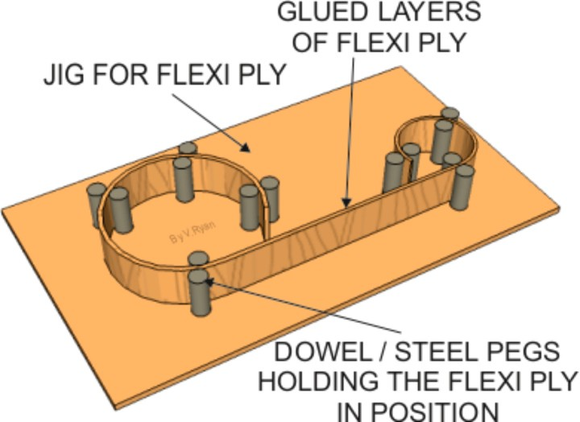
HELPFUL LINK http://www.technologystudent.com/despro_ﬂsh/ﬂexply1.html
4. The products shown below have been manufactured from ﬂexi-ply.
4f. Why is ﬂexi-ply ideal for their manufacture of the products?
3 marks
4g. Describe how a former similar to the one seen opposite, could be used to manufacture the sides of one the products displayed at the top of the page. 3 marks

Slide 10

HELPFUL LINK http://www.technologystudent.com/despro_ﬂsh/ﬁnish2.html
4h. The surfaces of the three pieces of furniture shown in question 4, must be prepared carefully to receive a ﬁnish. This is achieved through sanding with glass paper. Describe the procedure. 3 marks
HELPFUL LINK http://www.technologystudent.com/joints_ﬂsh/nylon1.html
4i. The photograph shown opposite is of waterproof clothing. Why is nylon a suitable material? 3 marks

Slide 11
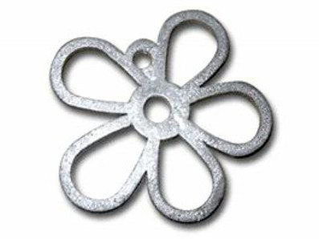
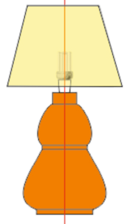
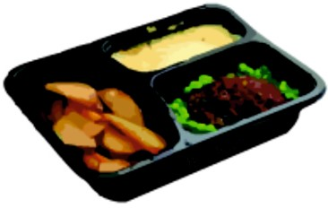
5a. Select one of the products shown below. Then, describe two reasons, for it being suitable for manufacture in large numbers / mass production. 2 x 2 marks
DESKTIDY
PEWTER CASTING
WOOD - LAMP
WOOD TURNING
POLYETHYLENE TEREPHTHALATE VACUUM FORMED TRAY
TO HELP YOU ANSWER THIS QUESTION
http://www.technologystudent.com/equip_ﬂsh/pewtt1.html http://www.technologystudent.com/equip_ﬂsh/pewtt2.html http://www.technologystudent.com/equip1/woodturn1.html http://www.technologystudent.com/equip1/woodturning2.html http://www.technologystudent.com/equip1/wturning8.html http://www.technologystudent.com/joints/pet1.html http://www.technologystudent.com/joints/petevac1.html
PRODUCT:
REASON 1:
REASON 2:
HELPFUL LINK http://www.technologystudent.com/prddes_2/crowd1.html
5b. Your chosen product is to be ﬁnanced through crowd funding. What is crowd funding? 2 marks

Slide 12
HELPFUL LINK http://www.technologystudent.com/prddes1/remote1.html
5c. The chosen product will be remotely manufactured. What is remote manufacturing? 4 marks
HELPFUL LINK http://www.technologystudent.com/despro2/focgrp1.html
5d. What role would a focus group play in evaluating the product, before it goes on sale in the shops and on the internet? 2 marks
HELPFUL LINK http://www.technologystudent.com/prddes1/markrs1.html
5e. Before your selected product is manufactured, it would be wise to carry out market research.
What is market research? 2 marks
Describe ONE aim of marketing. 1 mark

Slide 13


HELPFUL LINK http://www.technologystudent.com/pdf14/maths3.pdf
WORLD ASSOCIATION OF TECHNOLOGY TEACHERS https://www.facebook.com/groups/254963448192823/ www.technologystudent.com © 2017 V.Ryan © 2017
A rectangular acrylic window for an Art project seen below, is composed of two rectangular pieces, accurately cut to size on a laser cutter. They ﬁt perfectly together.
5f. Calculate the total area of piece A, before ‘B’ is removed
5g. Calculate the area of piece B. 2 marks
5h. Calculate the area of A, after ‘B’ is removed. 1 mark
200mm
2 marks
A
B
150mm
300mm
400mm
WORLD ASSOCIATION OF TECHNOLOGY TEACHERS
https://www.facebook.com/groups/254963448192823/
www.technologystudent.com © 2017
V.Ryan © 2017

Slide 14
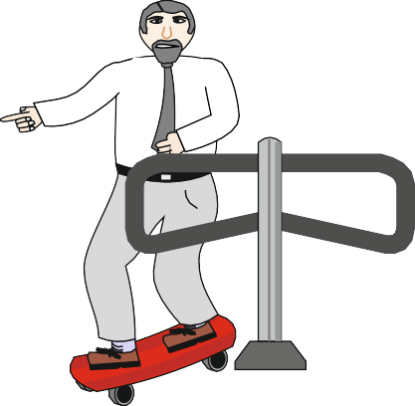
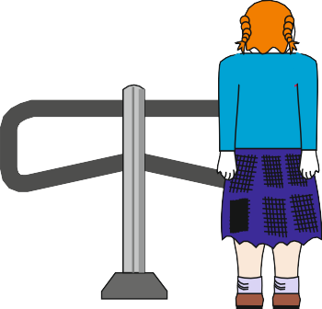
SECTION B
ANSWER ONLY ONE QUESTION
Electronics and Systems
HELPFUL LINK http://www.technologystudent.com/sysprp08/quest15.html
6. The turnstile system continually calculates the number of people who have entered the theme park and the number of people leaving. This is to ensure that the total never exceeds the legal limit.
A Technology pupil has devised a simple model to test his/her programming. The maximum number of people allowed through the entrance for the test run is ten. The program must calculate those entering the park and balance it with those leaving the park. The total number of those in the park must not exceed ten.
EXIT
ENTRANCE
OUTPUT MOTOR A
INPUT 2
The sequence of events are as follows; The system is switched on.
The total of people in the park is set at 0.
INPUT 1
input 1 and 2 are continually checked.
If input 1 detects a person entering the park then 1 is added to the total. If input 2 detects a person leaving the park 1 is subtracted from the total.
If the total number of people in the park reaches 10 a solenoid locks the entrance turnstile (this stops more people entering the park)
WORLD ASSOCIATION OF TECHNOLOGY TEACHERS https://www.facebook.com/groups/254963448192823/
www.technologystudent.com © 2017 V.Ryan © 2017
6a. Write flow chart to represent the programmed sequence of events. Use the following the process / systems boxes shown below. Complete your work on the following page 4 marks
INPUT OUTPUT
PROCESS
STOP
DECISION
NO
 | SUBROUTINE
SUBROUTINE
YES

Slide 15
HELPFUL LINK http://www.technologystudent.com/sysprp08/quest15.html
Describe how your flow chart works by explaining each stage on the right hand side
FLOW CHART EXPLANATION
WORLD ASSOCIATION OF TECHNOLOGY TEACHERS
https://www.facebook.com/groups/254963448192823/
www.technologystudent.com © 2017 V.Ryan © 2017

Slide 16
HELPFUL LINK http://www.technologystudent.com/sysprp7/sysq17.html
6b. The turnstile system is to be updated to sliding doors. The two doors are shown below. Add to the drawing a suitable mechanical system that would allow the doors to be opened and closed, in the event of an electronic / electrical failure. Add explanatory notes and labels. 5 marks
WORLD ASSOCIATION OF TECHNOLOGY TEACHERS https://www.facebook.com/groups/254963448192823/
www.technologystudent.com © 2017 V.Ryan © 2017
NOTES

Slide 17
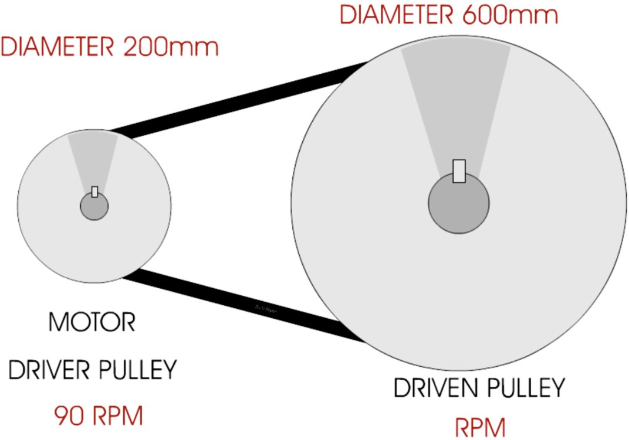
HELPFUL LINK http://www.technologystudent.com/gears1/pulley3.htm
6. The turnstile system is to be updated again, so that it works automatically the through a system of pulleys (shown in the diagram below).
B
A
6c. Calculate the Velocity Ratio of the pulley system. Include all your working out
2 marks
6d. Calculate the RPM of pulley ‘B’. Include all your working out.
3 marks

Slide 18
HELPFUL LINK http://www.technologystudent.com/prddes1/repair1.html
6e. The turnstile system is to be manufactured so that it is repairable, rather than having to be replaced each time a fault develops. What are the advantages of designing products that are repairable, compared to those that need replacing? 5 marks
_{HELPFUL LINKS} http://www.technologystudent.com/prddes1/closeloop1.html http://www.technologystudent.com/prddes1/closeloop2.html
6. Designers need to consider environmental issues when designing products. Consequently, many of the products sold in the theme park have been designed to be recycled, as part of a ‘Closed Loop System’.
6f. What is Closed Loop Recycling? Include reference to how ‘plastic’ drinks bottles are recycled through this system. 6 marks

Slide 19
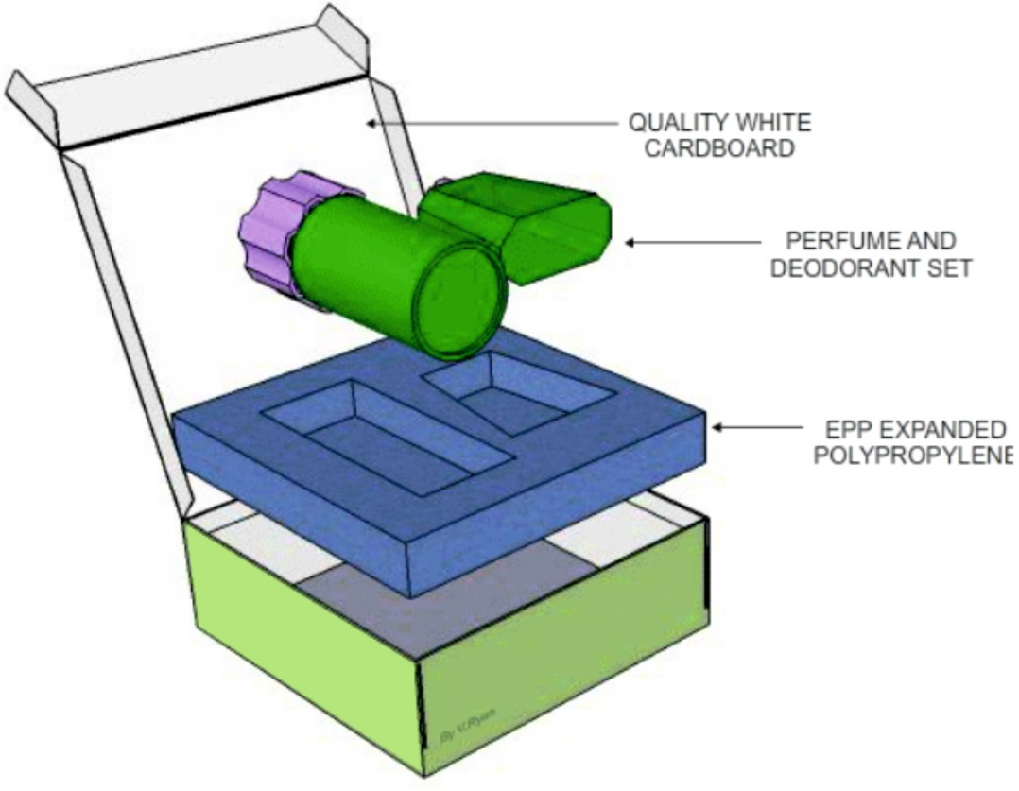
Paper and Boards
7. The photograph shows the packaging for a perfume product.
HELPFUL LINK http://www.technologystudent.com/prddes1/perfpk4.html
7a. Quality white card has been used for the manufacture of the box / package shown above. Explain why card has been used. 2 marks
7b. Why do you think the packaging is ‘cuboid’ in shape? 1 mark

Slide 20

HELPFUL LINK http://www.technologystudent.com/prddes1/perfpk3.html
7c. Why has Expanded Polystyrene (EPS) been used to manufacture the insert, that holds the product in position? 2 marks
HELPFUL LINK http://www.technologystudent.com/despro_ﬂsh/foilblk1.html
7d. The manufacturer intends to use the foil blocking technique, to produce quality gold printing on the top surface. Explain how foiling blocking could be used to produce the required ﬁnish. Include notes and sketches in your answer. 4 marks
NOTES
SKETCHES

Slide 21
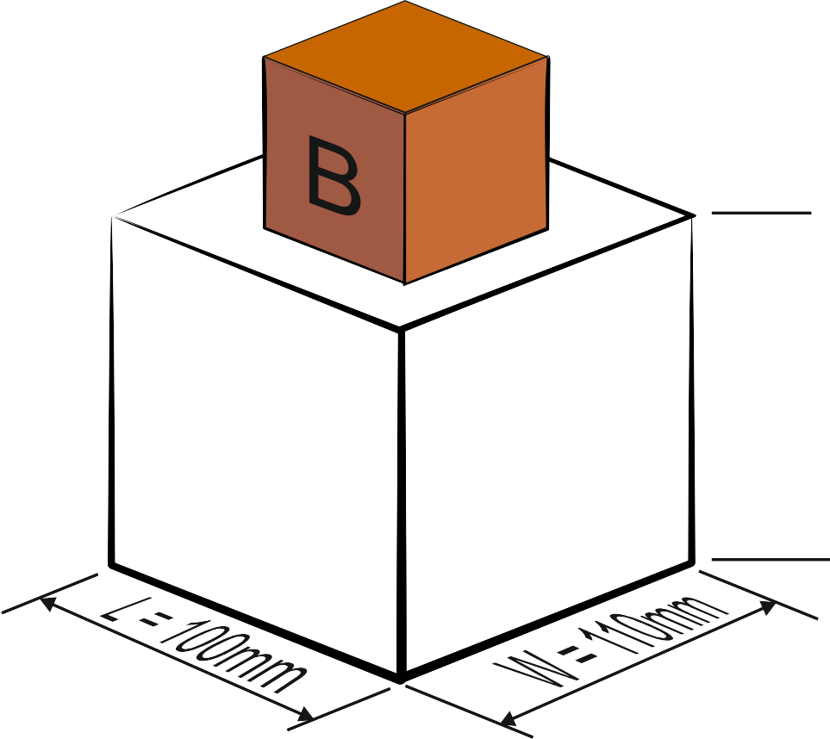
HELPFUL LINK http://www.technologystudent.com/pdf14/maths_rec_prism1.pdf
7. The shape and form of the packaging is to be changed, to the one shown below.
H=60mm
The unusual solid geometrical shape shown opposite, can be treated as two rectangular prisms, A and B.
7e. Calculate the entire volume of the shape/form
.
Explain your working out.
5 marks
H=120mm
A
WORLD ASSOCIATION OF TECHNOLOGY TEACHERS
https://www.facebook.com/groups/254963448192823/
www.technologystudent.com © 2017 V.Ryan © 2017

Slide 22
HELPFUL LINK http://www.technologystudent.com/prddes1/packenv1.html
7f. A large amount of packaging, used to protect food products, is discarded everyday, having a harmful impact on the environment. How can this harmful impact be reduced? 5 marks
_{HELPFUL LINKS} http://www.technologystudent.com/prddes1/closeloop1.html http://www.technologystudent.com/prddes1/closeloop2.html
7. Designers need to consider environmental issues when designing products. Consequently, packaging is often designed to be recycled as part of a ‘Closed Loop System’.
7g. What is Closed Loop Recycling? Include reference to how ‘plastic’ drinks bottles are recycled through this system. 6 marks

Slide 23
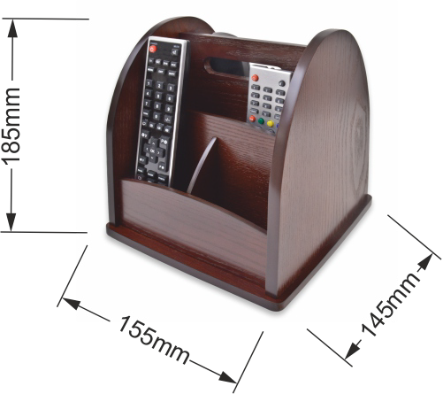
Natural and manufactured timber
8. Study the mahogany desk tidy shown opposite.
HELPFUL LINK http://www.technologystudent.com/rmﬂsh1/remote5.html
8a. Why is mahogany a suitable material for the desk tidy? 2 marks
HELPFUL LINK http://www.technologystudent.com/despro_ﬂsh/ﬁnish3.html
8b. The desk tidy has been ‘ﬁnished’ with water-based varnish. Why can this be considered a suitable choice? 2 marks
8c. Name one alternative ﬁnish, that could be applied to the desk tidy. 1 mark

Slide 24
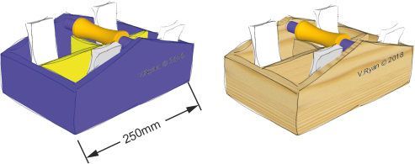
The desk organiser seen below, is an updated design.
HELPFUL LINK http://www.technologystudent.com/rmﬂsh1/remote15.html
8d. Name and sketch a suitable joint for the corners. 4 marks
NAME:
SKETCH

Slide 25
HELPFUL LINK http://www.technologystudent.com/pdf14/maths3.pdf Page 7
WORLD ASSOCIATION OF TECHNOLOGY TEACHERS https://www.facebook.com/groups/254963448192823/
www.technologystudent.com © 2017 V.Ryan © 2017
A new side has been designed for the desk tidy (see below).
8e. Calculate the area of the material required, before it is cut to shape (the overall rectangle of material required, before it is cut to an L shape). 2 marks
8f. Calculate the area of the ﬁnal L shape. 3 marks
250mm
200mm
400mm
500mm
WORLD ASSOCIATION OF TECHNOLOGY TEACHERS
https://www.facebook.com/groups/254963448192823/
www.technologystudent.com © 2017 V.Ryan © 2017

Slide 26


HELPFUL LINKS
http://www.technologystudent.com/prddes1/susenv1.html http://www.technologystudent.com/joints/sustain1.html
8g. Manufacturers of natural wood products are encouraged to source their materials from sustainable forests.
What is a sustainable forest and why are sustainable forests important? 5 marks
HELPFUL LINK http://www.technologystudent.com/joints/sustain1.html
8h. The logo shown opposite is sometimes printed on timber and packaging.
Explain the meaning of this logo. 3 marks
8i. The logo shown opposite is sometimes printed on timber and packaging.
Explain the meaning of this logo. 3 marks

Slide 27
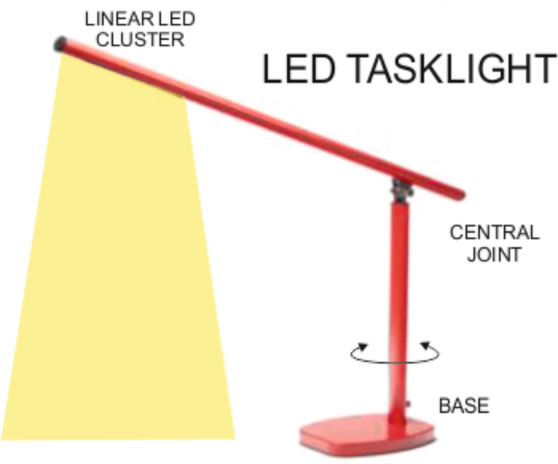
Ferrous and non-ferrous metals
9. This aluminium task light is supplied in a range of colours. It is adjustable and an LED cluster supplies the light. The base is manufactured from steel.
SQUARE
SECTION
TUBE
HELPFUL LINKS
http://www.technologystudent.com/joints_ﬂsh/oﬃce4.html http://www.technologystudent.com/designpro/metals1.htm
9a. Why is aluminium tube suitable for the ‘arms’ of the task light? 1 mark
HELPFUL LINK http://www.technologystudent.com/joints_ﬂsh/metal2.html
9b. The aluminium has been anodised. What is anodising of aluminium? 2 marks
HELPFUL LINK http://www.technologystudent.com/joints_ﬂsh/oﬃce4.html
9c. Give two reasons for using steel for the base of the task light. 2 marks

Slide 28
HELPFUL LINK http://www.technologystudent.com/equip_ﬂsh/hacksw2.html
9d. Describe how the square section aluminium tube, would be cut to length, using tools commonly found in a school workshop. Use notes and sketches.
4 marks

Slide 29
HELPFUL LINK http://www.technologystudent.com/pdf14/maths4.pdf Page 11
WORLD ASSOCIATION OF TECHNOLOGY TEACHERS https://www.facebook.com/groups/254963448192823/
www.technologystudent.com © 2017 V.Ryan © 2017
9. A student measures the dimensions (measurements) for the ‘round section’ handle of a machine vice, that he intends to manufacture. The student measures the radius of an existing handle and ﬁnds it to be 25mm.
9e. What is the circumference of the handle? 9f. What is the area of the end of the handle?
3 marks
2 marks
FORMULA
FORMULA
AREA = πr ²
π (pi) = 3.14
CIRCUMFERENCE = 2 x π x r
π (pi) = 3.14
WORLD ASSOCIATION OF TECHNOLOGY TEACHERS
https://www.facebook.com/groups/254963448192823/
www.technologystudent.com © 2017
V.Ryan © 2017

Slide 30
HELPFUL LINK http://www.technologystudent.com/joints/alloys1.html
9g. The base of the task light is manufactured from the alloy, steel. What is an alloy?
2 marks
HELPFUL LINK http://www.technologystudent.com/joints/alloys1.html
9h. Many bridges around the world are manufactured from steel, although during Victorian times, iron was used in bridge building. Why is steel used today?
3 marks
HELPFUL LINK http://www.technologystudent.com/equip_ﬂsh/galv1.html
One way of ensuring metal products have a reduced impact on the environment, is to prevent / reduce corrosion, lengthening their working life.
9i. Galvanising steel helps to prevent corrosion and rust. What is the galvanising process and how does it prevent corrosion?
3 marks

Slide 31
HELPFUL LINK http://www.technologystudent.com/joints_ﬂsh/metal6.html
9j. Powder Coating is an alternative ﬁnish to metals. What is powder coating?
3 marks

Slide 32
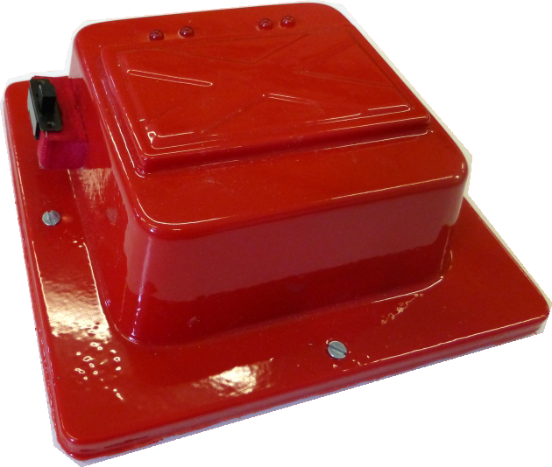
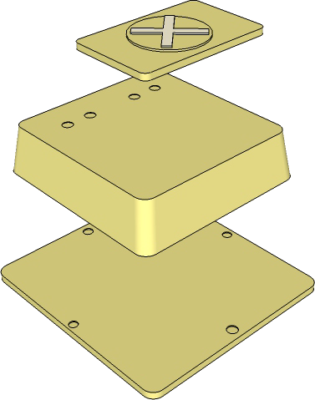
Thermosetting and thermoforming plastics
10. The product seen opposite, is a warning light system, composed of a ‘plastic’ casing and an electronic circuit.
When the switch is ‘on’, the LEDs ﬂash.
HELPFUL LINK http://www.technologystudent.com/gprep07/vac2.html
10a. What thermoplastic material, is most suitable for the manufacture of the casing?
1 mark
HELPFUL LINK http://www.technologystudent.com/equip1/vacform1.htm
10b. What is the name of the process, that results in the base being manufactured?
1 mark
10c. The mould for the casing is seen opposite. How is the mould ﬁnished, to ensure that it can be removed from the moulded ‘plastic’, after vacuum forming? 2 marks
LOGO / SYMBOL
MOULD
MDF BACK

Slide 33
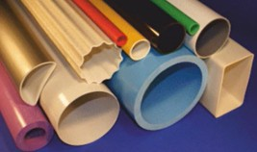
HELPFUL LINK
http://www.technologystudent.com/equip1/plasextru1.html
10d. A process called extrusion has been is used to manufacture the proﬁles seen in the photograph opposite.
Why is extrusion a suitable process?
1 mark
HELPFUL LINK
http://www.technologystudent.com/equip1/plasextru1.html
10e. Using notes and a sketch, explain the extrusion process. 4 marks
SKETCH
NOTES

Slide 34
HELPFUL LINK
http://www.technologystudent.com/pdf14/maths_pyramids1.pdf Page 4
10f. A 3D Printer has been used to manufacture a special casing for an electronic circuit. What is the volume of the shape (a square pyramid)? 5 marks
WORLD ASSOCIATION OF TECHNOLOGY TEACHERS
https://www.facebook.com/groups/254963448192823/
www.technologystudent.com © 2017 V.Ryan © 2017
HEIGHT
120mm
80mm
FORMULAS
AREA OF BASE = LENGTH²
Using the formulas opposite, calculate the volume of the square pyramid.
Volume = ¹ x Base x Height
3
V = ¹ x B x H
3

Slide 35
HELPFUL LINKS
http://www.technologystudent.com/prddes_2/global1.html http://www.technologystudent.com/prddes_2/global2.html
10g. Numerous ‘plastic’ products, such as the casings for electronic pdevices, are manufactured cheaply because of ‘Globalisation’. What is Globalisation?
5 marks
_{HELPFUL LINKS} http://www.technologystudent.com/prddes1/closeloop1.html http://www.technologystudent.com/prddes1/closeloop2.html
9h. Designers need to consider environmental issues when designing products. Consequently, packaging is often designed to be recycled as part of a ‘Closed Loop System’.
What is Closed Loop Recycling? Include reference to how ‘plastic’ drinks bottles are recycled through this system. 6 marks

Slide 36
ADD YOUR OWN TEXTILES SPECIFIC EXAMINATION QUESTIONS

