Slide 1
SAMPLE DESIGN AND TECHNOLOGY
GCSE EXAMINATION PAPER
(SAMPLE 4)
WORLD ASSOCIATION OF TECHNOLOGY TEACHERS https://www.facebook.com/groups/254963448192823/
www.technologystudent.com © 2018 V.Ryan © 2018
CENTRE NUMBER CANDIDATE NUMBER
SURNAME
FORENAME(S)
CANDIDATE SIGNITURE
2 HOURS ALLOWED
Materials required for this examination:
normal writing and drawing instruments
a calculator
a protractor.
Instructions to candidates:
Use black ink or black ball-point pen. Use pencil only for drawing.
Fill in the boxes at the top of this page.
Answer all questions.
You must answer the questions in the spaces provided. Do not write on
Do all rough work in this book. Cross through any work that you do not want to be marked.
blank pages.
Information
The marks for questions are displayed.
The maximum mark for this paper is 131.
There are 22 marks for Section A, 37 marks for Section B and 72 marks for Section C.
This example examination paper can be duplicated and printed out if required but not edited in any way.
The links to www.technologystudent.com cannot be removed.
The PDF ﬁle can be stored on school / college systems and distributed electronically (NO EDITING ALLOWED)
PLEASE RESPECT THE COPYRIGHT - report infringers to techteacher@technologystudent.com Not be distributed at courses or by course instructors / consultants
WORLD ASSOCIATION OF TECHNOLOGY TEACHERS https://www.facebook.com/groups/254963448192823/
www.technologystudent.com © 2018 V.Ryan © 2018

Slide 2
CORE TECHNICAL PRINCIPLES - SECTION A
The questions to follow are multiple choice. Tick one answer for each question.
WORLD ASSOCIATION OF TECHNOLOGY TEACHERS https://www.facebook.com/groups/254963448192823/
www.technologystudent.com © 2018 V.Ryan © 2018
1. Which one of the following energy production systems is an alternative energy ?
Wind Power
Hydraulic Fracturing
Crude Oil
Coal
This link will help you answer this question
http://www.technologystudent.com/energy1/engex.htm
2. Which type of motion does the diagram below represent?
Rotary
Reciprocating
Linear
Oscillating
This link will help you answer this question
http://www.technologystudent.com/forcmom/motion2.html
3. A Foam Metal is:
Link to potential answer
http://www.technologystudent.com/joints_ﬂsh/metalfoam1.html
A dense metal, starting at the core and out to the exterior layer .
A metal that cannot be heated, as it will melt.
A solid structures, usually composed of a dense outer layer, with the inner portion in the form of a matrix of pores.
A composite metal, made up of several layers.

Slide 3
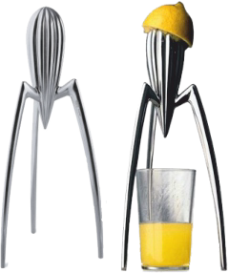
4. From the list of woods, identify the natural wood.
WORLD ASSOCIATION OF TECHNOLOGY TEACHERS
https://www.facebook.com/groups/254963448192823/
www.technologystudent.com © 2018 V.Ryan © 2018
Plywood
MDF
Mahogany
Flexiply
Link to potential answer
http://www.technologystudent.com/designpro/natwd1.htm
5. Which of the following designers, designed the ‘Juicy Salif’ - Citrus Squeezer?
Charles Eames.
Marcel Breuer
Philippe Starck
Robin Day
Link to potential answer
http://www.technologystudent.com/despro_ﬂsh/phillipe1.html
Which of the following statements describing ‘plywood’ is FALSE?
Link to potential answer http://www.technologystudent.com/joints/plywood1.html
Plywood is a composite material.
Plywood is composed of several layers of thin plies / veneers.
Plywood is relatively weak, compared to other manufactured boards.
Plywood is supplied in a variety of thicknesses.
Which of the statements below is the deﬁnition of the physical property ‘fusability’?
Link to potential answer
http://www.technologystudent.com/joints_ﬂsh/property3.html
The ability of a material to be twisted into a variety of shapes, without the need for heat.
The ability of a material to resist a stretching force, without cracking.
The ability of a material to return to its original shape, repeatedly.
The ability of a material to be transformed from a solid state to a liquid state, due to the application of heat.

Slide 4
8. Which of the following statements is representative of Iterative Design?
Link to potential answer http://www.technologystudent.com/despro_ﬂsh/iterative1.html
A linear design process, whereby one stage follows another.
A process of continual improvement, of a concept, prototype, design or product, with model making, sketching, client feedback applied when required.
Designing as a team, following a strict design process.
A systems approach - PROCESS - SYSTEM - OUTCOME.
WORLD ASSOCIATION OF TECHNOLOGY TEACHERS
https://www.facebook.com/groups/254963448192823/
www.technologystudent.com © 2018 V.Ryan © 2018
Which of the following is the process called ‘INJECTION MOULDING’?
Link to potential answer http://www.technologystudent.com/equip1/inject1.htm
An automated painting process.
Plastic coating of a metal surface, to increase its resistance to temperature.
A process that creates a ‘reﬂective’ coating on a range of polymers.
A process involving heating ‘plastic’ granules to liquid form and forcing the solution into a mould .
10. What is the name of the area of circle labelled ‘A’, seen below?
A
Follow the link to a potential answer.
http://www.technologystudent.com/pdf14/maths4.pdf
RADIUS (r)
DIAMETER (d)
SEGMENT
Sector
Radian
Triangulated Part
Aspect

Slide 5
TO HELP YOU ANSWER THIS QUESTION
http://www.technologystudent.com/joints/titanium1.html
11. Give two reasons why Titanium is suitable for making turbine blades in jet engines. 2 marks
WORLD ASSOCIATION OF TECHNOLOGY TEACHERS https://www.facebook.com/groups/254963448192823/
Reason 1:
www.technologystudent.com © 2018 V.Ryan © 2018
Reason 2:
TO HELP YOU ANSWER THIS QUESTION
http://www.technologystudent.com/despro_ﬂsh/graphene1.html http://www.technologystudent.com/despro_ﬂsh/graphene2.html
12. Describe one potential practical application of Graphene. Include in your answer, why graphene is suitable for the practical application. 2 marks
Practical Application:
Why suitable?:
TO HELP YOU ANSWER THIS QUESTION
http://www.technologystudent.com/energy1/nuclear1.htm http://www.technologystudent.com/energy1/rwaste1.htm
13. Nuclear Power Stations, produce electricity from radioactive fuel sources such as uranium. Give two reasons why some people are against this method of energy production. 2 marks
Reason 1:
Reason 2:

Slide 6
TO HELP YOU ANSWER THIS QUESTION
http://www.technologystudent.com/energy1/nuclear1.htm http://www.technologystudent.com/energy1/rwaste1.htm
14. Give two reasons why some people are in favour of Nuclear Power. 2 marks
WORLD ASSOCIATION OF TECHNOLOGY TEACHERS
https://www.facebook.com/groups/254963448192823/
www.technologystudent.com © 2018
V.Ryan © 2018
Reason 1:
Reason 2:
TO HELP YOU ANSWER THIS QUESTION
http://www.technologystudent.com/pdf14/maths4.pdf PAGE 2
15. What is the circumference of the circle seen in the diagram.
You will gain marks for each stage of the calculation, written in the space below
4 marks
CALCULATION:
RADIUS
100mm
FORMULA
CIRCUMFERENCE = 2 x π x r
π (pi) = 3.14

Slide 7
SECTION B - Specialist Technical Principles
WORLD ASSOCIATION OF TECHNOLOGY TEACHERS https://www.facebook.com/groups/254963448192823/
www.technologystudent.com © 2018 V.Ryan © 2018
METAL FOAM
16. Select one of the materials listed above.
PLYWOOD
Name of Material
Describe your chosen material’s manufacture. Include notes and a labelled sketch(s)
8 marks
TO HELP YOU ANSWER THIS QUESTION
http://www.technologystudent.com/joints_ﬂsh/metalfoam1.html http://www.technologystudent.com/joints/plywood1.html

Slide 8
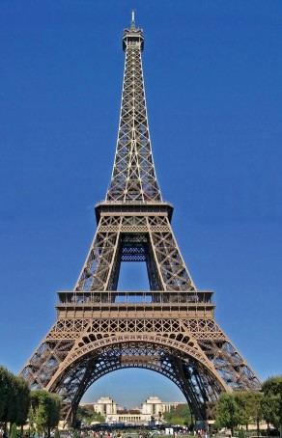
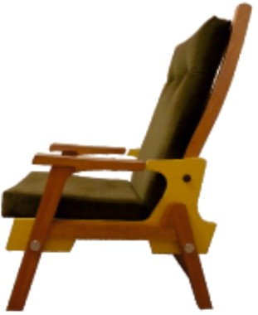
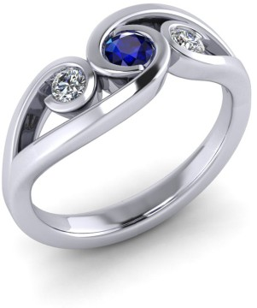
TO HELP YOU ANSWER THIS QUESTION
http://www.technologystudent.com/joints_ﬂsh/metal7.html http://www.technologystudent.com/joints_ﬂsh/revcard_metal6.html
17a. Why is lacquer sometimes applied to a metal surface? 2 marks
WORLD ASSOCIATION OF TECHNOLOGY TEACHERS https://www.facebook.com/groups/254963448192823/
www.technologystudent.com © 2018 V.Ryan © 2018
17b. Describe the process of applying lacqurer to a metal surface? 2 marks
18. Select one of the products shown below. Then, give two reasons, why the product is a good example of one oﬀ / single item production. 2 x 2 marks
BESPOKE CHAIR
HANDMADE JEWELLERY
THE EIFFEL TOWER
TO HELP YOU ANSWER THIS QUESTION
http://www.technologystudent.com/joints/sing1a.htm http://www.technologystudent.com/joints/revcard_oneoﬀ1.html
PRODUCT:
REASON 1:

Slide 9
REASON 2:
WORLD ASSOCIATION OF TECHNOLOGY TEACHERS https://www.facebook.com/groups/254963448192823/
www.technologystudent.com © 2018 V.Ryan © 2018
19. Metals can be permanently joined in a number of ways. Using notes and sketches, describe / explain the industrial process called BRAZING. 5 marks
TO HELP YOU ANSWER THIS QUESTION
http://www.technologystudent.com/equip1/braz1.htm http://www.technologystudent.com/joints/braz2.htm
THE INDUSTRIAL PROCESS CALLED BRAZING INCLUDE NOTES AND A SKETCH(S)

Slide 10
20a. What is the Lean Manufacturing system?
4 marks
WORLD ASSOCIATION OF TECHNOLOGY TEACHERS
https://www.facebook.com/groups/254963448192823/
www.technologystudent.com © 2018 V.Ryan © 2018
TO HELP YOU ANSWER THIS QUESTION
Follow the links below. http://www.technologystudent.com/despro_3/lean1.html http://www.technologystudent.com/despro_3/lean2.html http://www.technologystudent.com/despro_3/revcard_lean1.
20b. Name four international companies that utilise the Lean Manufacturing philosophy 4 marks
Follow the links below.
http://www.technologystudent.com/despro_3/lean1.html http://www.technologystudent.com/despro_3/lean2.html http://www.technologystudent.com/despro_3/revcard_lean1.
TO HELP YOU ANSWER THIS QUESTION

Slide 11
TO HELP YOU ANSWER THIS QUESTION
Follow the links below.
http://www.technologystudent.com/prddes_2/global1.html
21a. What is Globalisation?
4 marks
WORLD ASSOCIATION OF TECHNOLOGY TEACHERS
https://www.facebook.com/groups/254963448192823/
www.technologystudent.com © 2018
V.Ryan © 2018
TO HELP YOU ANSWER THIS QUESTION
Follow the links below.
http://www.technologystudent.com/prddes_2/global1.html
http://www.technologystudent.com/prddes_2/global2.html
21b. Select a manufactured product that is the result of globalisation, Describe the stages involved in it’s manufacture. 4 marks
PRODUCT: DESCRIPTION:

Slide 12
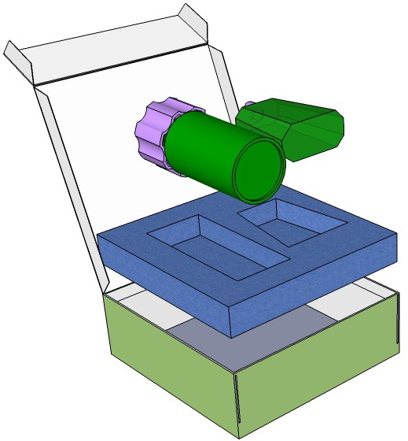
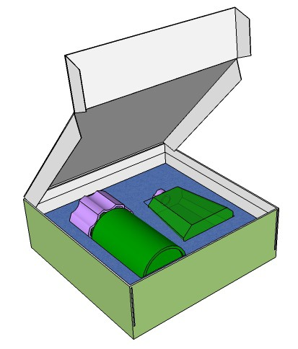
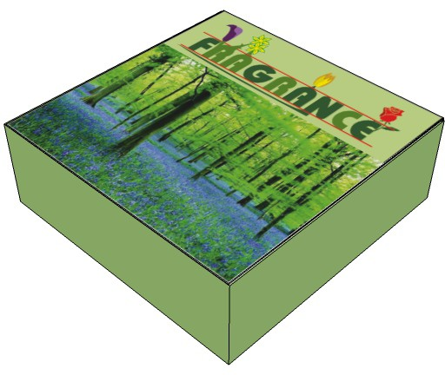
SECTION C - DESIGNING AND MAKING PRINCIPLES
WORLD ASSOCIATION OF TECHNOLOGY TEACHERS https://www.facebook.com/groups/254963448192823/
www.technologystudent.com © 2018 V.Ryan © 2018
PACKAGING OF PERFUMED PRODUCTS
The packaging seen below, has been designed to hold / store deodorant and perfume containers.
QUALITY WHITE CARDBOARD
PERFUME AND DEODORANT SET
EPP EXPANDED POLYPROPYLENE

Slide 13
22. The packaging should have the following design features:
TO HELP YOU ANSWER THIS QUESTION
Follow the links below.
http://www.technologystudent.com/despro2/drink7.htm
http://www.technologystudent.com/despro2/drink14.htm
22a. Draw a typical symbol that should be found on the packaging and add a description / explanation of the symbol. 2 marks
22b.What is the advantage of using Expanded Polypropylene (EPP)?
2 marks (Link for help http://www.technologystudent.com/prddes1/perfpk3.html)
22c. Why is quality card also used in the manufacture of the packaging?
(Link for help - http://www.technologystudent.com/prddes1/perfpk4.html )
2 marks
22d. The printing process called lithography is used to print the detail, images and colour on to the surfaces of the packaging. Draw a labelled diagram of lithography and included a written explanation. 4 marks (Link for help http://www.technologystudent.com/designpro/prtpro5.htm )

Slide 14
TO HELP YOU ANSWER THIS QUESTION
Follow the link below.
http://www.technologystudent.com/despro_3/promopk2.html
WORLD ASSOCIATION OF TECHNOLOGY TEACHERS https://www.facebook.com/groups/254963448192823/
www.technologystudent.com © 2018 V.Ryan © 2018
23a. List FOUR ways, in which the printed surfaces of packaging, helps in the promotion of a product? 4 marks
23b. How could the packaging be improved, if the target market was speciﬁcally aimed at teenagers? 4 marks

Slide 15
TO HELP YOU ANSWER THIS QUESTION
Follow the link below.
http://www.technologystudent.com/despro2/prneﬀ2.htm
WORLD ASSOCIATION OF TECHNOLOGY TEACHERS https://www.facebook.com/groups/254963448192823/ www.technologystudent.com © 2018 V.Ryan © 2018
24a. The surface of the packaging is to ﬁnished through the process of UV varnishing? Explain this process with a diagram and notes 5 marks
TO HELP YOU ANSWER THIS QUESTION
Follow the link below.
http://www.technologystudent.com/prddes1/perfpk12.
24b. The packaging is in the form of a cuboid. Give three advantages of using this common shape 3 marks
REASON 1:
REASON 2:
REASON 3:

Slide 16
Follow the link below.
http://www.technologystudent.com/prddes1/brand2.html
TO HELP YOU ANSWER THIS QUESTION
http://www.technologystudent.com/prddes1/brand1.html
WORLD ASSOCIATION OF TECHNOLOGY TEACHERS https://www.facebook.com/groups/254963448192823/
www.technologystudent.com © 2018 V.Ryan © 2018
25a. These questions are related to Brand Identity (8 marks in total)
What is a brand?
2 marks
25b. Name a company that you think has reached brand status. Explain why you consider it has reached this status. 2 marks
25c. Describe / explain four characteristics of Brand Identity.
4 marks

Slide 17
TO HELP YOU ANSWER THIS QUESTION
Follow the link below.
http://www.technologystudent.com/prddes1/markrs1.html http://www.technologystudent.com/prddes1/marks2.html http://www.technologystudent.com/prddes1/markrs2.html http://www.technologystudent.com/prddes1/ict1.html
WORLD ASSOCIATION OF TECHNOLOGY TEACHERS https://www.facebook.com/groups/254963448192823/
Designers need an understanding of Market Research
www.technologystudent.com © 2018
V.Ryan © 2018
26a. What is meant by the term Market Research?
4 marks
26b. How can ICT specifically contribute to market research?
4 marks

Slide 18
TO HELP YOU ANSWER THIS QUESTION
Follow the link below.
http://www.technologystudent.com/pdf14/maths3.pdf (page 6)
WORLD ASSOCIATION OF TECHNOLOGY TEACHERS https://www.facebook.com/groups/254963448192823/
www.technologystudent.com © 2017 V.Ryan © 2017
An acrylic panel for a storage unit is seen below.
27a. Calculate the area of the acrylic required, before it is cut to shape (the overall rectangle of acrylic required before it is cut into an L shape). 3 marks
27b. Calculate the area of the ﬁnal L shape 5 marks
250mm
200mm
400mm
500mm
WORLD ASSOCIATION OF TECHNOLOGY TEACHERS
https://www.facebook.com/groups/254963448192823/
www.technologystudent.com © 2017
V.Ryan © 2017

Slide 19
TO HELP YOU ANSWER THIS QUESTION
Follow the link below.
http://www.technologystudent.com/joints_ﬂsh/phosphor1.html http://www.technologystudent.com/joints_ﬂsh/recard_phos1.html
WORLD ASSOCIATION OF TECHNOLOGY TEACHERS https://www.facebook.com/groups/254963448192823/
www.technologystudent.com © 2018 V.Ryan © 2018
28a. Designers need an understanding of smart materials. Phosphorescent Pigments have many practical applications. What are Phosphorescent Pigments? 2 marks
28b. Describe two practical applications of Phosphorescent Pigments. 2 x 3 marks
PRACTICAL APPLICATION 1:
PRACTICAL APPLICATION 1:

Slide 20
TO HELP YOU ANSWER THIS QUESTION
Follow the link below.
http://www.technologystudent.com/designpro/model1.htm
WORLD ASSOCIATION OF TECHNOLOGY TEACHERS https://www.facebook.com/groups/254963448192823/
www.technologystudent.com © 2018 V.Ryan © 2018
29a. Designers make models throughout the design and development of a product? Why is model making important? 2 marks
TO HELP YOU ANSWER THIS QUESTION Follow the links below.
http://www.technologystudent.com/prddes1/modmat1.html http://www.technologystudent.com/prddes1/modemat2.html
29b. Name two model making materials used by designers and describe the characteristics that make them suitable for model making. 2 x 3 marks
Modelling Materials 1:
Modelling Material 2:

Slide 21
WORLD ASSOCIATION OF TECHNOLOGY TEACHERS https://www.facebook.com/groups/254963448192823/
www.technologystudent.com © 2018 V.Ryan © 2018
30. A local public bus, takes a route from Keighley to Bradford, as shown on the map below. The bus stops are indicated on the map
Draw a topological map, in the style of London Underground, in the available space.
6 marks
THWAITES
A650
KEIGHLEY
1
BINGLEY
2
3
COTTINGLY BRIDGE
4
5
SHIPLEY
COTTINGLY
MANNINGHAM
6
TO HELP YOU ANSWER THIS QUESTION
http://www.technologystudent.com/despro_ﬂsh/time15.html http://www.technologystudent.com/despro_ﬂsh/time16.html
7
BRADFORD

