Slide 1
DESIGN AND TECHNOLOGY - GCSE SAMPLE PAPER 2
COMPONENT 1
Candidate Name | Centre Number |  |  |  |  | Candidate Number
WORLD ASSOCIATION OF TECHNOLOGY TEACHERS https://www.facebook.com/groups/254963448192823/
www.technologystudent.com © 2017 V.Ryan © 2017
TIME ALLOWED - 2 HOURS
USE THE INSERT PROVIDED HALF WAY THROUGH THIS BOOKLET
EQUIPMENT REQUIRED
Drawing and writing equipment, coloured pencils and a calculator
INSTRUCTIONS
Write in black in,k not pencil.
Answer all the questions.
Use the insert for when answering questions from Section B
Include all working out
TOTAL MARKS FOR THIS PAPER IS 100
This example examination paper can be duplicated and printed out if required but not edited in any way.
The links to www.technologystudent.com cannot be removed.
The PDF ﬁle can be stored on school / college systems and distributed electronically (NO EDITING ALLOWED)
PLEASE RESPECT THE COPYRIGHT - report infringers to techteacher@technologystudent.com Not be distributed at courses or by course instructors / consultants
WORLD ASSOCIATION OF TECHNOLOGY TEACHERS https://www.facebook.com/groups/254963448192823/ www.technologystudent.com © 2018 V.Ryan © 2018

Slide 2
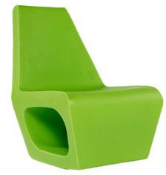
SECTION A
Answer all the questions
HELPFUL LINK http://www.technologystudent.com/joints/ldpe1.html
1. The photograph shows a ‘plastic’ chair. It can be manufactured from Low Density Polyethylene (LDPE).
1a. Explain the physical properties that make LDPE suitable. 3 marks
WORLD ASSOCIATION OF TECHNOLOGY TEACHERS
https://www.facebook.com/groups/254963448192823/
www.technologystudent.com © 2017
V.Ryan © 2017
HELPFUL LINK http://www.technologystudent.com/joints/ldpe3.html
1b. Name and describe a manufacturing process that would be suitable for the industrial production of the chair. 3 mark

Slide 3

HELPFUL LINK http://www.technologystudent.com/joints/ldpe3.html
1c. In the space below, sketch the process you have described, adding labels.
4 marks
HELPFUL LINK http://www.technologystudent.com/pdf14/maths3.pdf Page 3
1d. A precision model of the chair is to be placed in a display case, at the entrance of an architects oﬃce. The display case has a lockable door. Calculate the area of the door 2 marks
115mm
75mm

Slide 4
_{HELPFUL LINKS} http://www.technologystudent.com/prddes1/quality1.html http://www.technologystudent.com/prddes1/qual2.html
1e. The chair shown in question 1a, undergoes Quality Control, as it is manufactured. What is Quality Control? 4 marks
WORLD ASSOCIATION OF TECHNOLOGY TEACHERS https://www.facebook.com/groups/254963448192823/
www.technologystudent.com © 2017 V.Ryan © 2017
_{HELPFUL LINKS} http://www.technologystudent.com/prddes1/quality1.html http://www.technologystudent.com/prddes1/qual1.html
1f. A Quality Assurance system, has been set up by the factory manufacturing the chair. What is Quality Assurance and how does it diﬀer from Quality Control?
6 marks

Slide 5


HELPFUL LINK http://www.technologystudent.com/pdf14/ratios1.pdf Page 7
WORLD ASSOCIATION OF TECHNOLOGY TEACHERS https://www.facebook.com/groups/254963448192823/
www.technologystudent.com © 2017 V.Ryan © 2017
2a. Part of a recipe to serve two people, requires 4 cups of ﬂour and 1 cup of water.
3 marks
FLOUR WATER
If the recipe is to be scaled up to serve 10 people, how many cups of ﬂour and water will be required as part of the recipe.
FLOUR
4
WATER
1
SERVES TWO PEOPLE =
EXPLANATION:
:
2b. If the recipe is to be scaled up to serve 12 people, how many cups of ﬂour and water will be required as part of the recipe. 3 marks
FLOUR
4
WATER
1
SERVES TWO PEOPLE =
EXPLANATION:
:
WORLD ASSOCIATION OF TECHNOLOGY TEACHERS
https://www.facebook.com/groups/254963448192823/
www.technologystudent.com © 2017 V.Ryan © 2017

Slide 6
HELPFUL LINK http://www.technologystudent.com/pdf14/maths4.pdf Page 6
WORLD ASSOCIATION OF TECHNOLOGY TEACHERS https://www.facebook.com/groups/254963448192823/
www.technologystudent.com © 2017 V.Ryan © 2017
2c. Round section (circular section material) is regularly used in workshops. The names / labels of parts of a circle are listed below. Using the diagram of the circle, write each of the names / labels in the correct positions. 5 marks
NAMES / LABELS
CIRCUMFERENCE
SECTOR SEGMENT
RADIUS DIAMETER
HELPFUL LINK http://www.technologystudent.com/grp09/tessel1.html
2d. Tessellations are often applied to designs. What is a tessellation? 1 marks

Slide 7
HELPFUL LINK http://www.technologystudent.com/prddes1/perfpk16.html
WORLD ASSOCIATION OF TECHNOLOGY TEACHERS https://www.facebook.com/groups/254963448192823/
www.technologystudent.com © 2017 V.Ryan © 2017
2e. Tessellations are very useful when designing the nets (developments) for packaging. Why is this the case? Your answer should include brief notes and a diagram. 4 marks
SKETCH
NOTES

Slide 8
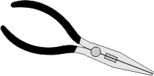


HELPFUL LINK http://www.technologystudent.com/elec1/stcomp2.htm
WORLD ASSOCIATION OF TECHNOLOGY TEACHERS https://www.facebook.com/groups/254963448192823/ www.technologystudent.com © 2017 V.Ryan © 2017
3a. Three basic tools for electronics are shown below. Name each tool and brieﬂy explain its function. 6 marks
ELECTRONICS TOOL
 | NAME: EXPLANATION:
 | NAME: EXPLANATION:
 | NAME: EXPLANATION:

Slide 9
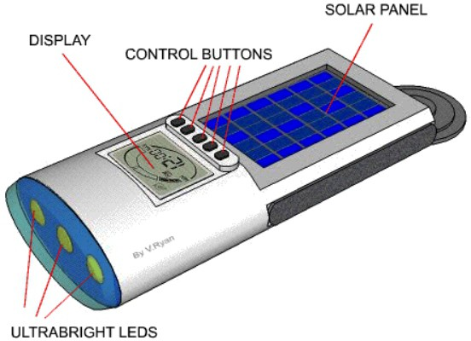
HELPFUL LINK http://www.technologystudent.com/enerﬂsh/soltor1.html
WORLD ASSOCIATION OF TECHNOLOGY TEACHERS https://www.facebook.com/groups/254963448192823/
3b. A SolarBright Torch is seen opposite. It has a solar panel that enable the batteries to recharge, from sunlight.
What is the function of the suction cup? 2 marks
www.technologystudent.com © 2017 V.Ryan © 2017
SUCTION CUP
HELPFUL LINK http://www.technologystudent.com/pdf14/ratios1.pdf Page 13
This question is about alternative energy.
3c. The total amount of renewable energy produced in 2016 was 90 Terawatt hours (Twh). The ratio of hydroelectricity compared to other renewable energy forms was 1:12. What amount of energy was produced through hydroelectricity ? 3 marks
HYDROELECTRICITY : OTHER RENEWABLE FORMS
1 : 12
EXPLANATION:

Slide 10
HELPFUL LINK http://www.technologystudent.com/energy1/solar7.htm
WORLD ASSOCIATION OF TECHNOLOGY TEACHERS https://www.facebook.com/groups/254963448192823/
www.technologystudent.com © 2017 V.Ryan © 2017
3d. Write two advantages of using Solar Power to produce electricity. 2 marks
3e. Write two disadvantages of using Solar Power to produce electricity.
2 marks
HELPFUL LINK http://www.technologystudent.com/enerﬂsh/foot1.html
3f. What is an individuals carbon footprint? 2 marks

Slide 11
PRODUCT INSERTS
Page 1

Slide 12
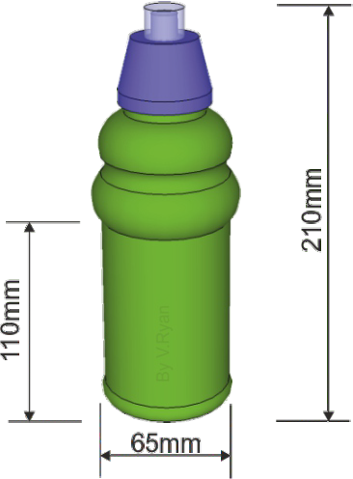
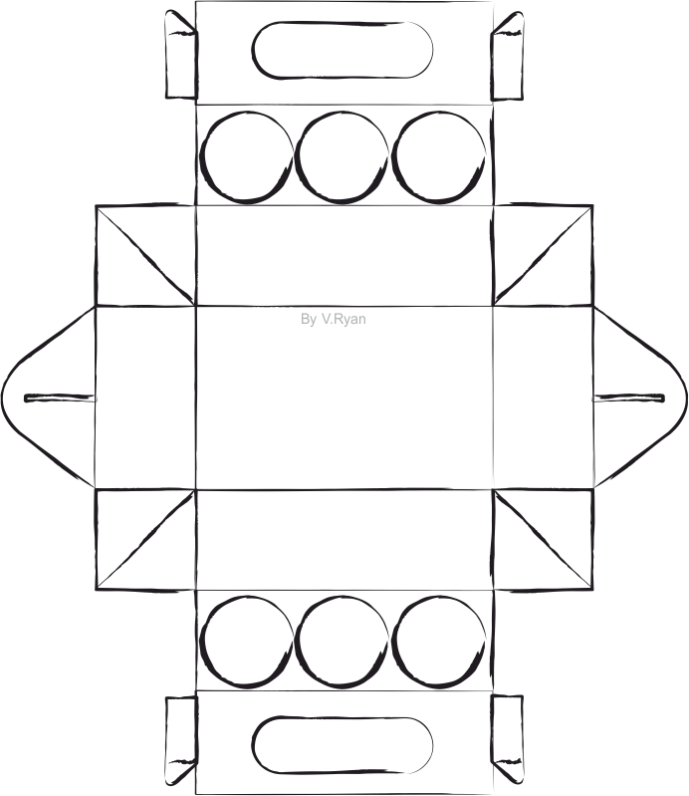
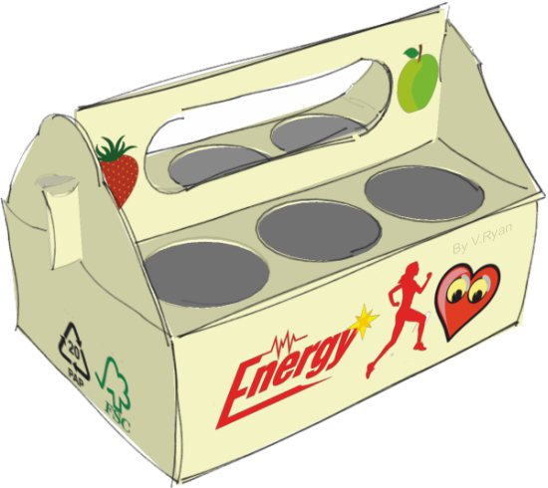
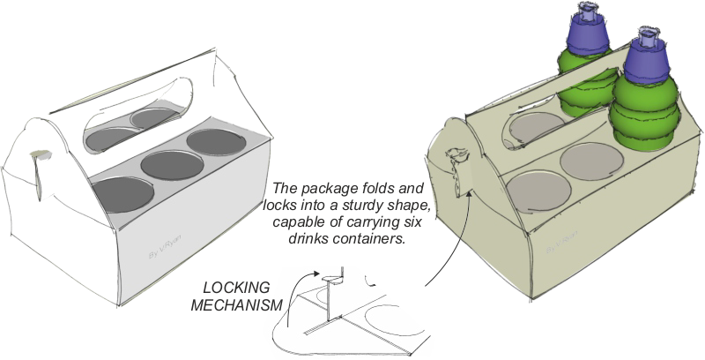
Page 2
WORLD ASSOCIATION OF TECHNOLOGY TEACHERS https://www.facebook.com/groups/254963448192823/
www.technologystudent.com © 2017 V.Ryan © 2017
Product 1 - Promotional Packaging for Six Drinks Container (Paper and Boards)
The promotional packaging is manufactured through mass production. It has been designed to be recycled and to be sturdy, capable of withstanding drops and knocks. It carries a maximum of six bottles.

Slide 13
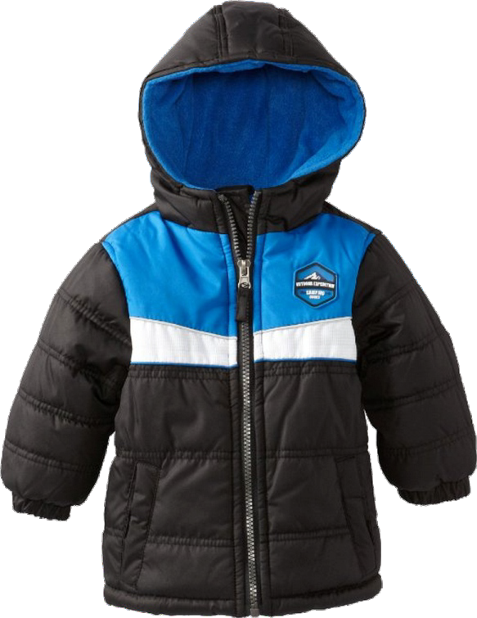

Page 3
Product 2 - TEXTILES - Children’s Coat
A classic insulated unisex children’s coat, for winter. The waist and cuﬀs are elasticated. An easy to use zip allows closing of the coat. Available in a range of sizes and colours. Suitable for everyday wear and ideal for the journey to school. An individual badge can be added, representing clubs and schools.

Slide 14
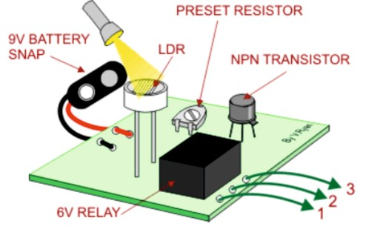
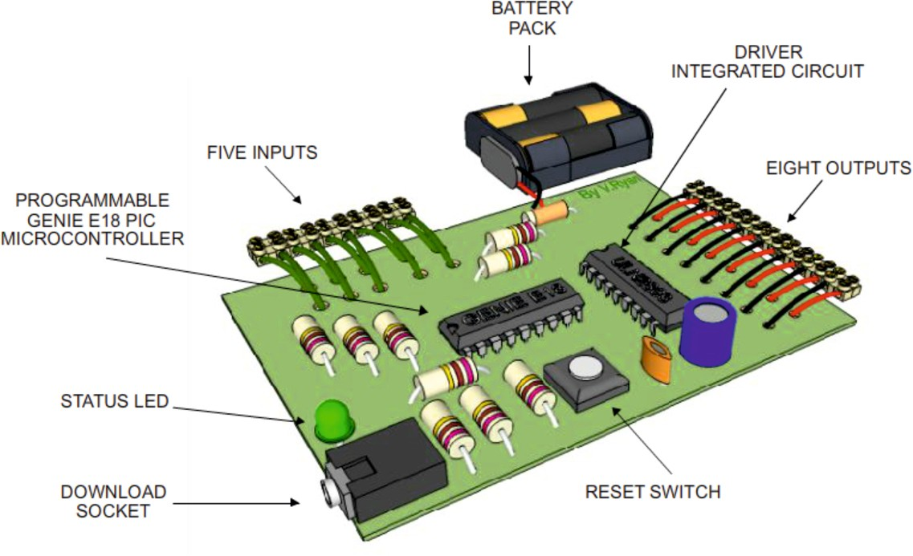
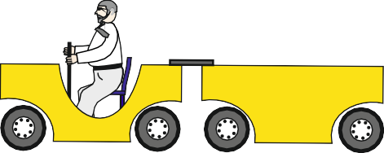


Page 4
Product 3 – Model Railway Barrier (Design Engineering)
PIC-MICROCONTROLLER
LIGHT / DARK SENSOR
RYAN RAIL SYSTEMS
LIGHT SENSOR
The model barrier is connected to a microcontroller, which has been programmed to monitor a light / dark sensor. It lowers the barrier when it detects a ‘train’ and lifts it when there is no train.
The barrier is manufactured from sheet aluminium.

Slide 15
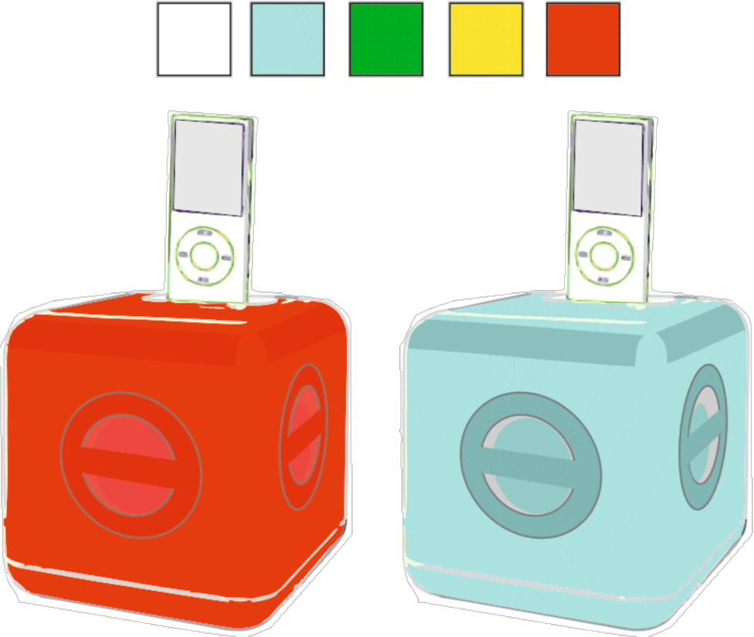
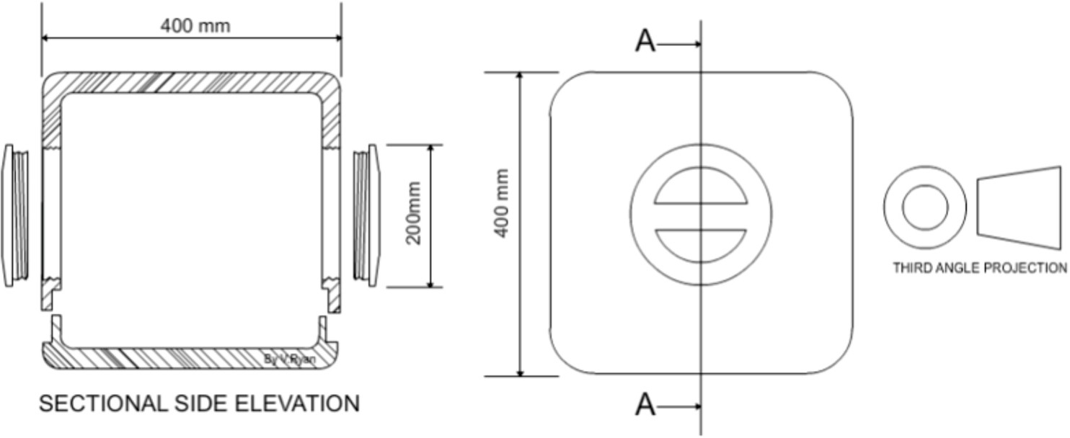
Page 5
WORLD ASSOCIATION OF TECHNOLOGY TEACHERS https://www.facebook.com/groups/254963448192823/
www.technologystudent.com © 2017
V.Ryan © 2017
Product 4 - MP3 Docking Station (polymers)
high density polythene casing, supplied in a variety of colours
The MP3 player is manufactured from high density polythene. It is supplied in a range of colours and can be plugged into the mains or powered by batteries. It has high quality speakers and is supplied with a remote control.

Slide 16
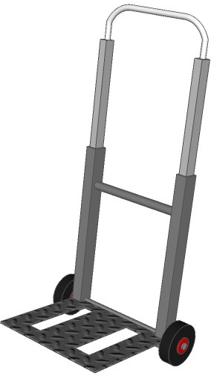
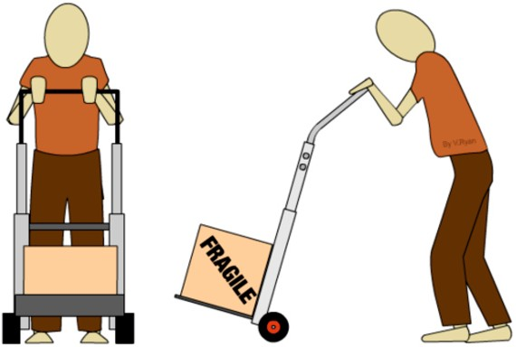


Page 6
WORLD ASSOCIATION OF TECHNOLOGY TEACHERS https://www.facebook.com/groups/254963448192823/
www.technologystudent.com © 2017
V.Ryan © 2017
Product 5 – Mobile Trolley System (metals)
HANDLE (STEEL)
SELF TAPPING SCREWS
(STEEL HANDLE TO ALUMINUM SIDE).
SIDE (ALUMINIUM)
STRENGTHENING PIECE (STEEL)
BRAZING
(STEEL STRENGTHENING PIECE TO STEEL SIDE).
SHELF (SHEET STEEL)
THREADED BOLTS (WHEELS TO TROLLEY
FRAME).
LOCK NUTS
STEEL BOLT
The trolley is lightweight and foldable. It can be transported and also stored. The is manufactured from steel and aluminium tube.
The product is designed to be completely recyclable, at the end of its life cycle.
It is ideal for use in shops and distribution / storage centres, as well as personal use at home.

Slide 17
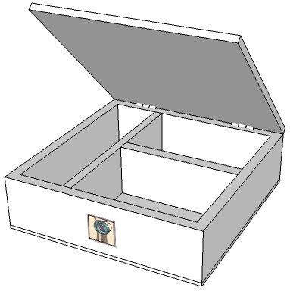
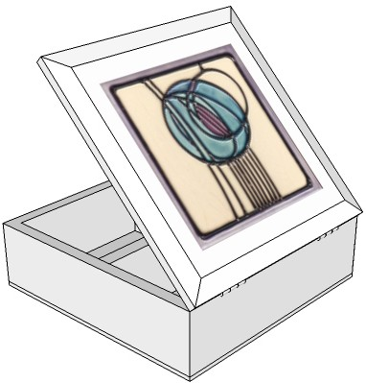
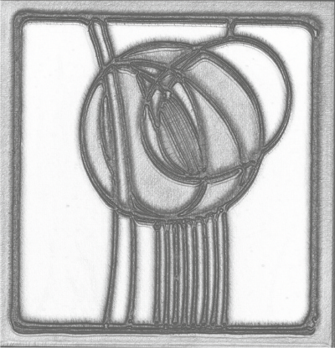
Page 7
WORLD ASSOCIATION OF TECHNOLOGY TEACHERS https://www.facebook.com/groups/254963448192823/
www.technologystudent.com © 2017 V.Ryan © 2017
Product 6 – Bits and Bobs Storage (timbers)
240mm
150mm
300mm
300mm
This storage box is available in a variety of natural woods. Traditional jointing methods have be used during its manufacture. It has a quality ﬁnish and can be locked for security. It is designed in a Charles Rennie Mackintosh style.

Slide 18
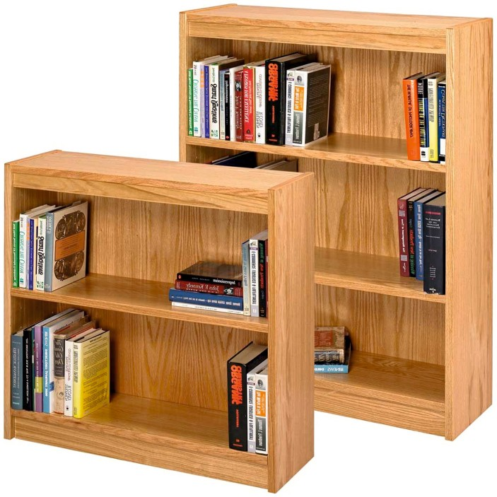
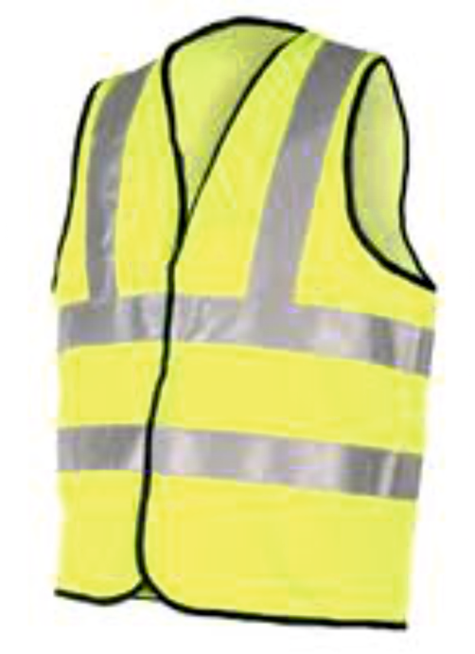
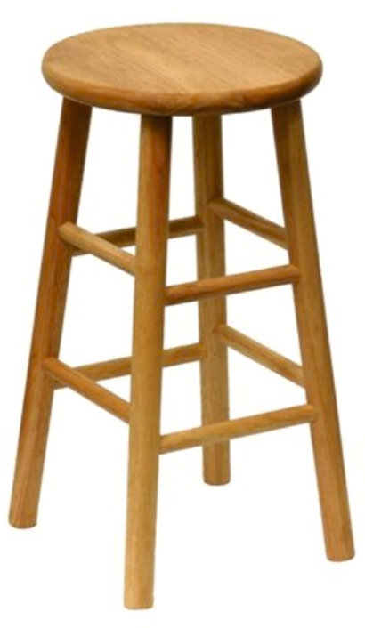
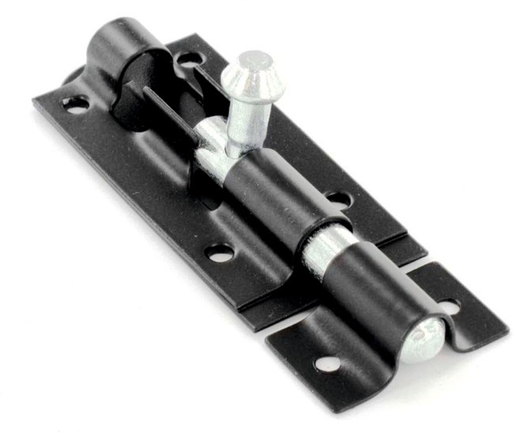
Page 8
Information on this page is required to answer Questions 4 and 5 (c).
IMAGE A
IMAGE C
IMAGE C
IMAGE D

Slide 19
SECTION B
Answer all the questions in this section
The inserts must be used to help you answer all the questions in Section B. These are products that you would ﬁnd in a department store, as a ﬁxture or as a product for sale.
4. Study page 8 of the insert Booklet.
WORLD ASSOCIATION OF TECHNOLOGY TEACHERS https://www.facebook.com/groups/254963448192823/
www.technologystudent.com © 2017 V.Ryan © 2017
HELPFUL LINK http://www.technologystudent.com/grp08/prnt1.html
4a. The books shown in Image A, are composed of pages printed through the process called ‘Direct Printing’.
Give two reasons why this printing process is suitable for this product. 2 marks
(I)
(ii)
4b. List one disadvantage of Direct Printing, as a printing process for small print runs.
1 mark
HELPFUL LINK http://www.technologystudent.com/joints/pet1.html
4c. Image B shows a luminous jacket manufactured from a synthetic material. Name a suitable synthetic material. 1 mark
(I)
Give two reasons why the material you have named is suitable. 2 marks
(ii)
(iii)

Slide 20
4d. Image C shows a typical bolt / latch for a garden gate.
HELPFUL LINK http://www.technologystudent.com/forcmom/motion2.html
Name the type of movement (motion) that is represented by the latch / bolt. 1 mark
(I)
Describe the movement / motion you have named.
1 mark
(ii)
WORLD ASSOCIATION OF TECHNOLOGY TEACHERS
https://www.facebook.com/groups/254963448192823/
www.technologystudent.com © 2017 V.Ryan © 2017
HELPFUL LINK http://www.technologystudent.com/rmﬂsh1/pine2.html
4e. Image D shows a stool manufactured from scots pine. Explain why pine is a suitable natural wood for this product. 2 marks

Slide 21
You will need to answer both questions 5 and 6, in relation to ONE product selected from below. Keep in mind that you have been studying a specialist area in detail, throughout the course.
It is important that you read questions 5 and 6 before selected the product.
Product 1 - Promotional Packaging for Six Drinks Container (Paper and Boards)
Product 2 - Children’s Coat (TEXTILES)
Product 3 – Model Railway Barrier (Design Engineering) Product 4 - MP3 Docking Station (polymers)
Product 5 – Mobile Trolley System (metals) Product 6 – Bits and Bobs Storage (timbers)
WORLD ASSOCIATION OF TECHNOLOGY TEACHERS https://www.facebook.com/groups/254963448192823/
www.technologystudent.com © 2017 V.Ryan © 2017
USEFUL LINKS FOR QUESTIONS 5 AND 6
Joining Materials
http://www.technologystudent.com/despro_ﬂsh/mats_join1.html
Wood Based Product
http://www.technologystudent.com/despro_3/trolmanf.html
Metal Based Product
http://www.technologystudent.com/despro_ﬂsh/mats_proj13.html
Polymer Based Product
http://www.technologystudent.com/despro_ﬂsh/mats_proj7.html
Design Engineering / Microcontrollers
http://www.technologystudent.com/pics/picdex1.htm
Finishes for Woods and Metals
http://www.technologystudent.com/despro_ﬂsh/mats_ﬁnish1.html
Manufacturing a Card Product by Hand http://www.technologystudent.com/despro2/develp4.htm Manufacturing a Card Product - Small Scale Production
http://www.technologystudent.com/despro2/devman1.htm
Manufacturing a Card Product - Die Cutting
http://www.technologystudent.com/despro2/devman2.htm
Printing Processes for Paper and Card
http://www.technologystudent.com/despro_ﬂsh/graphics_print1.html

Slide 22
Spend no more than 20 minutes on this question
WORLD ASSOCIATION OF TECHNOLOGY TEACHERS https://www.facebook.com/groups/254963448192823/
www.technologystudent.com © 2017 V.Ryan © 2017
5a. After a detailed design process, a ﬁnal product / design is manufactured. In the space below and on the next page, explain / describe how your chosen product is manufactured. Use sketches, labels and notes. 12 marks
Include the following details:
The manufacturing processes. Tools and equipment required. Quality and safety checks.
Finish(s) applied to the completed product.

Slide 24
HELPFUL LINK
http://www.technologystudent.com/prddes1/upcycling1.html
WORLD ASSOCIATION OF TECHNOLOGY TEACHERS
https://www.facebook.com/groups/254963448192823/
www.technologystudent.com © 2017 V.Ryan © 2017
5b. One environmental solution, to a product that reaches the end of its useful working life, is ‘Upcycling’
What is Upcycling? Include reference to how a product of your choice, could be upcyced through this system. 5 marks

Slide 25
HELPFUL LINKS
http://www.technologystudent.com/prddes_2/crowd1.html http://www.technologystudent.com/prddes_2/rev_crowd1.html
WORLD ASSOCIATION OF TECHNOLOGY TEACHERS
https://www.facebook.com/groups/254963448192823/
www.technologystudent.com © 2017 V.Ryan © 2017
5c. Some Product Design businesses are ‘cooperatives’. What is Cooperative?
6 marks

Slide 26
http://www.technologystudent.com/prddes1/advert1.html http://www.technologystudent.com/prddes1/advert2.html http://www.technologystudent.com/despro_ﬂsh/revise13.html http://www.technologystudent.com/prddes1/ict1.html
HELPFUL LINKS
WORLD ASSOCIATION OF TECHNOLOGY TEACHERS
https://www.facebook.com/groups/254963448192823/
www.technologystudent.com © 2017 V.Ryan © 2017
6. Considering the product you chose for question 5:
(a) Product promoting / advertising / marketing a product, can take many forms. Explain / describe one form of ‘advertising’ that you consider to be ideal, for promoting your selected product. Justify your chosen form of advertising / marketing / product promotion. 4 marks

Slide 27
HELPFUL LINK http://www.technologystudent.com/despro_ﬂsh/mats_smart1.html
WORLD ASSOCIATION OF TECHNOLOGY TEACHERS
https://www.facebook.com/groups/254963448192823/
www.technologystudent.com © 2017 V.Ryan © 2017
6b. Smart materials are in wide use, in the modern world around us.
Name a smart material, explain its properties and give practical examples of its use. Include sketches if required.
8 marks

