Slide 2
TO ANSWER ALL THE QUESTIONS YOU WILL NEED TO DOWNLOAD THE ‘JEWELLERY AND SILVERSMITHING -2’ APP, FROM THE INTERACTIVE MOBILE APP SECTION OF www.technologystudent.com

Slide 3
TO ANSWER ALL THE QUESTIONS YOU WILL NEED TO DOWNLOAD THE ‘JEWELLERY AND SILVERSMITHING -2’ APP, FROM THE INTERACTIVE MOBILE APP SECTION OF www.technologystudent.com

Slide 4
TO ANSWER ALL THE QUESTIONS YOU WILL NEED TO DOWNLOAD THE ‘JEWELLERY AND SILVERSMITHING -2’ APP, FROM THE INTERACTIVE MOBILE APP SECTION OF www.technologystudent.com

Slide 5
TO ANSWER ALL THE QUESTIONS YOU WILL NEED TO DOWNLOAD THE ‘JEWELLERY AND SILVERSMITHING -2’ APP, FROM THE INTERACTIVE MOBILE APP SECTION OF www.technologystudent.com

Slide 6
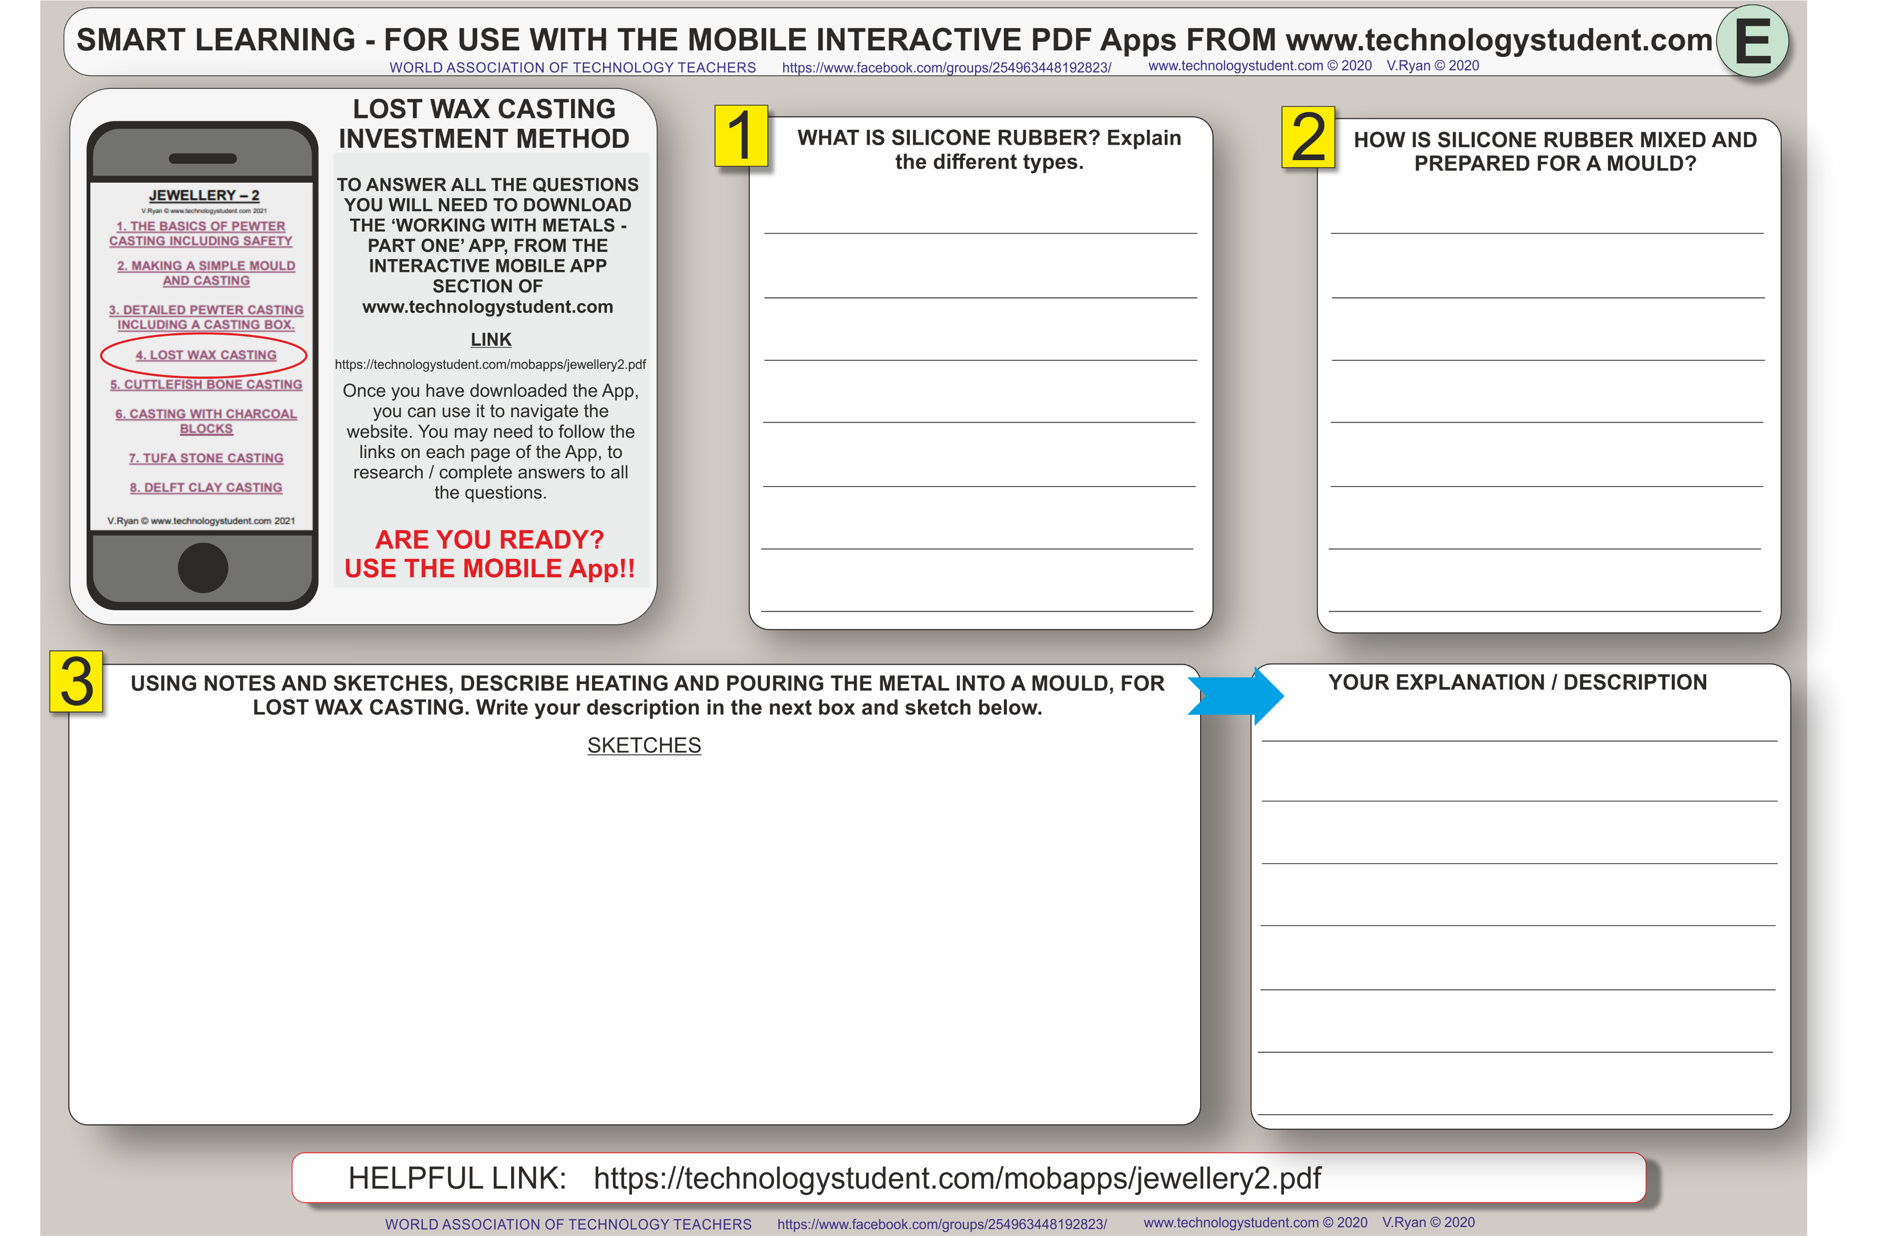
TO ANSWER ALL THE QUESTIONS YOU WILL NEED TO DOWNLOAD THE ‘JEWELLERY AND SILVERSMITHING -2’ APP, FROM THE INTERACTIVE MOBILE APP SECTION OF www.technologystudent.com

Slide 7
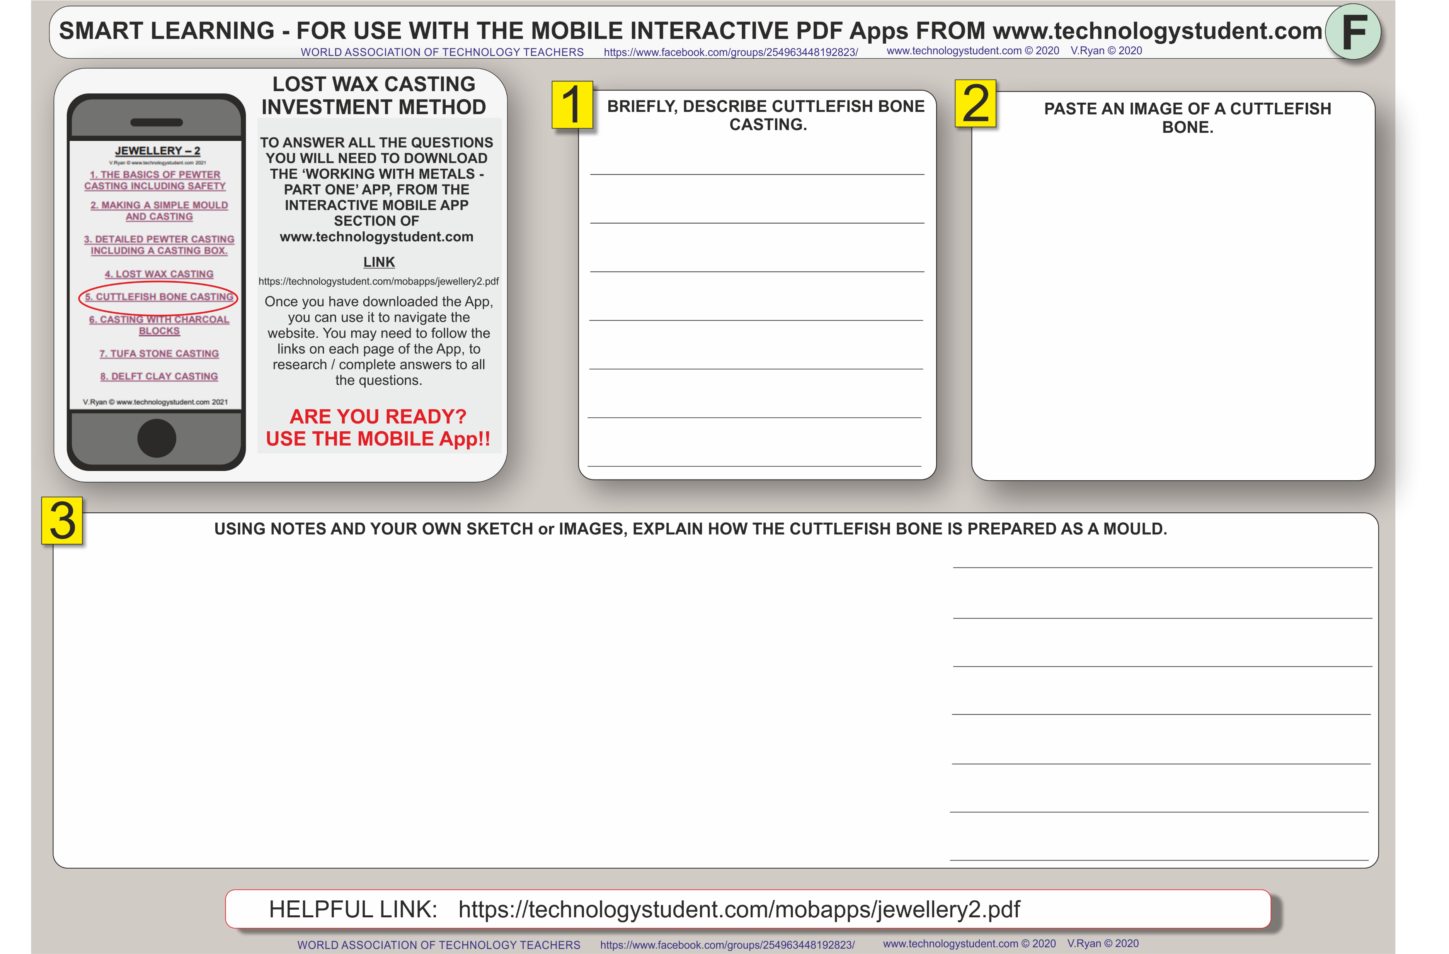
TO ANSWER ALL THE QUESTIONS YOU WILL NEED TO DOWNLOAD THE ‘JEWELLERY AND SILVERSMITHING -2’ APP, FROM THE INTERACTIVE MOBILE APP SECTION OF www.technologystudent.com

Slide 8
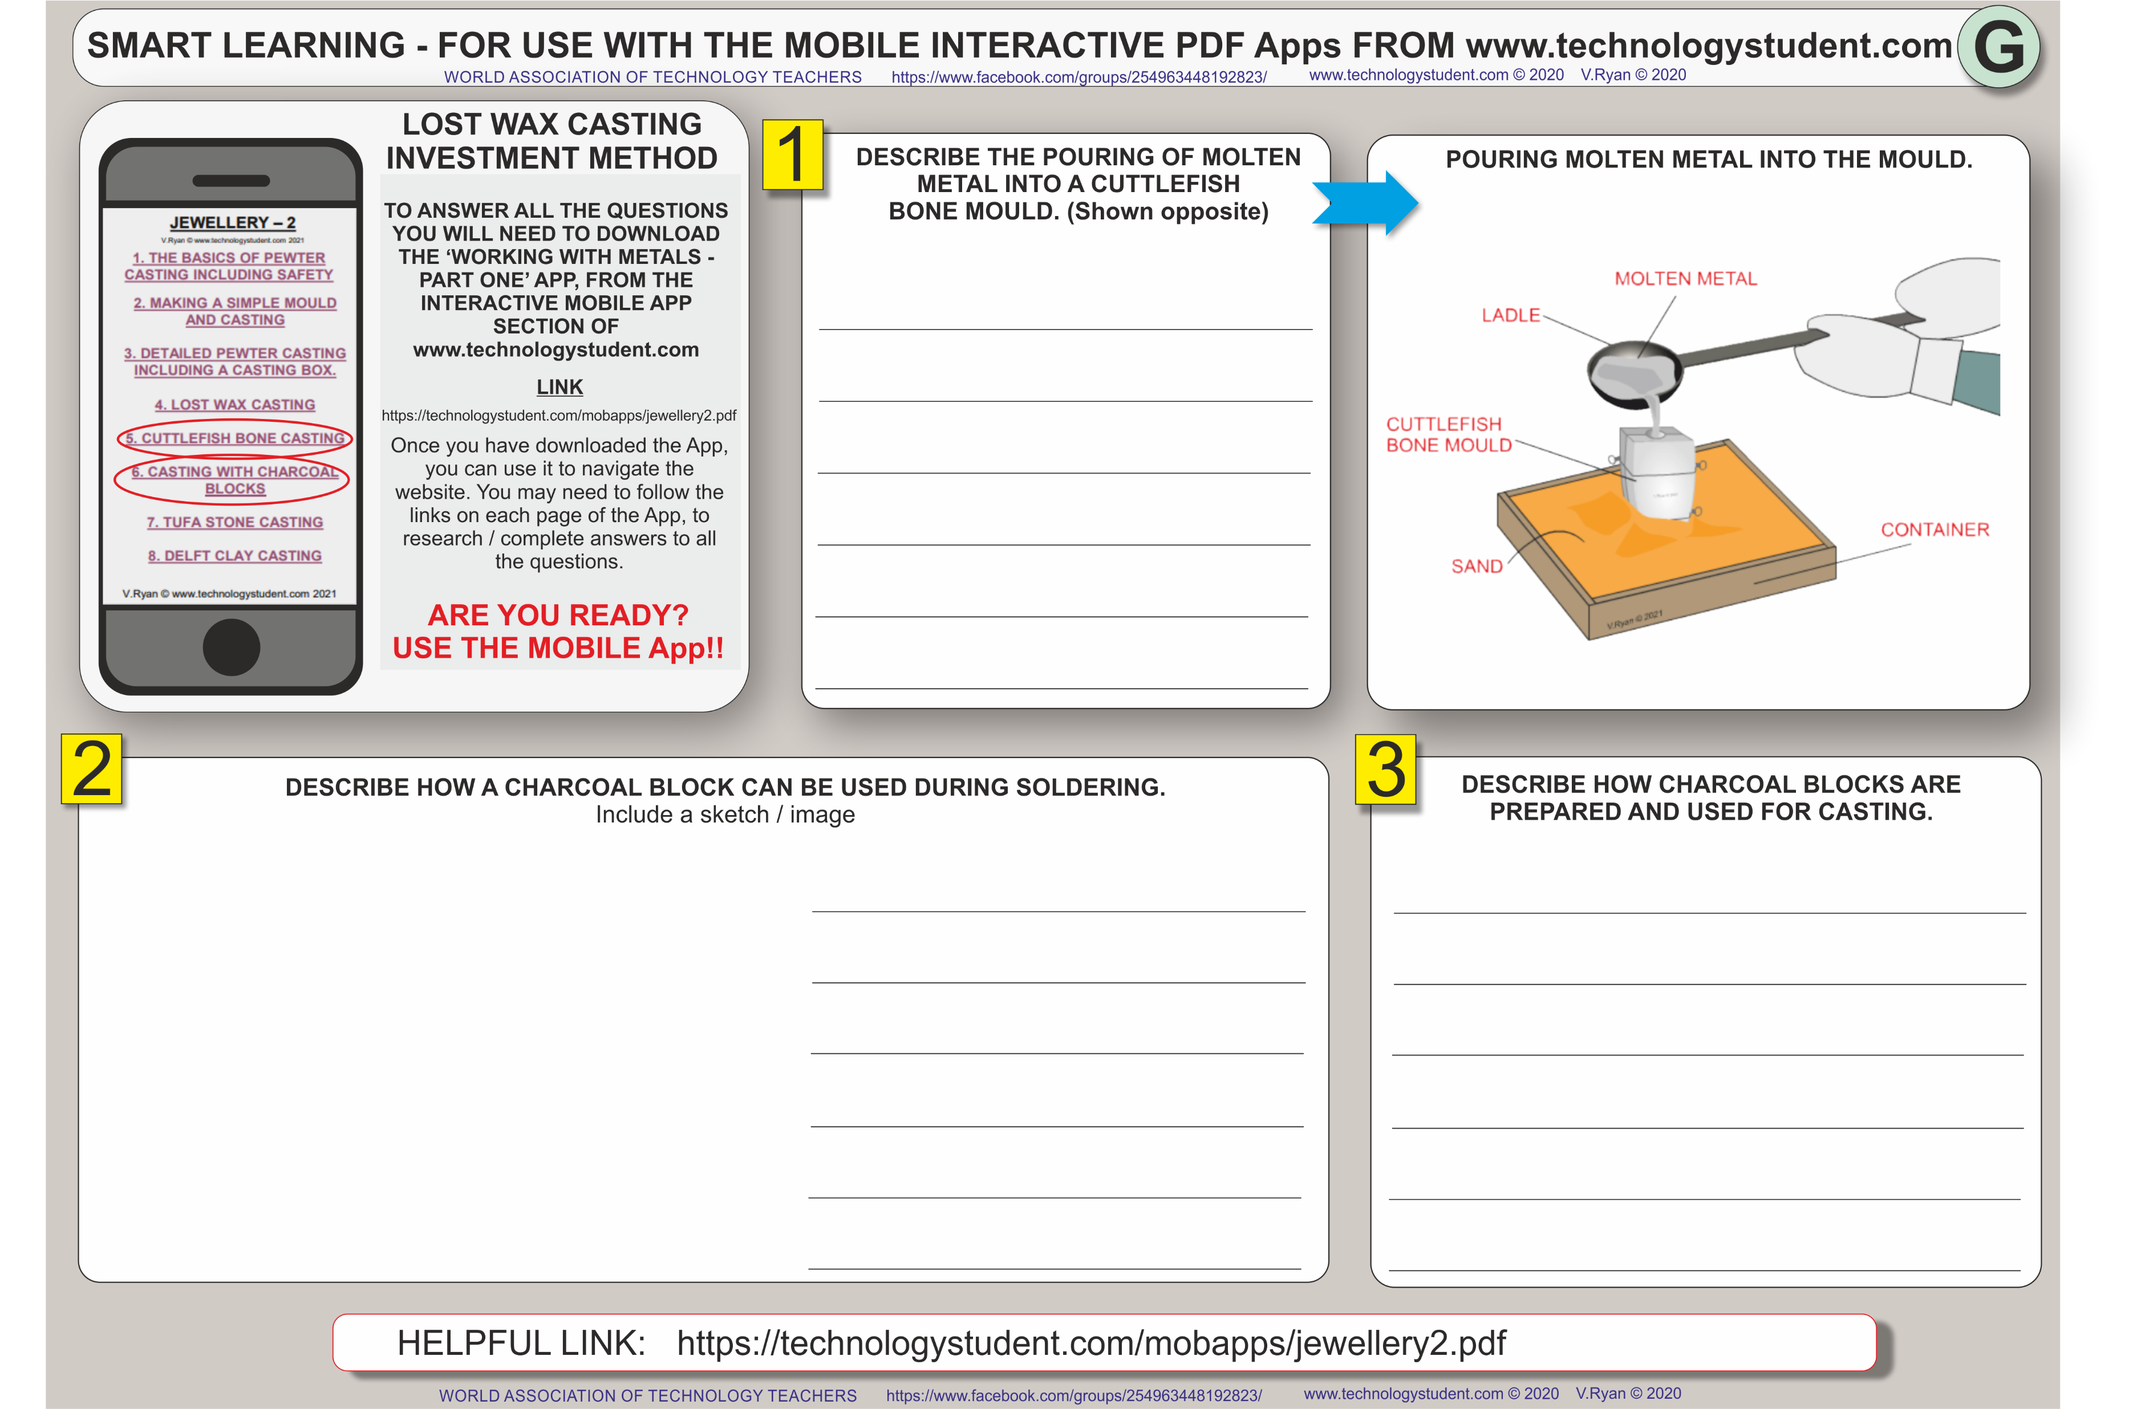
TO ANSWER ALL THE QUESTIONS YOU WILL NEED TO DOWNLOAD THE ‘JEWELLERY AND SILVERSMITHING -2’ APP, FROM THE INTERACTIVE MOBILE APP SECTION OF www.technologystudent.com

Slide 9
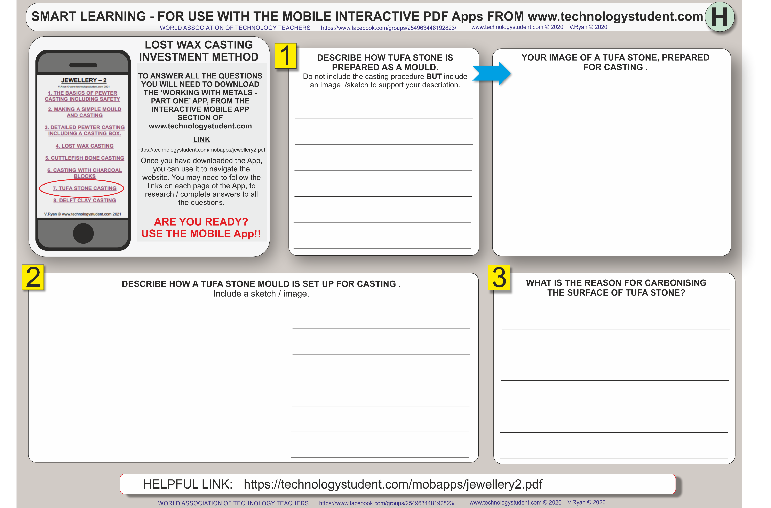
TO ANSWER ALL THE QUESTIONS YOU WILL NEED TO DOWNLOAD THE ‘JEWELLERY AND SILVERSMITHING -2’ APP, FROM THE INTERACTIVE MOBILE APP SECTION OF www.technologystudent.com

Slide 10
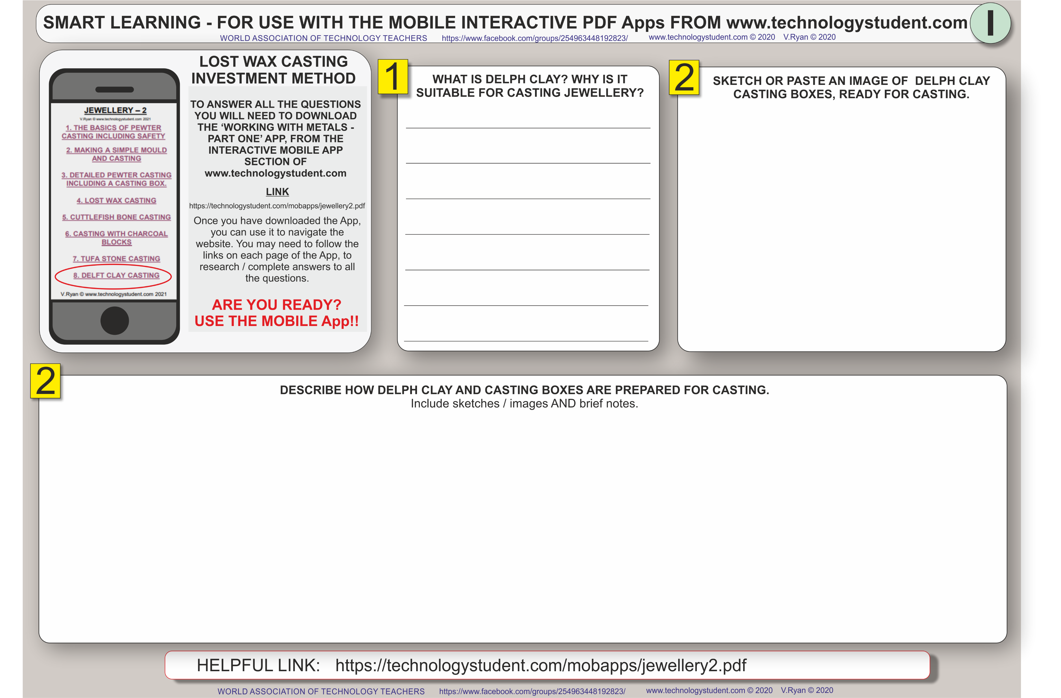
TO ANSWER ALL THE QUESTIONS YOU WILL NEED TO DOWNLOAD THE ‘JEWELLERY AND SILVERSMITHING -2’ APP, FROM THE INTERACTIVE MOBILE APP SECTION OF www.technologystudent.com

