Slide 1
DESIGN AND TECHNOLOGY
NAME: FORM/GROUP:
REVISION BOOKLET
https://www.fa1cebook.com/groups/254963448192823/
WORLD ASSOCIATION OF TECHNOLOGY TEACHERS
www.technologystudent.com © 2017 V.Ryan © 2017
SMART MATERIALS AND MODERN MATERIALS
General Questions on a selection of smart materials Shape Memory Alloys (SMA) and Muscle Wire Modern Material - Polymorph
WORLD ASSOCIATION OF TECHNOLOGY TEACHERS https://www.facebook.com/groups/254963448192823/
www.technologystudent.com © 2017 V.Ryan © 2017
SUITABLE REVISION MATERIAL FOR:
PRODUCT DESIGN RESISTANT MATERIALS GRAPHIC PRODUCTS DESIGN AND TECHNOLOGY
This examination booklet can be duplicated and printed out if required but not edited in any way.
The links to www.technologystudent.com cannot be removed.
The PDF ﬁle can be stored on school / college systems and distributed electronically (NO EDITING ALLOWED)
PLEASE RESPECT THE COPYRIGHT - report infringers to techteacher@technologystudent.com Not be distributed at courses or by course instructors / consultants
WORLD ASSOCIATION OF TECHNOLOGY TEACHERS https://www.facebook.com/groups/254963448192823/
www.technologystudent.com © 2017 V.Ryan © 2017

Slide 2
SMART MATERIALS
WORLD ASSOCIATION OF TECHNOLOGY TEACHERS https://www.facebook.com/groups/254963448192823/
www.technologystudent.com © 2017
V.Ryan © 2017
LINK TO HELP AND INFORMATION
https://www.technologystudent.com/joints/smarty1.html
1. Explain what is meant by the term ‘smart material’.
3 marks
2. Name a smart material and name / describe a product in which it is used.
SMART MATERIAL:
PRODUCT / DESCRIPTION:
3. Explain why the smart material you named is used in the product.

Slide 3
LINK TO HELP AND INFORMATION https://www.technologystudent.com/joints/smarty1.html
4. Describe / explain the following smart materials: 6 x 3 marks (total 18 marks)
HYDROCHROMIC INKS:
WORLD ASSOCIATION OF TECHNOLOGY TEACHERS https://www.facebook.com/groups/254963448192823/
www.technologystudent.com © 2017
V.Ryan © 2017
POLYMORTH:
SHAPE MEMORY ALLOYS (SMA):
HYDROMORPHIC POLYMERS:
HYDROCARBON ENCAPSULATING POLYMERS:
AROMA PIGMENTS:

Slide 4
SMART MATERIALS - SHAPE MEMORY ALLOY (SMA)
WORLD ASSOCIATION OF TECHNOLOGY TEACHERS https://www.facebook.com/groups/254963448192823/
www.technologystudent.com © 2017 V.Ryan © 2017
LINK TO HELP AND INFORMATION https://www.technologystudent.com/equip1/sma1.htm
5a. Complete the following paragraphs about SMA, by adding the missing words, in the correct places. The words listed at the bottom of the page will help you answer this question. 11 marks
SMA wire is sometimes called ‘ ’, as it is a composed of and . On first site this special wire looks like ordinary wire and even has many of the same properties. It can be to form complex shapes quite easily and it electricity. However, it is very expensive when compared to ordinary steel or even copper wire. However, it has properties that make it very special:
The wire has a - for example, if it is folded to form a shape and then heated above (centigrade) it returns to its shape.
The material can also be ‘ ’ to remember a shape. This can be achieved by folding the wire to a particular shape and clamping it in position. The wire is then heated for a approximately at precisely 150 degrees or pass an electric current through the wire. If the wire is now folded into another shape and then placed in hot water it returns to the original ‘programmed’ shape.
conducts memory
original
Nitinol
nickel
programmed 90 degrees
titanium folded
five minutes SMA

Slide 5
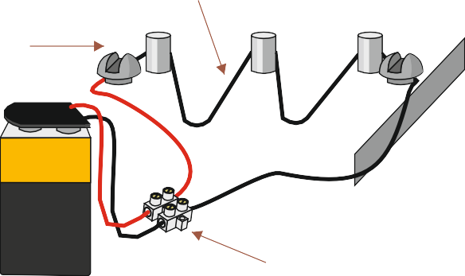



LINK TO HELP AND INFORMATION https://www.technologystudent.com/equip1/sma1.htm
WORLD ASSOCIATION OF TECHNOLOGY TEACHERS https://www.facebook.com/groups/254963448192823/
www.technologystudent.com © 2017 V.Ryan © 2017
5b. Below are diagrams that represent programming the shape of SMA wire and returning it to its original shape. Add notes under each diagram to help explain each stage. 3 x 4 marks (total 12 marks)
1. 2.
SMA WIRE
STEEL JIG BATTERY
+
BATTERY CONNECTOR
3.
4.

Slide 6
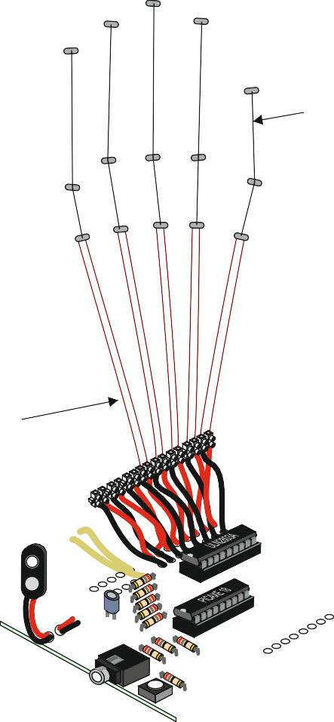
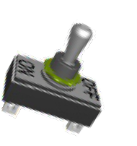

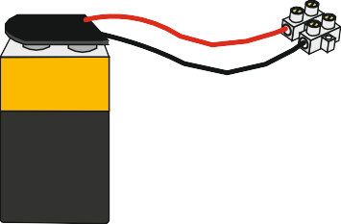


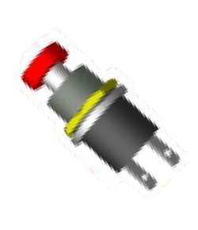
PRACTICAL USES OF MUSCLE WIRE
LINK TO HELP AND INFORMATION https://www.technologystudent.com/equip1/sma2.htm
Two practical uses of ‘muscle wire’ are shown below. Diagram ‘A’ shows a programmable circuit controlling the movement of an artificial hand, used in a shop display. As the wire expands and contracts the fingers move. Diagram ‘B’ shows muscle wire controlling a model railway signal. As the wire expands and contracts the signal moves up and down.
DIA. A
DIA. B
TOGGLE SWITCH
ORDINARY WIRE
+
CONNECTOR
_{BATTERY} MUSCLE WIRE
FIXED POINT
MUSCLE WIRE
QUESTION
5c. In the space below design an another way in which muscle wire could be used. Draw a diagram and add notes to explain your idea. 8 marks
WORLD ASSOCIATION OF TECHNOLOGY TEACHERS
https://www.facebook.com/groups/254963448192823/
www.technologystudent.com © 2017 V.Ryan © 2017
IDEA
NOTES

Slide 7
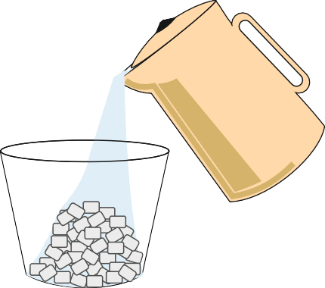
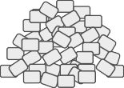
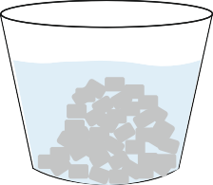
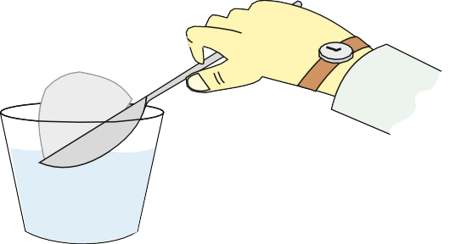
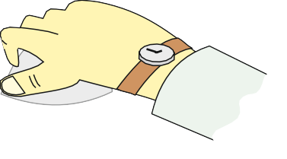
MODERN MATERIAL - POLYMORPH
WORLD ASSOCIATION OF TECHNOLOGY TEACHERS https://www.facebook.com/groups/254963448192823/
www.technologystudent.com © 2017 V.Ryan © 2017
LINK TO HELP AND INFORMATION https://www.technologystudent.com/equip1/poly1.htm
6a. Polymorph is a thermoplastic material that can be shaped and reshaped any number of times. Below are diagrams representing the stages involved in moulding the material. Add notes below each stage to help explain each process. 4 X 6 marks (total 24 marks)
NOTE !!! POLYMORPH IS NOW CLASSIFIED AS A MODERN MATERIAL
1. 2.
POLYMORPH GRANULES
ADD HOT WATER
3.
4.
GRANULES SLOWLY JOIN TOGETHER
MASS OF POLYMORPH
5.
6.
n
a
y
R
.
V
y
B
n
a
y
R
.
V
y
MOULD POLYMORPH GRANULES
B
REMOVE POLYMORPH
WORLD ASSOCIATION OF TECHNOLOGY TEACHERS
https://www.facebook.com/groups/254963448192823/
www.technologystudent.com © 2017
V.Ryan © 2017

Slide 8
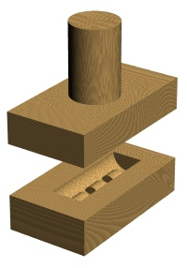
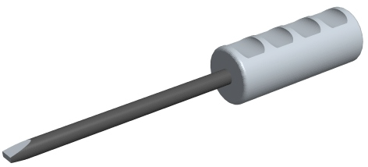
MODERN MATERIAL - POLYMORPH
LINK TO HELP AND INFORMATION https://www.technologystudent.com/equip1/sma2.htm
6b. Below are a set of incomplete diagrams representing the way polymorph can be shaped using a mould to form a screwdriver handle. Add diagrams to stage 2,3,4 and 5. Include explanatory notes underneath each stage. 4 x 5 marks (total 20 marks)
1.
2.
PREPARE MOULD ON CNC MACHINE
3.
4.
5.
6.
ADD SCREWDRIVER BLADE FOR REALISM
WORLD ASSOCIATION OF TECHNOLOGY TEACHERS
https://www.facebook.com/groups/254963448192823/
www.technologystudent.com © 2017 V.Ryan © 2017

