Slide 1
DESIGN AND TECHNOLOGY
NAME: FORM/GROUP:
REVISION BOOKLET
https://www.fa3cebook.com/groups/254963448192823/
WORLD ASSOCIATION OF TECHNOLOGY TEACHERS
www.technologystudent.com © 2017 V.Ryan © 2017
SMART MATERIALS AND MODERN MATERIALS
AROMA PIGMENTS PHOSPHORESCENT PIGMENT
METAL FOAMS AND THEIR PRACTICAL APPLICATION
FLEXI PLY ( A FLEXIBLE FORM OF PLYWOOD
WORLD ASSOCIATION OF TECHNOLOGY TEACHERS https://www.facebook.com/groups/254963448192823/
www.technologystudent.com © 2017 V.Ryan © 2017
SUITABLE REVISION MATERIAL FOR:
PRODUCT DESIGN RESISTANT MATERIALS GRAPHIC PRODUCTS DESIGN AND TECHNOLOGY
This examination booklet can be duplicated and printed out if required but not edited in any way.
The links to www.technologystudent.com cannot be removed.
The PDF ﬁle can be stored on school / college systems and distributed electronically (NO EDITING ALLOWED)
PLEASE RESPECT THE COPYRIGHT - report infringers to techteacher@technologystudent.com Not be distributed at courses or by course instructors / consultants
WORLD ASSOCIATION OF TECHNOLOGY TEACHERS https://www.facebook.com/groups/254963448192823/
www.technologystudent.com © 2017 V.Ryan © 2017

Slide 2
AROMA PIGMENTS
https://www.facebook.com/groups/254963448192823/
WORLD ASSOCIATION OF TECHNOLOGY TEACHERS
www.technologystudent.com © 2017 V.Ryan © 2017
LINK TO HELP AND INFORMATION https://www.technologystudent.com/joints/aroma1.html
1a. What are Aroma Pigments? 3 marks
1b. How do aroma stickers work? (You should mention micro-spheres in your answer).
3 marks
1c. Describe a practical application of an aroma pigmented sticker. Include a diagram to explain the practical application. 3 marks sketch(s) 3 marks notes

Slide 3
AROMA PIGMENTS - CONTINUED
WORLD ASSOCIATION OF TECHNOLOGY TEACHERS https://www.facebook.com/groups/254963448192823/
www.technologystudent.com © 2017 V.Ryan © 2017
LINK TO HELP AND INFORMATION https://www.technologystudent.com/joints/aroma1.html
2a. Briefly describe two other ways in which aroma pigments can be used. 2x 2 marks
A.
B.
2b. How could aroma pigments be used in a practical situation outdoors?( Not inside or in an enclosed area). Use a diagram(s) and notes to explain your practical application of aroma pigments. This should be a new practical application. 4 marks sketch(s) 4 marks notes
SKETCH(S)
NOTES

Slide 4
SMART MATERIALS - PHOSPHORESCENT PIGMENT - QUESTIONS
WORLD ASSOCIATION OF TECHNOLOGY TEACHERS https://www.facebook.com/groups/254963448192823/
www.technologystudent.com © 2017 V.Ryan © 2017
LINK TO HELP AND INFORMATION https://www.technologystudent.com/joints_ﬂsh/phosphor1.html
3a. What is phosphorescence? Include a description of a practical example / application in your answer. 5 marks
3b. What are phosphorescent pigments made from ?
3 marks
3c. The sports watch shown opposite contains phosphorescent pigment. How will this eﬀect the product? 2 marks
9:15
3 d . T h e s a f e t y s i g n s s h o w n o p p o s i t e a r e phosphorescent. Why is this an important feature?
2 marks
FIRE EXTINGUISHER
EXIT

Slide 5
METAL FOAMS AND THEIR PRACTICAL APPLICATION
WORLD ASSOCIATION OF TECHNOLOGY TEACHERS https://www.facebook.com/groups/254963448192823/
www.technologystudent.com © 2017 V.Ryan © 2017
LINK TO HELP AND INFORMATION https//www.technologystudent.com/joints_ﬂsh/metalfoam1.html
4a. What is the structure of a metal foam? Use notes and a diagram / sketch in your answer. 6 marks
NOTES SKETCH
4b. Brieﬂy, Describe / explain the physical properties of metal foams. 4 marks
4c. Describe two practical applications of metal foams. Use notes and sketches.
2 x 3 marks
NOTES: SKETCHES

Slide 6
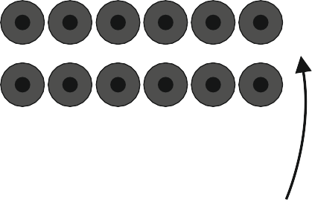
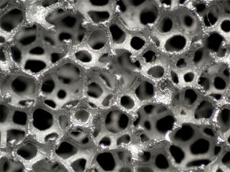
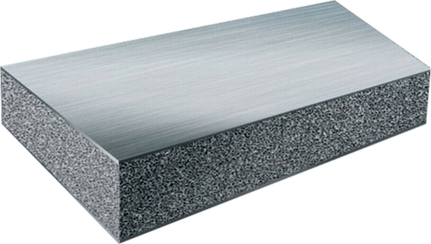
METAL FOAMS AND THEIR PRACTICAL APPLICATION
WORLD ASSOCIATION OF TECHNOLOGY TEACHERS https://www.facebook.com/groups/254963448192823/
www.technologystudent.com © 2017 V.Ryan © 2017
LINK TO HELP AND INFORMATION https://www.technologystudent.com/joints_ﬂsh/metalfoam2.html
5. Complete the explanatory notes, diagram a d labels, showing the manufacture of Aluminium Metal Foam. 14 marks
PRIMARY TANK
SECONDARY ROLLERS TANK
ROLLERS COMPRESS METAL FOAM TO A UNIFORM THICKNESS
GAS GAS GAS
GAS INPUT

Slide 7
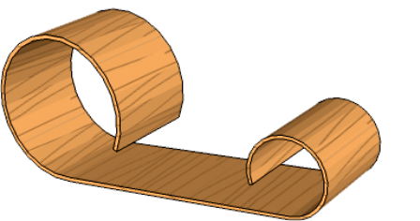
FLEXI PLY ( A FLEXIBLE FORM OF PLYWOOD)
WORLD ASSOCIATION OF TECHNOLOGY TEACHERS https://www.facebook.com/groups/254963448192823/
www.technologystudent.com © 2017 V.Ryan © 2017
LINK TO HELP AND INFORMATION
https://www.technologystudent.com/despro_ﬂsh/ﬂexply1.html
6a. Describe the main advantage of ﬂexi ply, over other forms of manmade boards? Use notes and sketches in your answer. 3 marks notes 3 marks sketche(s)
6b. Describe how the permanent form/shape seen opposite, could be manufactured from several layers of ﬂexi ply. Use labelled sketches and notes.
3 marks notes 3 marks sketch(s)
6c. Using the Internet, collect four images of pieces of furniture, manufactured from ﬂex ply. For each piece of furniture, write your thoughts on the design. 2 x 4 marks

