Slide 1
DESIGN AND TECHNOLOGY
NAME: FORM/GROUP
REVISION BOOKLET
https://www.fa9cebook.com/groups/254963448192823/
WORLD ASSOCIATION OF TECHNOLOGY TEACHERS
www.technologystudent.com © 2018 V.Ryan © 2018
THE ENVIRONMENT - BOOKLET 1
RECYCLING - UPCYCLING RECYCLING - DOWNCYCLING CLOSES LOOP RECYCLING ENVIRONMENTAL MODERNISM
WORLD ASSOCIATION OF TECHNOLOGY TEACHERS https://www.facebook.com/groups/254963448192823/
www.technologystudent.com © 2018 V.Ryan © 2018
SUITABLE REVISION MATERIAL FOR:
DESIGN AND TECHNOLOGY PRODUCT DESIGN RESISTANT MATERIALS GRAPHIC PRODUCTS
This examination booklet can be duplicated and printed out if required but not edited in any way.
The links to www.technologystudent.com cannot be removed.
The PDF ﬁle can be stored on school / college systems and distributed electronically (NO EDITING ALLOWED)
PLEASE RESPECT THE COPYRIGHT - report infringers to techteacher@technologystudent.com Not be distributed at courses or by course instructors / consultants
WORLD ASSOCIATION OF TECHNOLOGY TEACHERS https://www.facebook.com/groups/254963448192823/
www.technologystudent.com © 2018 V.Ryan © 2018

Slide 2
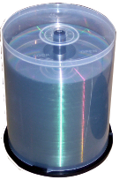
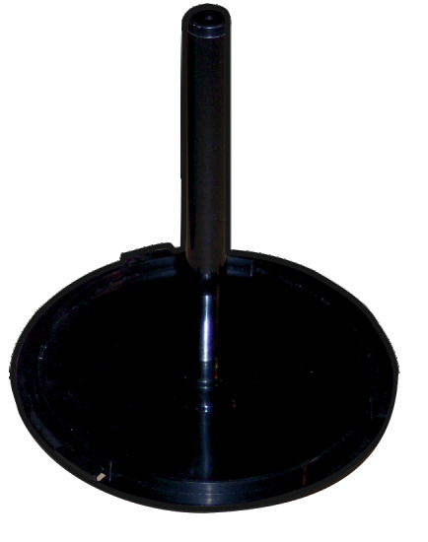
RECYCLING - UPCYCLING
WORLD ASSOCIATION OF TECHNOLOGY TEACHERS https://www.facebook.com/groups/254963448192823/
www.technologystudent.com © 2018 V.Ryan © 2018
LINK TO HELP AND INFORMATION https://www.technologystudent.com/prddes1/upcycling1.html
1. Sketch an ‘upcycling’ symbol, in the space below. 3 marks
2. What is ‘upcycling’? In your answer, explain how it diﬀers from normal recycling.
4 marks
3. Blank DVDs or CDs are purchased as ‘stacks of 50 or 100. They are stacked in a container composed of two parts (see below). Both parts are manufactured from polypropylene (PP). Quite often when the DVD / CDs are all used, the container is simply thrown away.
How could one of the parts be upcycled into a new high quality product? Use the space on the following page, for your sketches and notes.
PART A
PART B

Slide 3
RECYCLING - UPCYCLING
WORLD ASSOCIATION OF TECHNOLOGY TEACHERS https://www.facebook.com/groups/254963448192823/
www.technologystudent.com © 2018 V.Ryan © 2018
LINK TO HELP AND INFORMATION https://www.technologystudent.com/prddes1/upcycling1.html
QUESTION 3

Slide 4
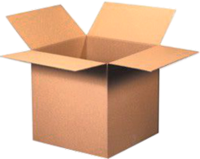
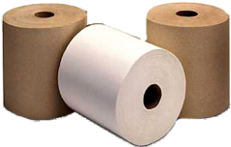
RECYCLING - DOWNCYCLING
WORLD ASSOCIATION OF TECHNOLOGY TEACHERS https://www.facebook.com/groups/254963448192823/
www.technologystudent.com © 2018 V.Ryan © 2018
LINK TO HELP AND INFORMATION https://www.technologystudent.com/prddes1/downcyc1.html
4. Sketch a ‘downcycling’ symbol, in the space below. 3 marks
5. What is ‘downcycling’? In your answer, explain how it diﬀers from upcycling.
4 marks
6.Describe the ‘downcycling’ journey of quality white paper. The sketches below will help you with your descriptive notes. 6 marks

Slide 5
CLOSED LOOP RECYCLING
WORLD ASSOCIATION OF TECHNOLOGY TEACHERS https://www.facebook.com/groups/254963448192823/
www.technologystudent.com © 2018 V.Ryan © 2018
LINK TO HELP AND INFORMATION https://www.technologystudent.com/prddes1/closeloop1.html
7. Before the 1990s, when a product came to the end of its useful life time, what happened to it ? 2 marks
8. Why should discarded products, not be ‘dumped’ in a landﬁll ? 2 marks
9. How do you contribute to recycling ? 2 marks
10. What is Closed Loop Recycling ? 4 marks

Slide 6
CLOSED LOOP RECYCLING
WORLD ASSOCIATION OF TECHNOLOGY TEACHERS https://www.facebook.com/groups/254963448192823/
www.technologystudent.com © 2018 V.Ryan © 2018
LINK TO HELP AND INFORMATION
https://www.technologystudent.com/prddes1/closeloop1.html
11. Name a material that can be ‘closed loop’ recycled. 1 mark
12. With reference to the material you named above, why is it suitable for closed loop recycling? 4 marks

Slide 7
CLOSED LOOP RECYCLING
WORLD ASSOCIATION OF TECHNOLOGY TEACHERS https://www.facebook.com/groups/254963448192823/
www.technologystudent.com © 2018 V.Ryan © 2018
LINK TO HELP AND INFORMATION
https://www.technologystudent.com/prddes1/closeloop2.html
13. In the space below, name and describe a product that is ideal for closed loop recycling. Then describe the manufacturing and recycling process, from the raw material to product manufacture, collection and reprocessing. Include notes and/or annotated sketches.
8 marks

Slide 8
ENVIRONMENTAL MODERNISM
WORLD ASSOCIATION OF TECHNOLOGY TEACHERS https://www.facebook.com/groups/254963448192823/
www.technologystudent.com © 2018
V.Ryan © 2018
LINK TO HELP AND INFORMATION
https://www.technologystudent.com/prddes1/envirmod1.html
14. What is Environmental Modernism ? 2 marks
15. How do Environmentalists and Environmental Modernists, diﬀer in their approach to environmental issues? Make reference to energy production in your answer.
6 marks

