Slide 1

WORLD ASSOCIATION OF TECHNOLOGY TEACHERS https://www.facebook.com/groups/254963448192823/
www.technologystudent.com © 2018 V.Ryan © 2018
NAME: FORM/GROUP:
NATURAL WOODS
1
WORLD ASSOCIATION OF TECHNOLOGY TEACHERS https://www.facebook.com/groups/254963448192823/
www.technologystudent.com © 2018 V.Ryan © 2018
NATURAL WOODS
WORLD DISTRIBUTION OF NATURAL WOODS
THE PREPARATION OF TIMBER - INCLUDING SEASONING THE INITIAL COMMERCIAL PREPARATION OF NATURAL WOOD
STOCK FORMS
WORLD ASSOCIATION OF TECHNOLOGY TEACHERS https://www.facebook.com/groups/254963448192823/
www.technologystudent.com © 2018 V.Ryan © 2018
This booklet can be duplicated and printed. Individual pages can be removed if they are not required.
Editing of text / images is NOT allowed.
The links to www.technologystudent.com cannot be removed.
The PDF ﬁle can be stored on school / college systems and distributed electronically (NO EDITING ALLOWED)
PLEASE RESPECT THE COPYRIGHT - report infringers to techteacher@technologystudent.com
WORLD ASSOCIATION OF TECHNOLOGY TEACHERS https://www.facebook.com/groups/254963448192823/
www.technologystudent.com © 2017 V.Ryan © 2017

Slide 2
RECORD SHEET
WORLD ASSOCIATION OF TECHNOLOGY TEACHERS https://www.facebook.com/groups/254963448192823/
www.technologystudent.com © 2018 V.Ryan © 2018
Record the completion date of each worksheet.
Use the web links on each of the sheets, for information and guidance.
EQUIPMENT / TOOL | DATE
WORLD DISTRIBUTION OF NATURAL WOODS - 1
WORLD DISTRIBUTION OF NATURAL WOODS - 2
SUMMARY - RAW MATERIALS - PROCESSING ....
PREPARATION OF TIMBER
AIR SEASONING
KILN SEASONING
STOCK FORMS - WOODS
VENEER

Slide 3
WORLD DISTRIBUTION OF NATURAL WOODS
WORLD ASSOCIATION OF TECHNOLOGY TEACHERS https://www.facebook.com/groups/254963448192823/
www.technologystudent.com © 2018 V.Ryan © 2018
USEFUL LINK
https://www.technologystudent.com/joints/forests1.html
1. Why the forests and woodlands of the world regarded as a precious natural resource?
As part of your answer you may wish to include a description of some of the products we use that are manufactured from natural wood.
2. What percentage of the worlds surface is covered by Tropical Rainforests?
3. List four woods found in the Tropical Rainforests. For each wood, name a product that is manufactured from it. You may need to research using the Internet.
WORLD ASSOCIATION OF TECHNOLOGY TEACHERS https://www.facebook.com/groups/254963448192823/ www.technologystudent.com © 2018 V.Ryan © 2018
4. List four woods found in the Boreal Forests. For each wood, name a product that is manufactured from it. You may need to research using the Internet.
5. List four woods found in the Temperate Forests. For each wood, name a product that is manufactured from it. You may need to research using the Internet.
6. Why are the Worlds Forests and Woodlands slowly declining / disappearing?

Slide 4
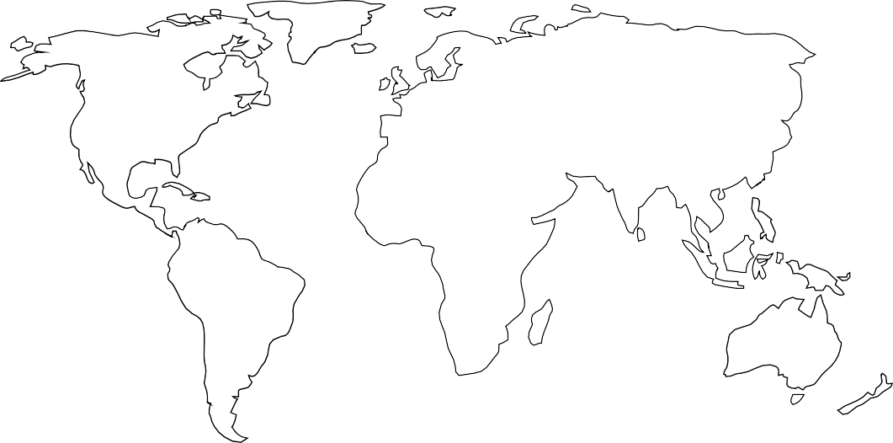
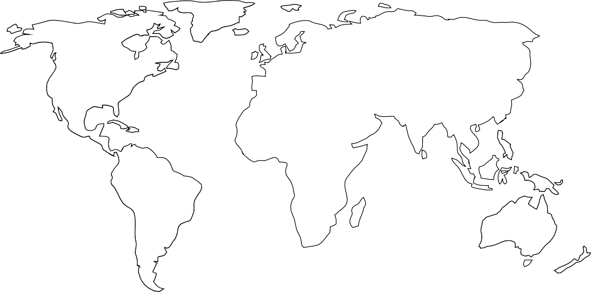

WORLD DISTRIBUTION OF NATURAL WOODS - 2
WORLD ASSOCIATION OF TECHNOLOGY TEACHERS https://www.facebook.com/groups/254963448192823/
www.technologystudent.com © 2017 V.Ryan © 2017
USEFUL LINK https://www.technologystudent.com/joints/forests1.html
On the global map outlines, shade the areas covered by Boreal Forests, Temperate Forests and Tropical Rainforests.
BOREAL FORESTS OF THE WORLD
www.technologystudent.com © 2018 V.Ryan © 2018
RAIN FORESTS OF THE WORLD
WORLD ASSOCIATION OF TECHNOLOGY TEACHERS https://www.facebook.com/groups/254963448192823/
TEMPERATE FORESTS OF THE WORLD

Slide 5
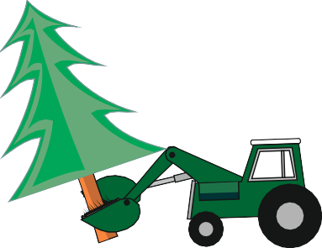

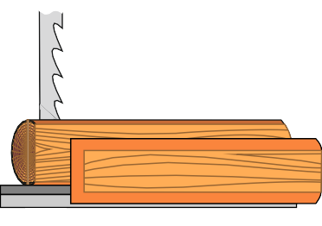
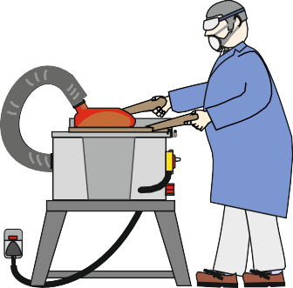
SUMMARY - RAW MATERIALS AND PROCESSING TO PRODUCT
WORLD ASSOCIATION OF TECHNOLOGY TEACHERS https://www.facebook.com/groups/254963448192823/
www.technologystudent.com © 2018 V.Ryan © 2018
https://www.technologystudent.com/joints/forest3a.html https://www.technologystudent.com/joints/forest4a.html https://www.technologystudent.com/joints/forest5a.html https://www.technologystudent.com/joints/wdprocess1.html
USEFUL LINKS
The incomplete drawings below, show the stages involved in the ‘harvesting’ of trees, processing of boards and the manufacture of wood based products. Complete the set of drawings, by sketching / pasting the missing stages.
STAGE ONE - TREE FELLING
STAGE TWO - STORAGE
STAGE THREE - TRANSPORT TO SAWMILL
STAGE FOUR - BREAKING DOWN
/ ROUGH SAWING IN THE SAWMILL
STAGE FIVE - SEASONING
STAGE SIX - RESAWING TO ACCURATE SIZES
STAGE SEVEN - MANUFACTURE A PRODUCT
POWER BREAKER
WORLD ASSOCIATION OF TECHNOLOGY TEACHERS
https://www.facebook.com/groups/254963448192823/
www.technologystudent.com © 2018 V.Ryan © 2018

Slide 6
PREPARATION OF TIMBER
WORLD ASSOCIATION OF TECHNOLOGY TEACHERS https://www.facebook.com/groups/254963448192823/
www.technologystudent.com © 2018
V.Ryan © 2018
USEFUL LINKS https://www.technologystudent.com/joints/timber1.html
https://www.technologystudent.com/joints/timber2.html
1. What is meant by the term ‘rough sawn’?
2. When is it advantageous to use rough sawn timber rather than planed timber?
3. How does planed timber differ from rough sawn?
WORLD ASSOCIATION OF TECHNOLOGY TEACHERS https://www.facebook.com/groups/254963448192823/
4. What is the meaning of the following terms?
www.technologystudent.com © 2018 V.Ryan © 2018
PLANED ALL ROUND (PAR):
PLANED BOTH SIDES (PBS):
PLANED SQUARE EDGE (PSE):
ROUGH SAWN:
5. Describe with the aid of diagrams, how the edges and sides of a piece of planed timber are checked for accuracy.

Slide 7
AIR SEASONING
https://www.facebook.com/groups/254963448192823/
WORLD ASSOCIATION OF TECHNOLOGY TEACHERS
www.technologystudent.com © 2018
V.Ryan © 2018
USEFUL LINK
https://www.technologystudent.com/joints/forest4a.html
1. Describe how water is stored inside a tree.
2. What is the seasoning of natural wood?
3. Why is it necessary to season natural wood before it is used?
WORLD ASSOCIATION OF TECHNOLOGY TEACHERS https://www.facebook.com/groups/254963448192823/ www.technologystudent.com © 2018 V.Ryan © 2018
4. In the space below, draw a sketch of one method of seasoning natural wood. Add notes to explain your diagram.
SKETCH
NOTES

Slide 8
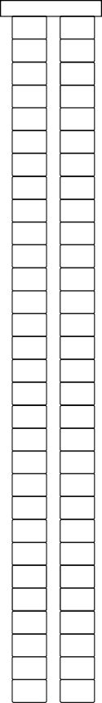
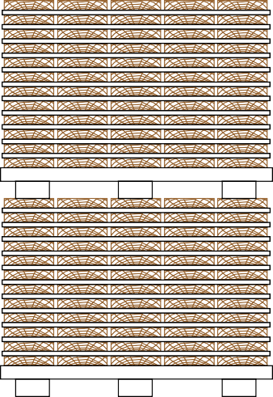
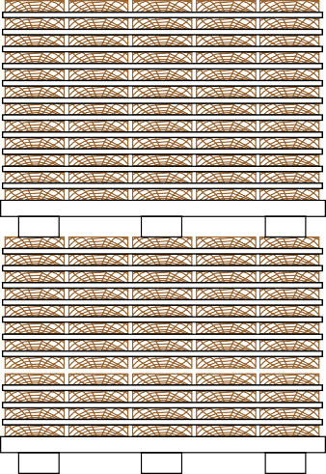
KILN SEASONING
https://www.facebook.com/groups/254963448192823/
WORLD ASSOCIATION OF TECHNOLOGY TEACHERS
www.technologystudent.com © 2018 V.Ryan © 2018
USEFUL LINK https://www.technologystudent.com/joints/forest5a.html
1. Explain / describe the processed called Kiln Seasoning.
2. Briefly describe and name two other types of natural wood seasoning, other than Air Seasoning.
A.
WORLD ASSOCIATION OF TECHNOLOGY TEACHERS https://www.facebook.com/groups/254963448192823/
www.technologystudent.com © 2018 V.Ryan © 2018
B.
3. Complete the drawing of the kiln below. Add labels to identify the various parts / aspects.

Slide 9
STOCK FORMS - WOODS
WORLD ASSOCIATION OF TECHNOLOGY TEACHERS https://www.facebook.com/groups/254963448192823/
www.technologystudent.com © 2018
V.Ryan © 2018
USEFUL LINKS
https://www.technologystudent.com/joints/timber1.html https://www.technologystudent.com/joints/timber2.html
Timber is supplied in a number of forms.
1. What is a ‘board’?
NOTES:
SKETCHES:
2. What is ‘square section timber’?
NOTES:
WORLD ASSOCIATION OF TECHNOLOGY TEACHERS https://www.facebook.com/groups/254963448192823/
SKETCHES:
www.technologystudent.com © 2018 V.Ryan © 2018
3. What is ‘dowel’?
NOTES:
SKETCHES:
3. What are manmade boards / sheets?
NOTES:
SKETCH WITH SIZES / DIMENSIONS:
4. Sketch shapes of sections of moulds / mouldings, in the box below.

Slide 10
VENEER
https://www.facebook.com/groups/254963448192823/
WORLD ASSOCIATION OF TECHNOLOGY TEACHERS
www.technologystudent.com © 2018
V.Ryan © 2018
USEFUL LINKS https://www.technologystudent.com/joints/timber4.html
1. What is veneer?
2. Describe with the aid of diagrams and notes, how veneer is produced.
3. Veneer is supplied in two forms. Name / describe each form.
FORM ONE:
FORM TWO:
WORLD ASSOCIATION OF TECHNOLOGY TEACHERS https://www.facebook.com/groups/254963448192823/ www.technologystudent.com © 2018 V.Ryan © 2018
4. Why is veneer applied to manmade boards?
5. Veneer can be ironed on to the edge of a board. Using notes and diagrams, describe the process.

