Slide 1
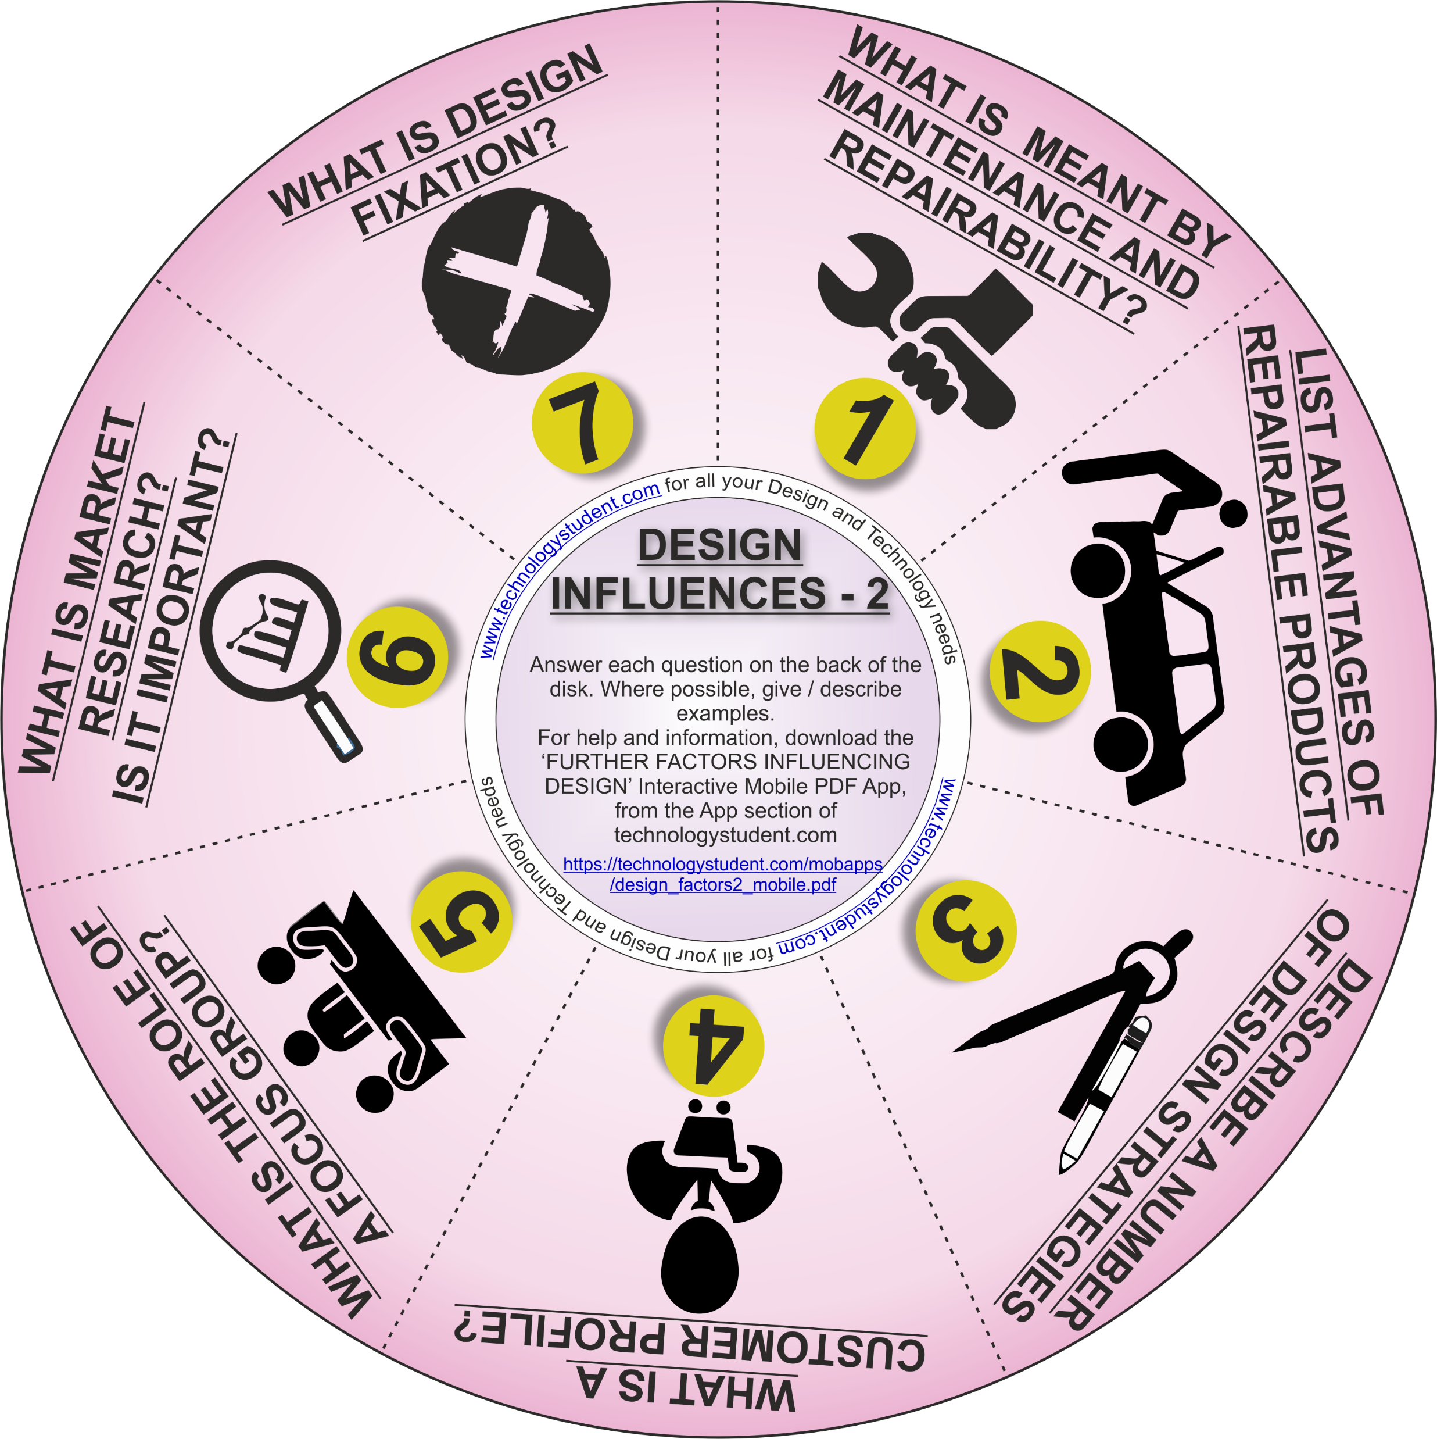
FACTORS INFLUENCING DESIGN - PART TWO
‘LEARNING CIRCLE’’
This disk will help you revise ‘Further Factors that Influence Design’. Where possible, give / describe examples.
For help and information, download the ‘FURTHER FACTORS INFLUENCING DESIGN’ Interactive Mobile PDF App, from the App section of technologystudent.com
https://technologystudent.com/mobapps/design_factors2_mobile.pdf
If you click on the circle, you will be able to rotate it, making it easier to read the symbols.

