Slide 1
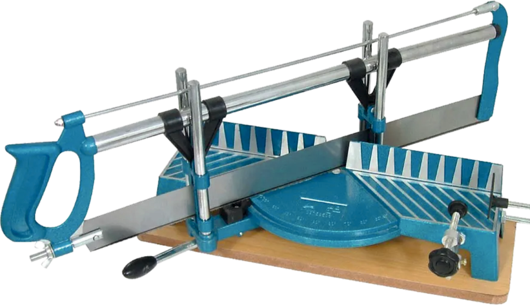
THE PRECISION HAND MITRE SAW - EXAMINATION QUESTIONS
WORLD ASSOCIATION OF TECHNOLOGY TEACHERS https://www.facebook.com/groups/254963448192823/
www.technologystudent.com © 2022 V.Ryan © 2022
HELPFUL LINK: https://technologystudent.com/equip_ﬂsh/mitres1.html
1. Brieﬂy describe the function / purpose of the Precision Hand Mitre Saw. 4 marks
2. Label the parts of the mitre saw, identiﬁed by the arrows.
8 marks

Slide 2
THE PRECISION HAND MITRE SAW - EXAMINATION QUESTIONS
WORLD ASSOCIATION OF TECHNOLOGY TEACHERS https://www.facebook.com/groups/254963448192823/
www.technologystudent.com © 2022 V.Ryan © 2022
HELPFUL LINK: https://technologystudent.com/equip_ﬂsh/mitres1.html
3. Brieﬂy describe how the Precision Hand Mitre Saw is used. Make reference to the diagram below, to support your answer. 6 marks
INDEX FINGER POINTING DOWN THE FRAME
V.Ryan © 2022
BLOCK ADDED (FOR SECURING IN VICE)

