Slide 1
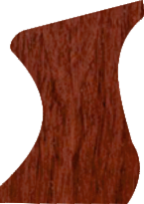
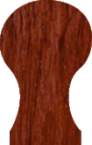
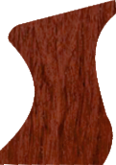
EXAMINATION QUESTIONS - PLANES - FACE EDGE AND FACE SIDE
WORLD ASSOCIATION OF TECHNOLOGY TEACHERS https://www.facebook.com/groups/254963448192823/ www.technologystudent.com © 2023 V.Ryan © 2023
HELPFUL LINK: https://technologystudent.com/equip1/planes2.htm
1. A smoothing plane and jack plane are shown below. 6 marks
Print the correct name for each plane..
Add notes, explaining the basic purpose of each plane.
A
NAME:
V.Ryan © 2023
BASIC PURPOSE:
223mm
B
NAME:
V.Ryan © 2023
BASIC PURPOSE:
340mm
2. Why is it necessary to plane a face edge and face side on a length of wood? 2 marks

Slide 2
EXAMINATION QUESTIONS - PLANES - FACE EDGE AND FACE SIDE
WORLD ASSOCIATION OF TECHNOLOGY TEACHERS https://www.facebook.com/groups/254963448192823/ www.technologystudent.com © 2023 V.Ryan © 2023
HELPFUL LINK: https://technologystudent.com/equip1/planes2.htm
3. In the two boxes, draw a face edge symbol and a face side symbol. 4 marks
FACE EDGE
FACE SIDE
4. A try square and a straight edge / long rule, are used to test the accuracy of a face edge and side. Describe how this is done and why it is important. 8 marks
NOTES: SKETCHES

