Slide 1
THE MARKING GAUGE - EXAMINATION QUESTIONS
V.Ryan © 2009 - 2023 World Association of Technology Teachers
USEFUL LINK: https://technologystudent.com/equip1/mgauge1.htm
1. A typical marking gauge is seen below. Complete the diagram by adding the missing labels.
5 marks
2. Add appropriate colour and shade to the diagram above (question 1). 3 marks
3. What is the function of the marking gauge? 2 marks
4. What materials are used for the manufacture of the various parts of the marking gauge?
3 marks

Slide 2
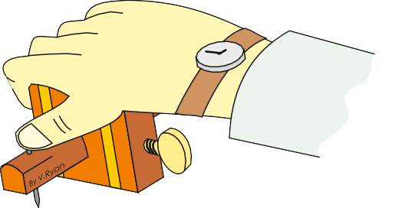
THE MARKING GAUGE - EXAMINATION QUESTIONS
V.Ryan © 2009 - 2023 World Association of Technology Teachers
USEFUL LINK: https://technologystudent.com/equip1/mgauge1.htm
5. Look carefully at the diagram of the marking gauge being used.
Describe what is happening in the diagram? 3 marks
6. Below is a description of how the distance between the spur and the stock is set:
“The distance between the stock and the spur can be adjusted by loosening the thumbscrew which allows the stock to slide along the stem. The thumbscrew can then be tightened, once the correct distance has been reached. A ruler is used to set the distance”.
In the space blow, draw a diagram that represents the description written above. 4 marks

