Slide 1
THE WOODWORKERS TRY-SQUARE
V.Ryan © 2009-2023 World Association of Technology Teachers
USEFUL LINK: https://technologystudent.com/equip1/try1.htm
A typical woodworkers try square is shown opposite.
BRASS FACE
1. The blade is manufactured from
. 1 Mark
BLADE
STOCK
2. The blade has been hardened and tempered because (2 marks):
3. Why does the stock have a brass face? (2 marks)
4. A try square and marking knife are used to mark out lengths of wood to the correct distance. Draw the marking knife in the correct position on the diagram shown opposite. 2 marks
MARKING KNIFE
WOOD
TRY-SQUARE
5. Why is a marking knife used rather than a pencil. Two possible answers are written below. Put a tick in the box opposite the correct answer. 2 marks
The knife cuts/breaks precisely, the wood fibres. This means that when a saw is used to cut away the waste wood, a frayed or uneven edge is avoided.
A pencil requires sharpening and this slows down the marking out procedure.

Slide 2
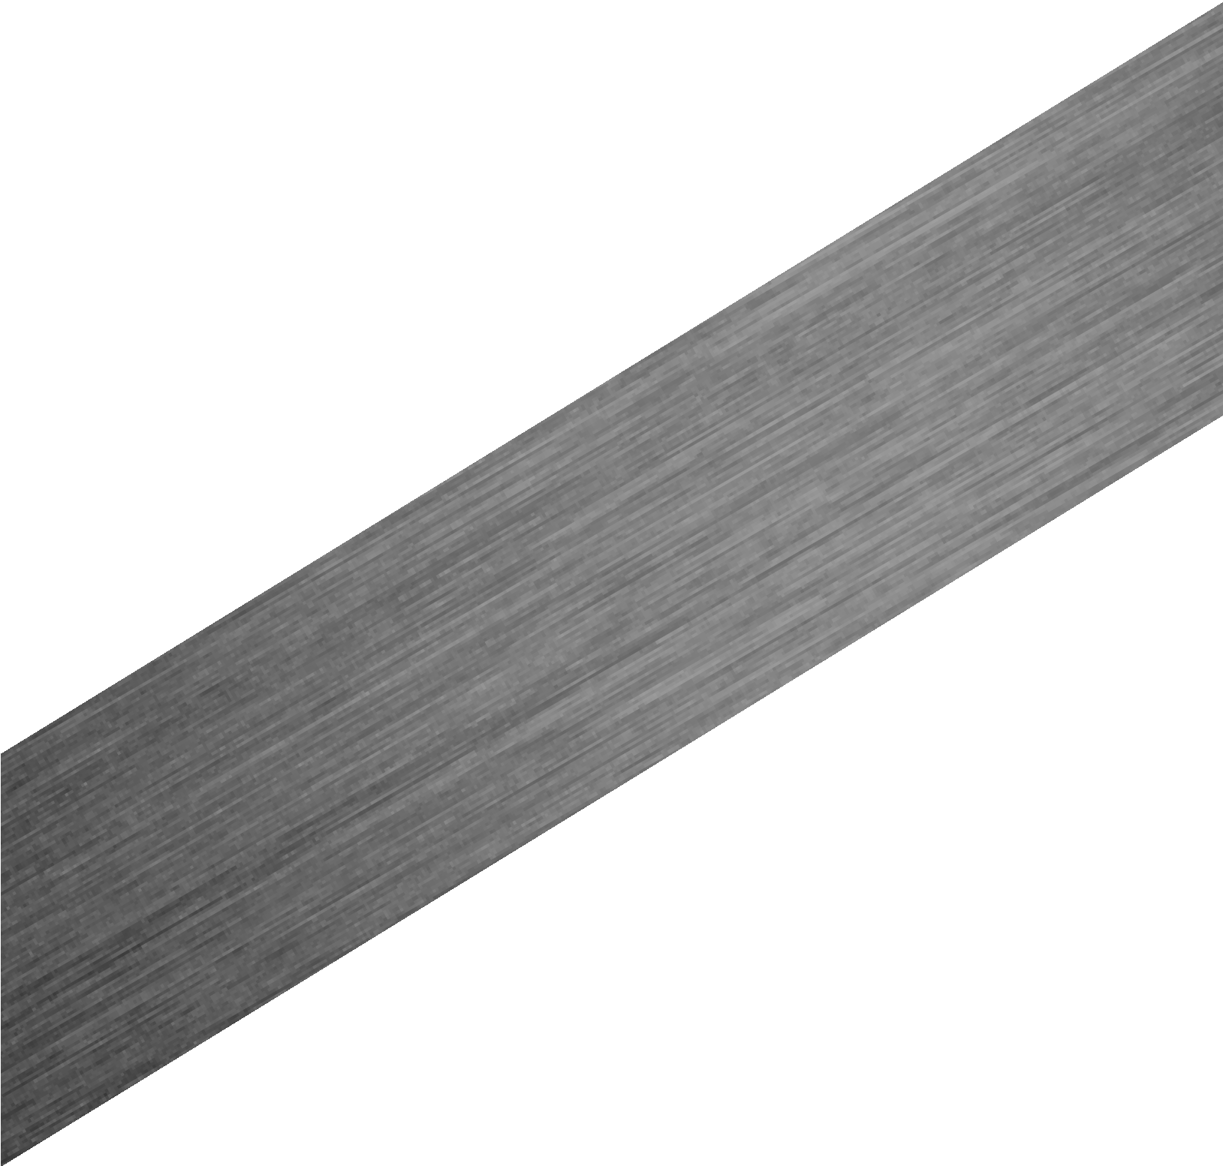
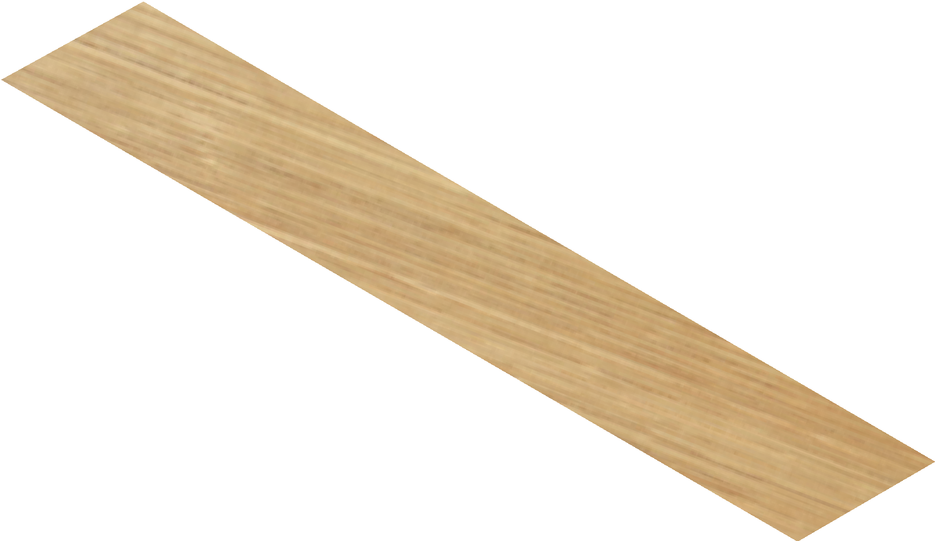
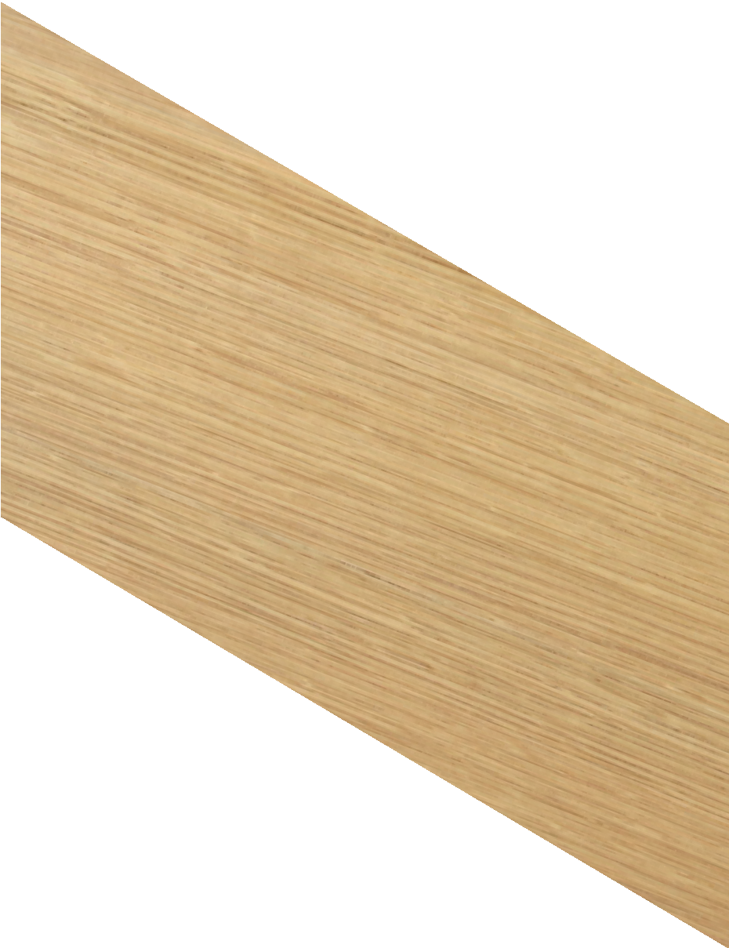
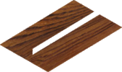
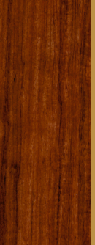
THE WOODWORKERS TRY-SQUARE
V.Ryan © 2009-2023 World Association of Technology Teachers
USEFUL LINK: https://technologystudent.com/equip1/try1.htm
6. The diagram below shows a woodworkers try square being used to carry out an important quality check. 3 marks
Explain / describe the quality check.
V.Ryan © 2023
V.Ryan © 2023
LIGHT SHINES THROUGH GAP
Ryanmatic
Made in Keighley
7. Describe another use of a woodworkers try square. Include a sketch. 6 marks

