Slide 1
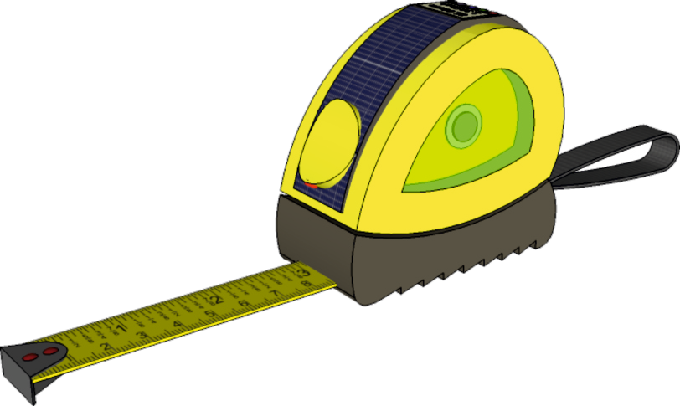
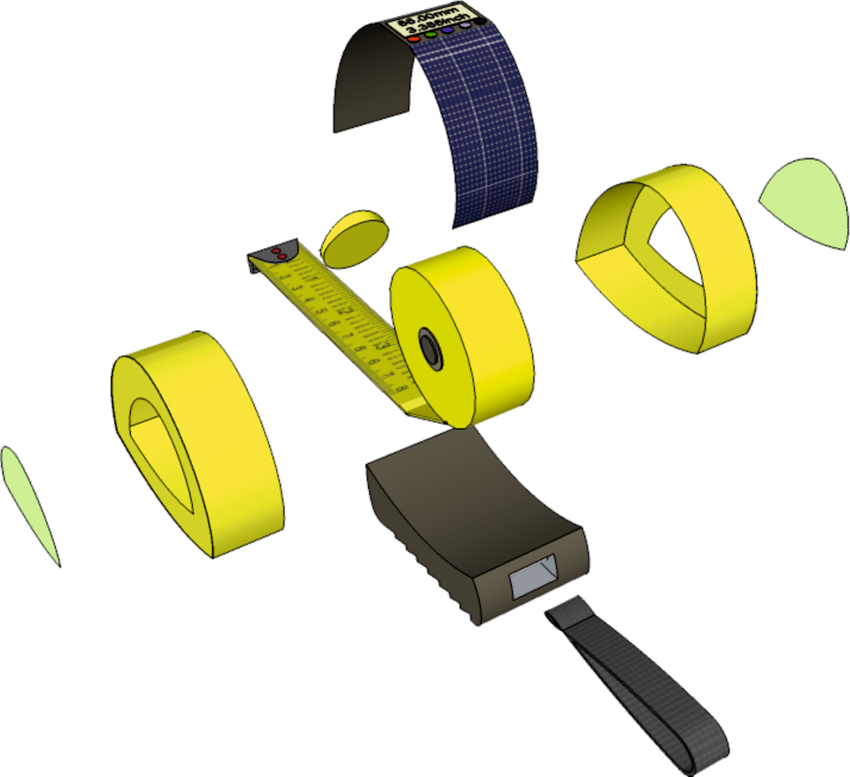
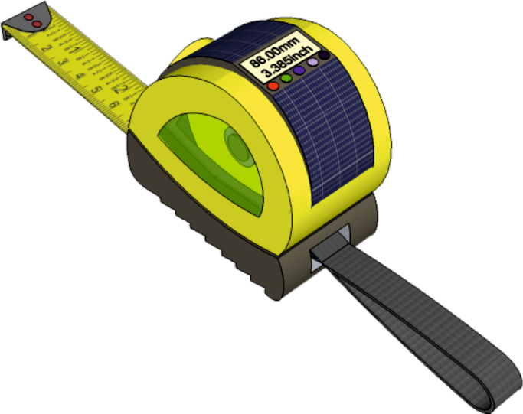
EXPLODED VIEWS - INTERACTIVE EXERCISES
WORLD ASSOCIATION OF TECHNOLOGY TEACHERS https://www.facebook.com/groups/254963448192823/
technologystudent.com © 2023 V.Ryan © 2023
WORK THROUGH THE EXERCISES ON EXPLODED VIEWS / DRAWINGS. ON EACH OF THE PAGES ARE ‘LINK BUTTONS’. CLICKING ON THESE WILL TAKE YOU TO USEFUL INFORMATION, THAT WILL HELP YOU ANSWER THE QUESTIONS / EXERCISES.
SOLAR PANEL AND DIGITAL DISPLAY
INTEGRATED WITH STYROFLEX
TRANSLUCENT SIDE PANEL
ROCKER SWITCH WITH INTEGRATED LED
DUAL SCALE TAPE MEASURE
HIGH IMPACT (HIGH DENSITY) POLYSTYRENE CASING
STYROFLEX BOTTOM GRIP WITH INTEGRATED STAINLESS STEEL STRAP PIN
KEVLAR STRAP
WORLD ASSOCIATION OF TECHNOLOGY TEACHERS
https://www.facebook.com/groups/254963448192823/
technologystudent.com © 2023
V.Ryan © 2023

Slide 2
EXPLODED VIEWS - FINE PEN DESIGN
V.Ryan © 2008 World Association of Technology Teachers
A fine felt pen is shown below. It has been drawn as an exploded 3D view. Complete the 2D version below by adding the missing lines and appropriate colour and shade.
HELPFUL LINK
Link

Slide 3
EXPLODED VIEWS - FOUNTAIN PEN DESIGN
V.Ryan © 2008 World Association of Technology Teachers
A fountain pen is shown below. It has been drawn as an exploded 3D view. Complete the 2D version below, by adding the missing lines and appropriate colour and shade.
HELPFUL LINK
Link

Slide 4
WORLD ASSOCIATION OF TECHNOLOGY TEACHERS
https://www.facebook.com/groups/254963448192823/
technologystudent.com © 2023
V.Ryan © 2023
EXPLODED DRAWINGS
ASSEMBLED TOY
DISASSEMBLED TOY
Complete the exploded drawing of the educational building block toy, by adding the missing lines.
HELPFUL LINK
Link
WORLD ASSOCIATION OF TECHNOLOGY TEACHERS
https://www.facebook.com/groups/254963448192823/
technologystudent.com © 2023
V.Ryan © 2023

Slide 5
WORLD ASSOCIATION OF TECHNOLOGY TEACHERS
https://www.facebook.com/groups/254963448192823/
technologystudent.com © 2023
V.Ryan © 2023
EXPLODED DRAWINGS
Draw an exploded view of the educational building block toy.
Add appropriate colour and shade. Start your drawing on the 30 degree lines and single vertical line, just below the centre of the page
DISASSEMBLED TOY
HELPFUL LINK
Link
WORLD ASSOCIATION OF TECHNOLOGY TEACHERS
https://www.facebook.com/groups/254963448192823/
technologystudent.com © 2023
V.Ryan © 2023

Slide 6
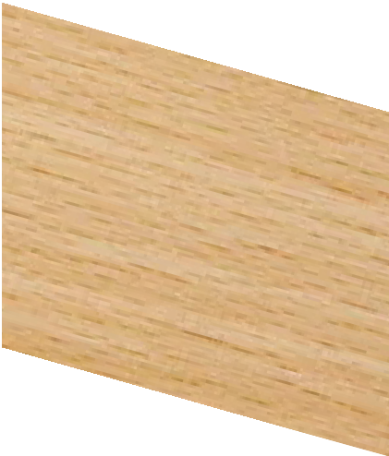
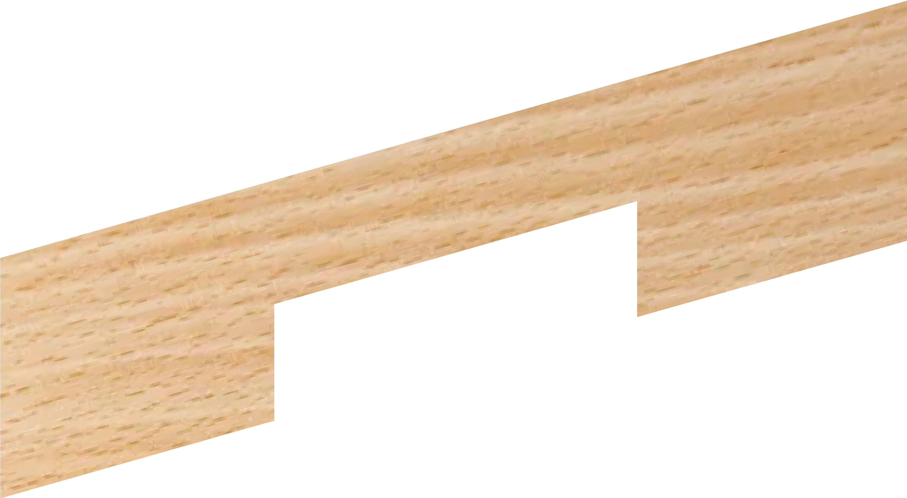
EXPLODED DRAWINGS
WORLD ASSOCIATION OF TECHNOLOGY TEACHERS https://www.facebook.com/groups/254963448192823/
technologystudent.com © 2023
V.Ryan © 2023
Detailed drawings of a common woodworking joint called a cross halving joint, are seen opposite.
Using a ruler and pencil / ink pen OR freehand (without a ruler), complete the sketch of the exploded view.
CROSS HALVING JOINT - ASSEMBLED VIEW
SURFACES LEVEL
YOUR - EXPLODED VIEW
TOP PIECE
BOTTOM PIECE
HELPFUL LINK
Link

Slide 7
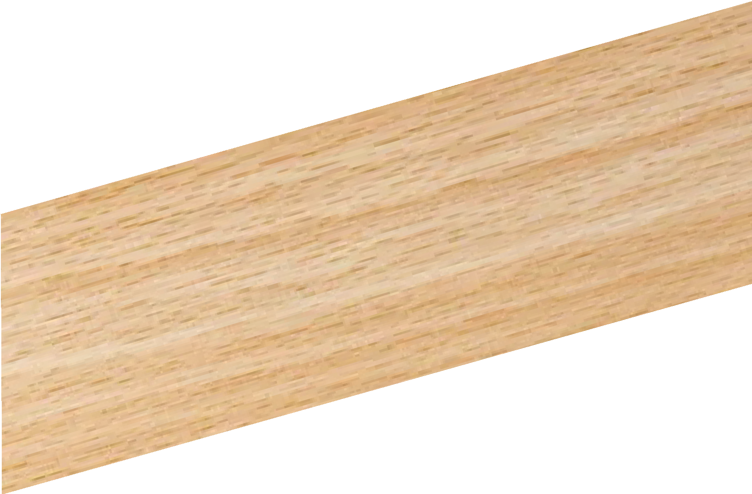
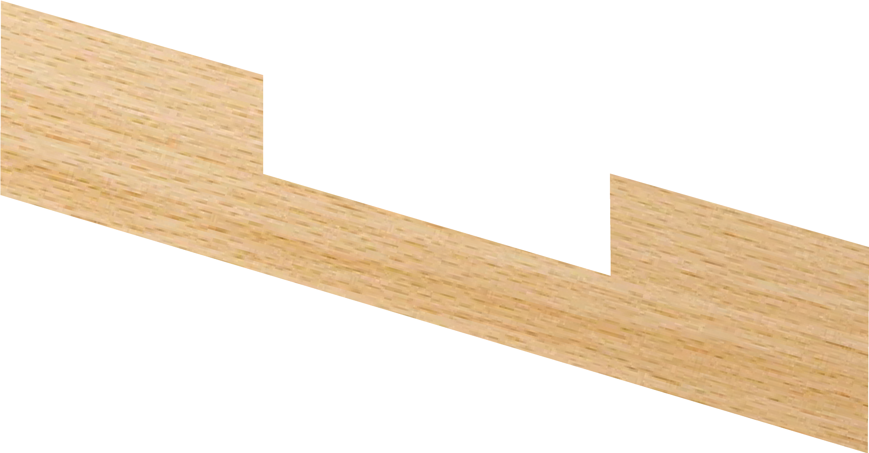
EXPLODED DRAWINGS
WORLD ASSOCIATION OF TECHNOLOGY TEACHERS https://www.facebook.com/groups/254963448192823/
technologystudent.com © 2023
V.Ryan © 2023
TEE HALVING JOINT - ASSEMBLED VIEW
SURFACES LEVEL
Detailed drawings of a common woodworking joint called a tee halving joint, are seen opposite.
Using a ruler and pencil / ink pen OR freehand (without a ruler), complete the sketch of the exploded view.
YOUR - EXPLODED VIEW
HELPFUL LINK
Link

Slide 8
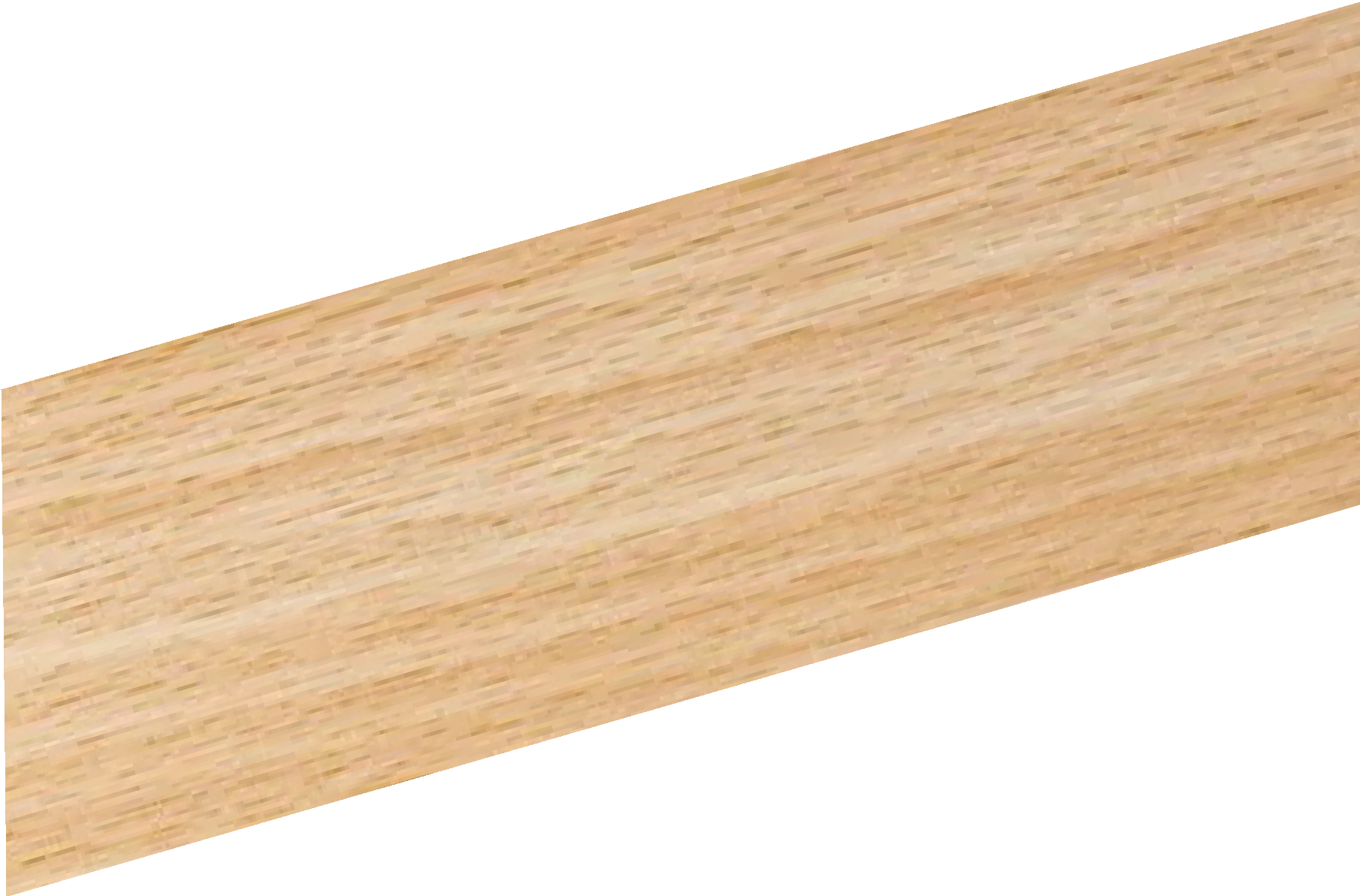
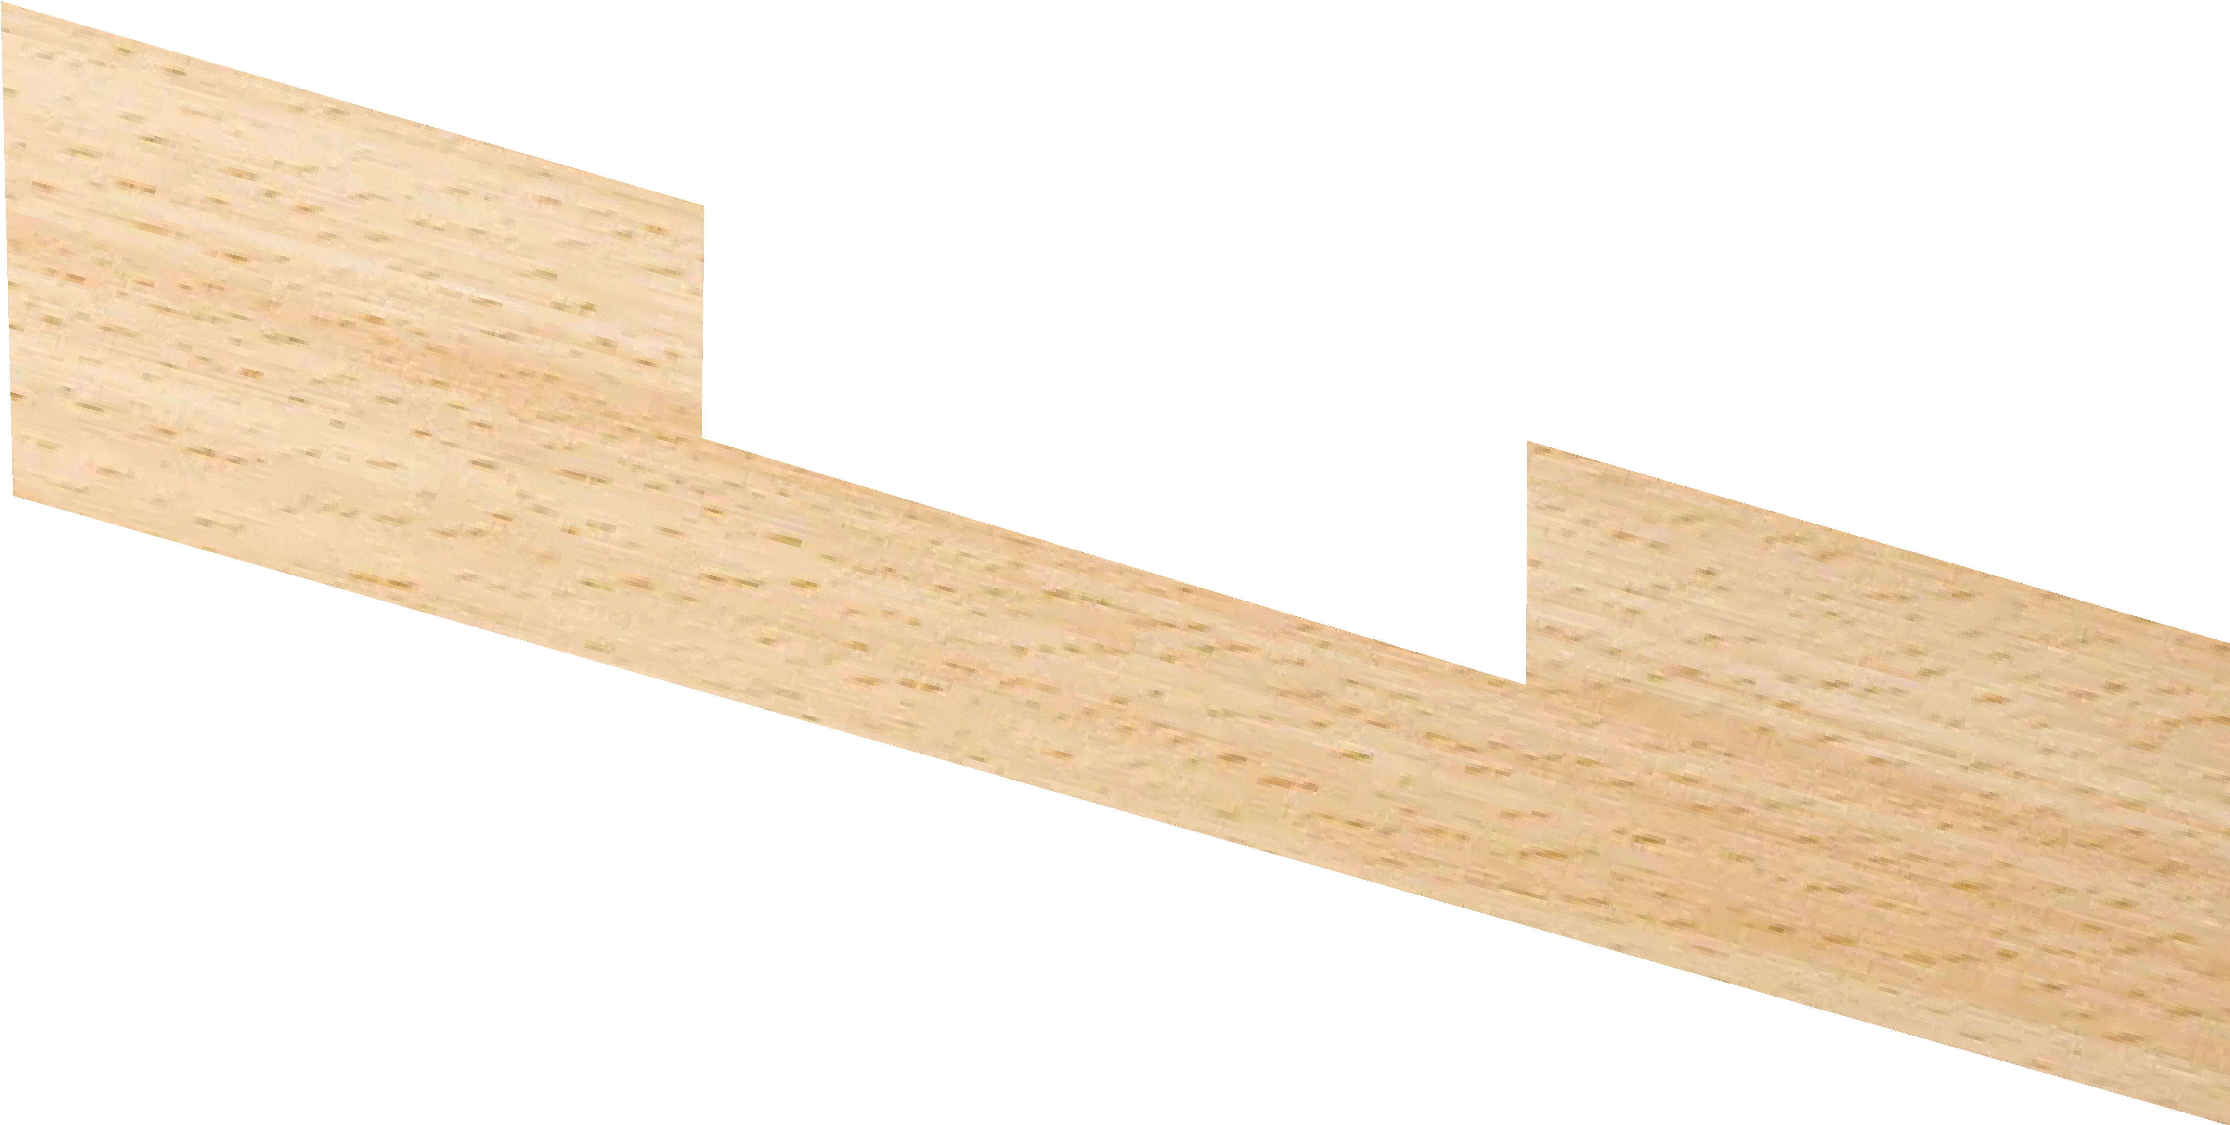
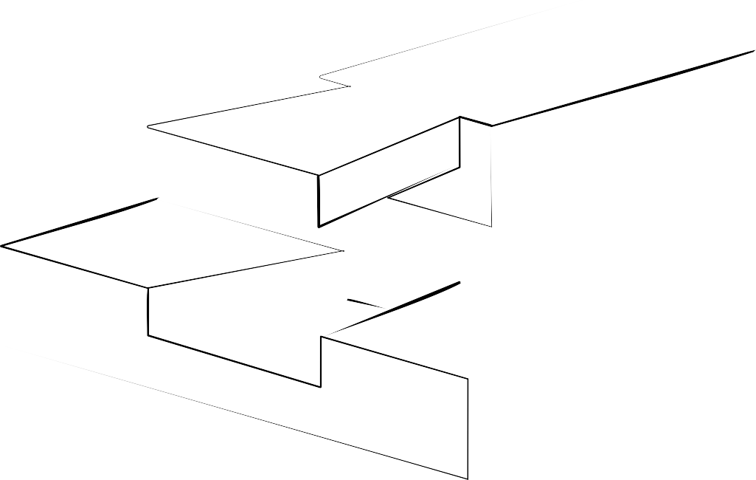
EXPLODED DRAWINGS
WORLD ASSOCIATION OF TECHNOLOGY TEACHERS https://www.facebook.com/groups/254963448192823/
technologystudent.com © 2023
V.Ryan © 2023
DOVETAIL HALVING JOINT
DOVETAIL HALVING JOINT - ASSEMBLED VIEW
SURFACES LEVEL
Detailed drawings of a common woodworking joint called a dovetail halving joint, are seen opposite.
Using a ruler and pencil / ink pen OR freehand (without a ruler), complete the sketch of the exploded view.
YOUR - EXPLODED VIEW
HELPFUL LINK
Link

Slide 9
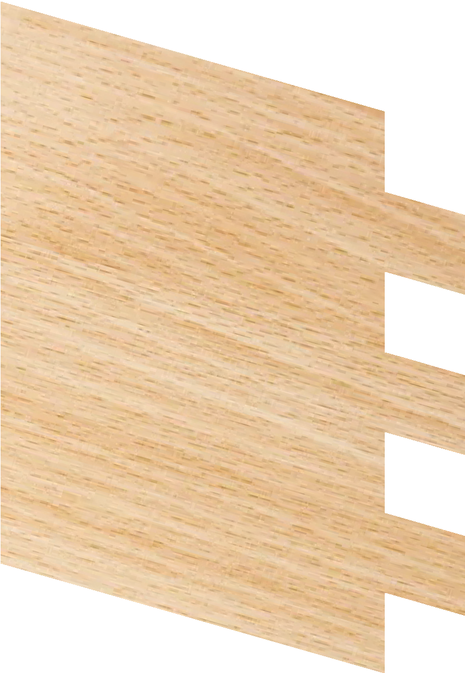
EXPLODED DRAWINGS
https://www.facebook.com/groups/254963448192823/
WORLD ASSOCIATION OF TECHNOLOGY TEACHERS
technologystudent.com © 2023
V.Ryan © 2023
FINGER / COMB JOINT
ASSEMBLED VIEW
Detailed drawings of a common woodworking joint called a ﬁnger / comb joint, are seen opposite.
Using a ruler and pencil / ink pen OR freehand (without a ruler), complete the sketch of the exploded view.
YOUR - EXPLODED VIEW
V.Ryan © 2022
HELPFUL LINK
Link

Slide 10
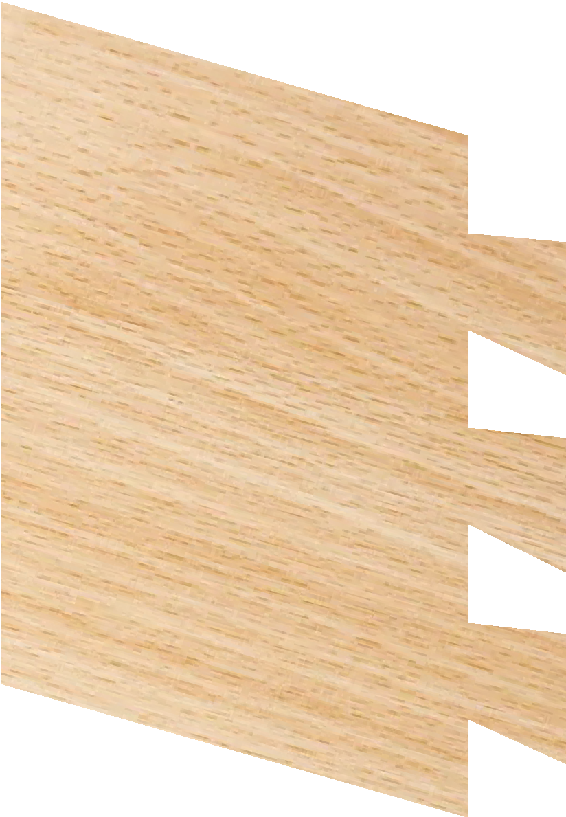
EXPLODED DRAWINGS
https://www.facebook.com/groups/254963448192823/
WORLD ASSOCIATION OF TECHNOLOGY TEACHERS
technologystudent.com © 2023
V.Ryan © 2023
THROUGH DOVETAIL JOINT
ASSEMBLED VIEW
Detailed drawings of a common woodworking joint called a through dovetail joint, are seen opposite.
Using a ruler and pencil / ink pen OR freehand (without a ruler), complete the sketch of the exploded view.
V.Ryan © 2022
YOUR - EXPLODED VIEW
HELPFUL LINK
Link

Slide 11
EXPLODED DRAWING
WORLD ASSOCIATION OF TECHNOLOGY TEACHERS https://www.facebook.com/groups/254963448192823/
technologystudent.com © 2023 V.Ryan © 2023
A disassembled pen is shown below (Dia A). Each of the parts have been labelled for you. There is also an assembled version of the pen (Dia B). The ‘outline’ of an exploded drawing of the pen is seen as Dia C (showing the correct position of each component).
You are to produce a detailed, colour rendered, exploded drawing of the pen, at the bottom of the page (space ‘D’). Include labels identifying each component.
A
DISASSEMBLED PEN
BARREL
CLIP
PLUNGER
BACK SPRING
FRONT SPRING
THRUST DEVICE
HELPFUL LINK
Ryanmatic
Link
INK CARTRIDGE
B
ASSEMBLED PEN
TIP
THRUST TUBE
V.Ryan © 2023
Ryanmatic
C
EXPLODED DRAWING - OUTLINE VERSION
D
YOUR EXPLODED DRAWING - DETAILED, COLOURED RENDERED VERSION
WORLD ASSOCIATION OF TECHNOLOGY TEACHERS
https://www.facebook.com/groups/254963448192823/
technologystudent.com © 2023
V.Ryan © 2023

Slide 12
EXPLODED DRAWING
WORLD ASSOCIATION OF TECHNOLOGY TEACHERS https://www.facebook.com/groups/254963448192823/
technologystudent.com © 2023 V.Ryan © 2023
A disassembled G cramp is shown below (Dia A). There is also an assembled version of the G Cramp (Dia B).
You are to produce a detailed, colour rendered, exploded drawing of the G Cramp, at the bottom of the page (space ‘C). Include labels identifying each component.
A
DISASSEMBLED G CRAMP
B
SWIVEL SHOE
THREAD
RETAINING
PIN
ASSEMBLED
G CRAMP
WINGNUT
FRAME
RYAN
RYAN
C
YOUR EXPLODED DRAWING - DETAILED, COLOURED RENDERED VERSION
HELPFUL LINK
Link
WORLD ASSOCIATION OF TECHNOLOGY TEACHERS
https://www.facebook.com/groups/254963448192823/
technologystudent.com © 2023
V.Ryan © 2023

Slide 13
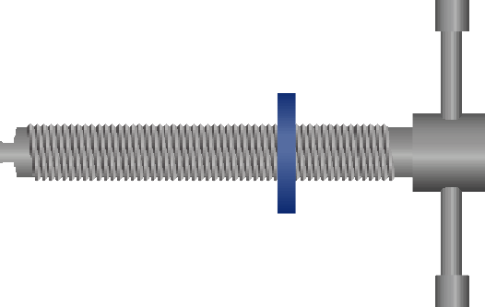
EXPLODED DRAWING
WORLD ASSOCIATION OF TECHNOLOGY TEACHERS https://www.facebook.com/groups/254963448192823/
technologystudent.com © 2023 V.Ryan © 2023
A disassembled G cramp (with Tommy Bar) is shown below (Dia A). There is also an assembled version of the G Cramp (Dia B).
You are to produce a detailed, colour rendered, exploded drawing of the G Cramp, at the bottom of the page (space ‘C). Include labels identifying each component.
A
DISASSEMBLED G CRAMP
B
SWIVEL SHOE
THREAD
ASSEMBLED
TOMMY BAR
G CRAMP
HELPFUL LINK
COLLAR
FRAME
Link
RYAN
RYAN
C
YOUR EXPLODED DRAWING - DETAILED, COLOURED RENDERED VERSION
WORLD ASSOCIATION OF TECHNOLOGY TEACHERS
https://www.facebook.com/groups/254963448192823/
technologystudent.com © 2023
V.Ryan © 2023

Slide 14
EXPLODED DRAWING
A
A disassembled perfume dispenser is shown opposite (Dia A). An assembled version is Dia B.
You are to produce a, colour rendered, exploded drawing of the Dispenser, in the space below.
SPRAY HEAD
V.Ryan © 2023
TOP / LID
STEM
technologystudent.com © 2023
BOTTLE
https://www.facebook.com/groups/254963448192823/
SEAL
SPRING
RETAINER
V.Ryan © 2023
PART SECTIONED SIDE VIEW SHOWING THE INTERNAL MECHANISM
B
V.Ryan © 2023
WORLD ASSOCIATION OF TECHNOLOGY TEACHERS
HELPFUL LINK
Link
WORLD ASSOCIATION OF TECHNOLOGY TEACHERS
https://www.facebook.com/groups/254963448192823/
technologystudent.com © 2023
V.Ryan © 2023

Slide 15
EXPLODED DRAWING USING ISOMETRIC PAPER
WORLD ASSOCIATION OF TECHNOLOGY TEACHERS https://www.facebook.com/groups/254963448192823/
technologystudent.com © 2023
V.Ryan © 2023
COMPLETE THE ISOMETRIC DRAWING OF A SIMPLE CAMERA, BY ADDING THE MISSING LINES / PARTS.
(Answer seen below)
HELPFUL LINK
Link

Slide 16
EXPLODED DRAWING USING ISOMETRIC PAPER
WORLD ASSOCIATION OF TECHNOLOGY TEACHERS https://www.facebook.com/groups/254963448192823/
technologystudent.com © 2023
V.Ryan © 2023
DRAW AN EXPLODED VIEW OF THE CAMERA SHOWN BELOW OR ONE OF YOUR OWN DESIGN. THE STARTING POINT IS ALREADY DRAWN ON THE ISOMETRIC PAPER.
HELPFUL LINK
Link

Slide 17
WORLD ASSOCIATION OF TECHNOLOGY TEACHERS https://www.facebook.com/groups/254963448192823/
DETAILED - EXPLODED VIEW
NOZZLE (PP) MAIN BODY (LDPE)
technologystudent.com © 2023
V.Ryan © 2023
QUESTION
In the space below, draw an exploded view of the trigger action spray bottle. You can choose to draw a ‘detailed exploded view OR an outline exploded view. Add labels identifying each part. (Please note - more marks will be awarded for the detailed view).
Detailed view 20 marks - Outline view 10 marks
HELPFUL LINK
V.Ryan © 2023
Link
PIVOT (PP)
GASKET (NYLON)
SPRING (STEEL)
OUTLINE - EXPLODED VIEW
TRIGGER (PP)
V.Ryan © 2023
TUBE RETAINER (PP)
PP = POLYPROPYLENE
LDPE = LOW DENSITY POLYETHYLENE
BOTTLE / CONTAINER (LDPE)
DIP TUBE (HDPE)
LID / CLOSURE (PP)
WORLD ASSOCIATION OF TECHNOLOGY TEACHERS
https://www.facebook.com/groups/254963448192823/
technologystudent.com © 2023
V.Ryan © 2023

