Slide 1
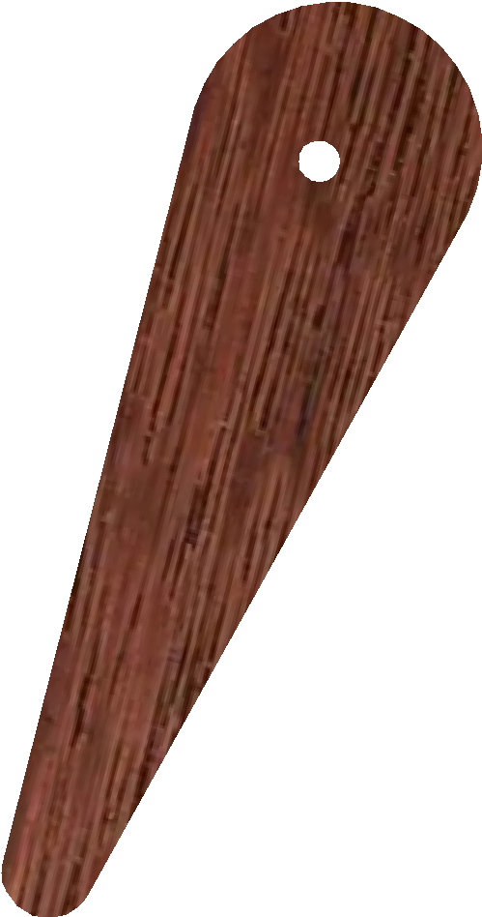
THE CAM CLAMP - EXAMINATION QUESTIONS
WORLD ASSOCIATION OF TECHNOLOGY TEACHERS https://www.facebook.com/groups/254963448192823/ www.technologystudent.com © 2023 V.Ryan © 2023
HELPFUL LINK: https://www.technologystudent.com/equip_ﬂsh/camclamp1.html
1. Complete the diagram of the Cam Clamp, by adding the labels indicated by the arrows.
7 marks
RYANMATIC
Made in Keighley
V.Ryan © 2023
2. Explain how the cam clamp is used. 5 marks (You can support your explanation with a sketch on the back of this sheet)

