Slide 1
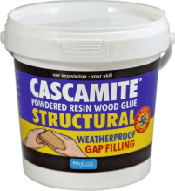
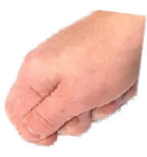
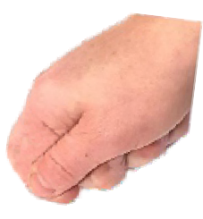
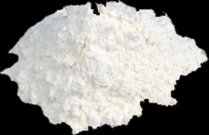
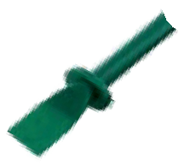
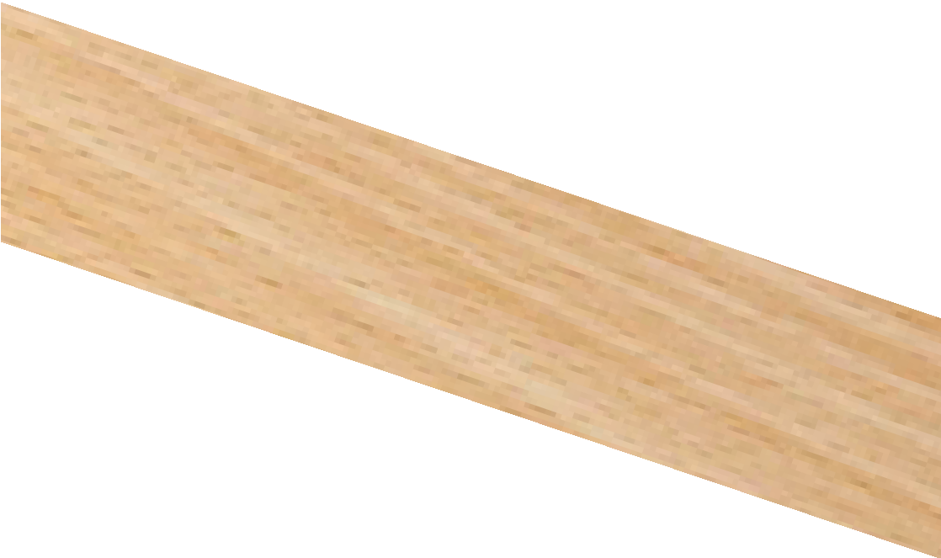
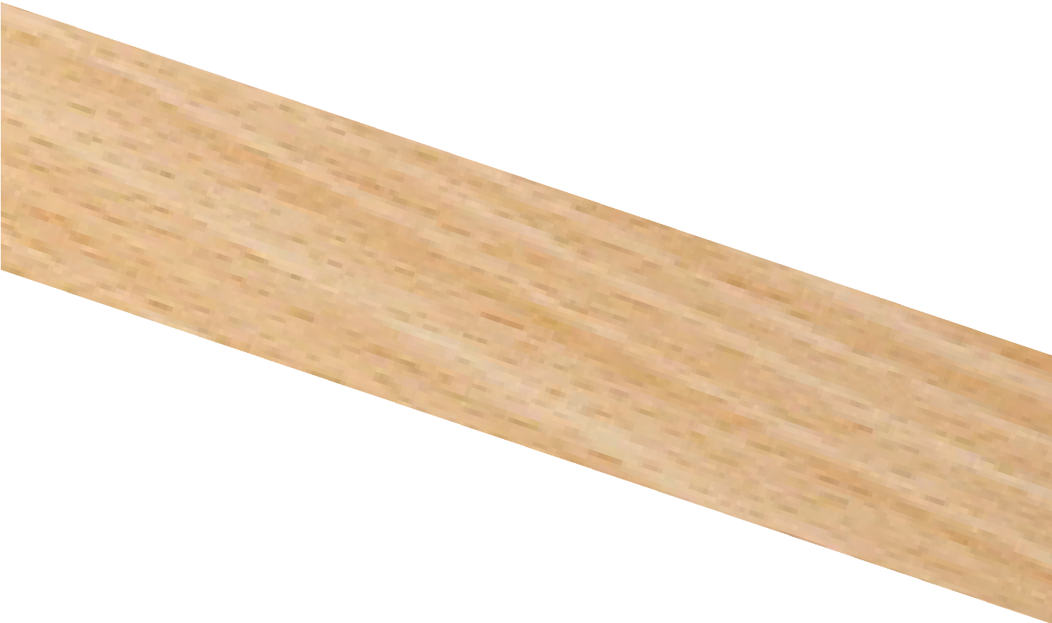
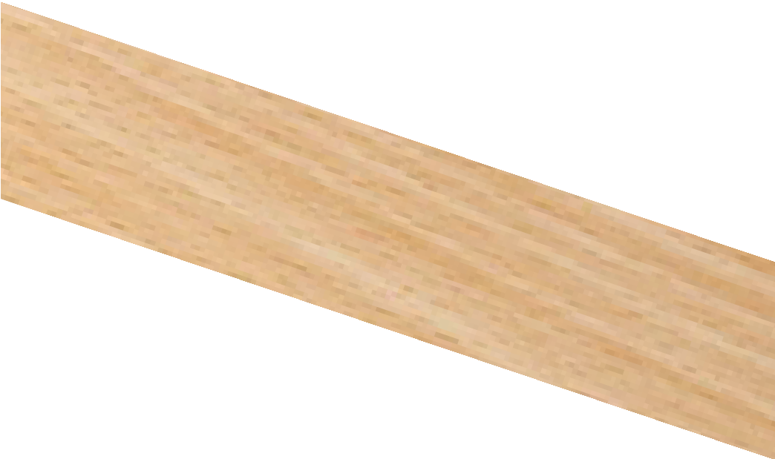
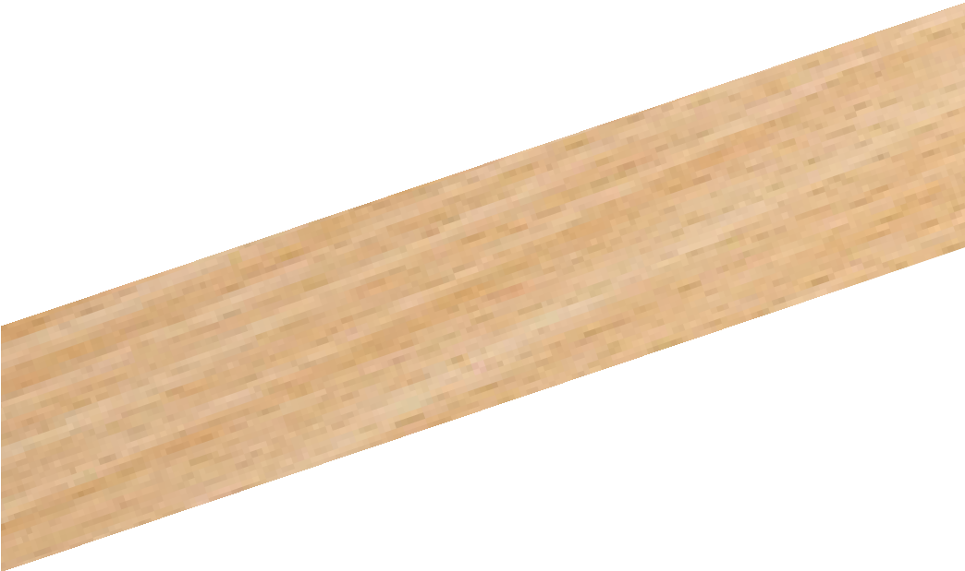
USING CASCAMITE WOODWORKING ADHESIVE
WORLD ASSOCIATION OF TECHNOLOGY TEACHERS https://www.facebook.com/groups/254963448192823/
www.technologystudent.com © 2022 V.Ryan © 2022
HELPFUL LINK: https://www.technologystudent.com/joints/casca1.htm
Complete the sequence drawing, showing the use of CASCAMITE, by adding the missing explanations
2. 3.
1.
V.Ryan © 2022
4.
5.
6.
V.Ryan © 2022
RYAN
RYAN
V.Ryan © 2022

