Slide 1
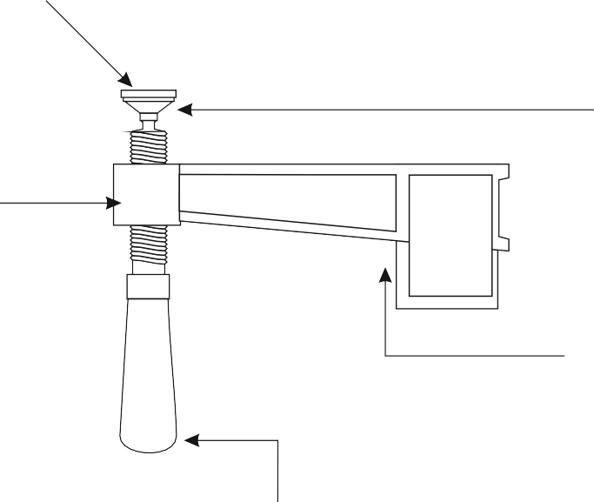
THE F-CLAMP - EXAMINATION QUESTIONS
WORLD ASSOCIATION OF TECHNOLOGY TEACHERS https://www.facebook.com/groups/254963448192823/ www.technologystudent.com © 2023 V.Ryan © 2023
HELPFUL LINK: https://www.technologystudent.com/equip_ﬂsh/fclamp1.html
1. Complete the diagram of the F-Clamp, by adding the labels indicated by the arrows.
8 marks
V.Ryan © 2023
2. Why does the F-Clamp have a swivel shoe? 2 marks

Slide 2
THE F-CLAMP - EXAMINATION QUESTIONS
WORLD ASSOCIATION OF TECHNOLOGY TEACHERS https://www.facebook.com/groups/254963448192823/ www.technologystudent.com © 2023 V.Ryan © 2023
HELPFUL LINK: https://www.technologystudent.com/equip_ﬂsh/fclamp1.html
3. Sketch two uses of a typical F-Clamp. 6 marks
SKETCH ONE
SKETCH TWO

