Slide 1
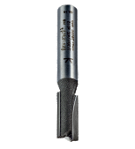
MACHINE ROUTER - EXAMINATION QUESTIONS
WORLD ASSOCIATION OF TECHNOLOGY TEACHERS https://www.facebook.com/groups/254963448192823/ www.technologystudent.com © 2023 V.Ryan © 2023
HELPFUL LINK: https://www.technologystudent.com/pwtol/rout1.htm
1. Complete the diagram of the Machine Router, by adding the labels indicated by the arrows.
10 marks
RYANMATIC
Machine Router
Made in Keighley, England.
2. Describe the safe use of the Router shown in the diagram above. 4 marks

