Slide 1
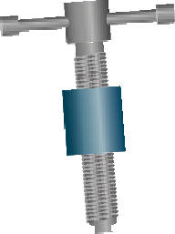
THE BENCH HOLDFAST - EXAMINATION QUESTIONS
WORLD ASSOCIATION OF TECHNOLOGY TEACHERS https://www.facebook.com/groups/254963448192823/ www.technologystudent.com © 2023 V.Ryan © 2023
HELPFUL LINK: https://www.technologystudent.com/equip_ﬂsh/holdfast1.html
1. Complete the diagram of the bench holdfast, by adding the labels indicated by the arrows.
8 marks
V.Ryan © 2023
SECTIONAL VIEW OF THE TOP OF A WORKBENCH
2. Explain how the bench holdfast shown above, is used. 4 marks

Slide 2
THE BENCH HOLDFAST - EXAMINATION QUESTIONS
WORLD ASSOCIATION OF TECHNOLOGY TEACHERS https://www.facebook.com/groups/254963448192823/ www.technologystudent.com © 2023 V.Ryan © 2023
HELPFUL LINK: https://www.technologystudent.com/equip_ﬂsh/holdfast1.html
3. With reference to the diagrams below (A and B), explain how this bench holdfast works.
8 marks
SHOE WITH RUBBER PAD
DIA. A
WORK
SECTIONAL VIEW OF THE TOP OF A WORKBENCH
V.Ryan © 2023
DOG HOLE
KNURLED STEM / BAR
DIA. B
CAM LEVER
PIVOT POINT
V.Ryan © 2023

