Slide 1
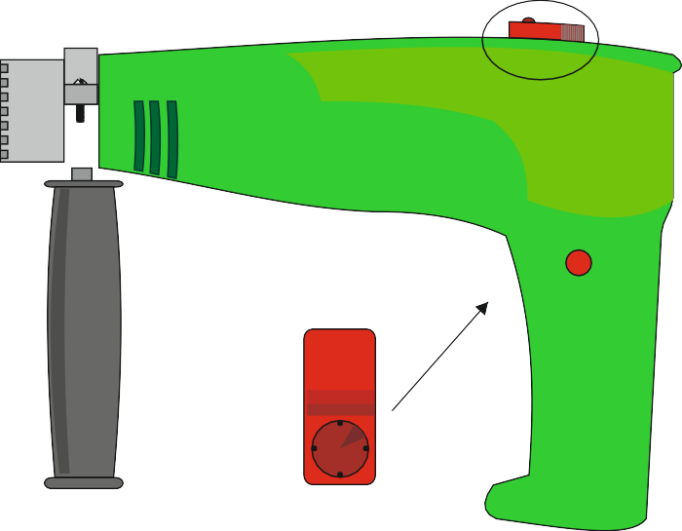
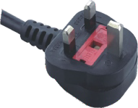
MAINTENANCE OF PRODUCTS
WORLD ASSOCIATION OF TECHNOLOGY TEACHERS https://www.facebook.com/groups/254963448192823/
www.technologystudent.com © 2011 V.Ryan © 2011
HELPFUL LINK: https://technologystudent.com/prddes1/drilltl1.html
Some products need maintenance checks to ensure that they are not damaged. Occasionally, the user needs to carry out maintenance to ensure that products remain safe to use. One such product is a power drill, shown below. Proper maintenance extends will extend the drills working life.
On the drawing of the power drill (including drill bit), identify parts that need checking for damage or normal wear and tear. Add notes to explain how damage / wear and tear can be corrected.
HAMMER ACTION CONTROL
DEPTH STOP
ON/OFF
SWITCH
FRONT
HANDLE
A
D B
C
SWITCH LOCK
HANDLE
SPEED CONTROL
CHUCK KEY

