Slide 1
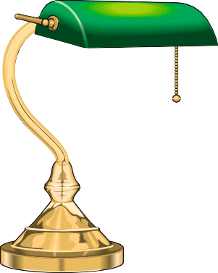
INCANDESCENT LAMPS (BULBS)
V.Ryan © 2009-2022 World Association of Technology Teachers
HELPFUL LINK: https://technologystudent.com/elec1/bulb2.htm
Filament bulbs are used in many applications in and around the home. Name and sketch four examples that you have seen. Add a description of each example.
EXAMPLE ANSWER
NAME
FILAMENT BULB
DESCRIPTION
SKETCH
A simple filament bulb is used in table lamp. As the cord is pulled it activates a switch, allowing current to flow, lighting the bulb. Lamps like this are common.
NAME
DESCRIPTION
SKETCH
NAME
DESCRIPTION
SKETCH

Slide 2
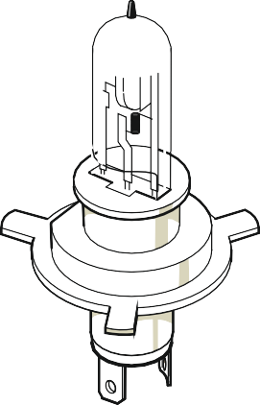
INCANDESCENT LAMPS (BULBS)
V.Ryan © 2009-2022 World Association of Technology Teachers
NAME
DESCRIPTION
SKETCH
NAME
DESCRIPTION
SKETCH
The two bulbs below look very different. However, they are both composed of a filament, placed inside an envelope of glass. The glass envelope of each bulb contains a gas. However, one of the bulbs is used in the house for producing standard light and the other is used in a car head light and is very bright.
BULB ‘A’
The household bulb is:
The car headlight bulb is:
BULB ‘B’
Explain the differences between bulb ‘A’ and bulb ‘B’. You may wish to search the internet for scientific / technical information on both bulbs

