Slide 1
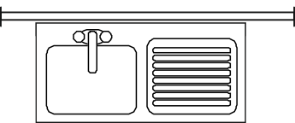
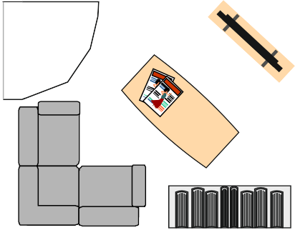
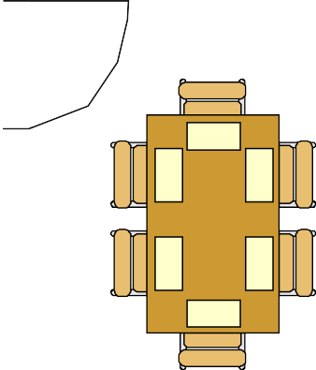
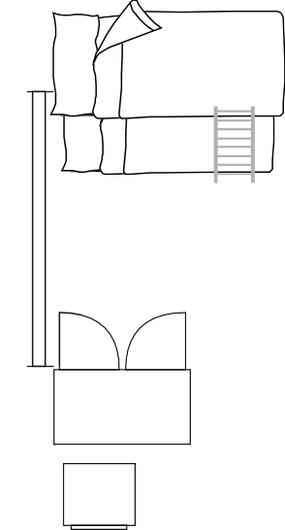
TASK - ARCHITECTURAL PLANS - PLAN / LAYOUT
WORLD ASSOCIATION OF TECHNOLOGY TEACHERS https://www.facebook.com/groups/254963448192823/
technologystudent.com © 2024 V.Ryan © 2024
THE DESIGN TASK
SAMPLE LAYOUTS
SAMPLE - GROUND FLOOR / FIRST FLOOR
You are to design the arrangement of furniture, fixtures and fittings of a typical detached house. The house has two floors with the dining room, kitchen and lounge downstairs. Bedrooms and bathroom upstairs.
The sample key shows how a variety of furniture, fixtures and fittings look as a plan
view (birds eye view). You can use examples from the key or develop your own designs. Think carefully about the style of furniture, fixtures and fittings.
Keep in mind, that there are certain pieces of furniture, fixtures and fittings that are
essential in any house.
KITCHEN
LOUNGE
GARAGE
HALL
DINING ROOM
B
y V
.
R
y
a
n
SECOND FLOOR / UPSTAIRS
BUNK BEDS
CORNER BATH
WC
BUILT
IN WARDR
OBE
SINK
TWO SEATER SETTEE
BATHROOM
SHOWER
BEDROOM
BUILT IN WARDROBE
HALL
MASTER BEDROOM
LOUNGE CHAIR
TABLE LAMP
HELPFUL LINK
BEDROOM
SINGLE BED
DOUBLE BED
HELPFUL LINK: https://technologystudent.com/despro2/architec4.html

Slide 2
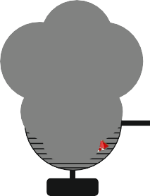
ARCHITECTURAL PLANS - SAMPLE KEY FOR FURNITURE / FITTINGS / GARDEN
WORLD ASSOCIATION OF TECHNOLOGY TEACHERS https://www.facebook.com/groups/254963448192823/
technologystudent.com © 2024 V.Ryan © 2024
DOUBLE DOOR
COMPUTER DESK AND CHAIR
BAR STOOL
BICYCLE AND STAND
BARBEQUE
SLIDING DOOR
SINGLE DOOR
ELECTRIC CHARGING POINT
SUN BED
OUTDOOR TABLE AND CHAIRS
DINING TABLE AND CHAIRS
WINDOW
GRAND PIANO
OUTDOOR UMBRELLA
SINK
WC
STANDARD BATH
PATIO / PAVING SLABS
ELECTRIC PIANO
SHOWER
BOOKCASE
TV
LOUNGE CHAIR
COFFEE TABLE
KITCHEN SINK UNIT
GRASS AREA WITH CURB
TWO SEATER SETTEE
LAMP STAND / TABLE LAMP
PLANT POT
WASHING MACINE
ELECTRIC KETTLE

Slide 3
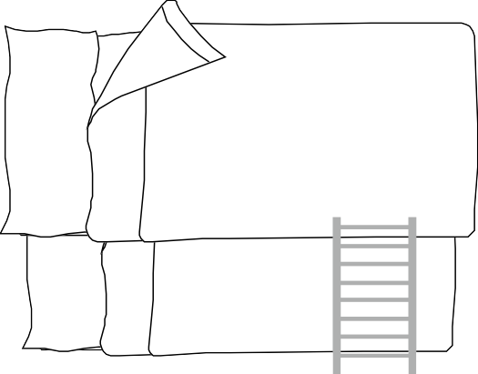
ARCHITECTURAL PLANS - SAMPLE KEY FOR FURNITURE / FITTINGS / GARDEN
WORLD ASSOCIATION OF TECHNOLOGY TEACHERS https://www.facebook.com/groups/254963448192823/
technologystudent.com © 2024 V.Ryan © 2024
PLANTS
ROLLER GARAGE DOOR
BI-FOLDING DOOR
BUSH
DAFODIL
COOKER
KITCHEN
ACCORDION / PARTITION DOOR
SINGLE STOREY STAIRS
WINDER STAIRS
SPIRAL STAIRCASE
CROCUS
IRIS
CORNER SETTEE
ROSE
TULIP
SINGLE BED
DOUBLE BED
BUNK BEDS
DESK LAMP
POND WITH BRIDGE
WOOD STOVE
DOUBLE STORAGE UNIT

Slide 4
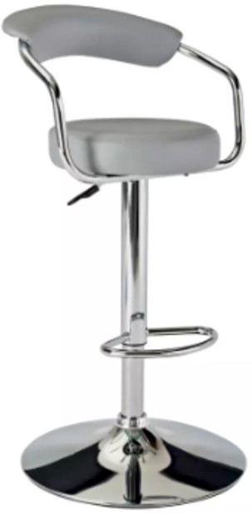
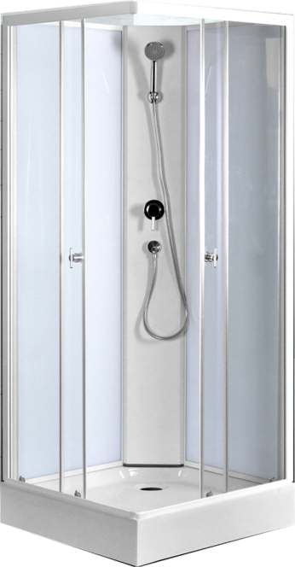
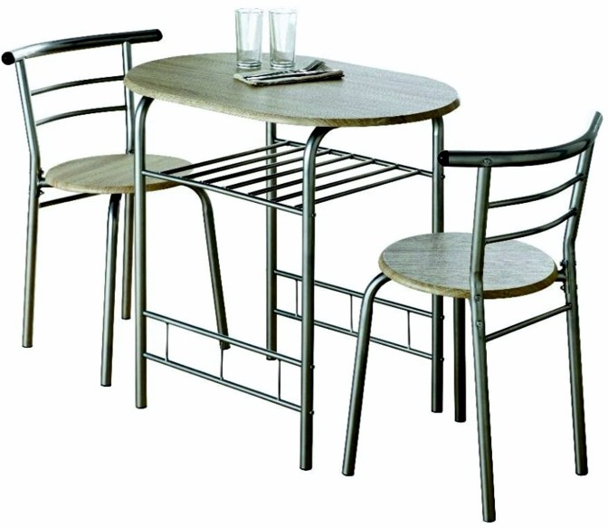
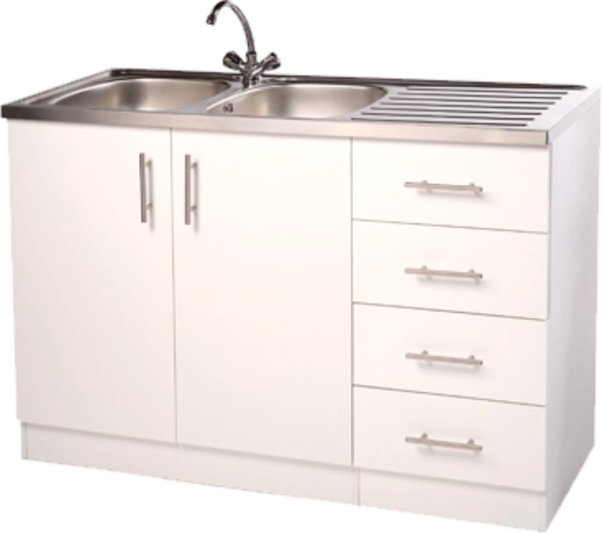
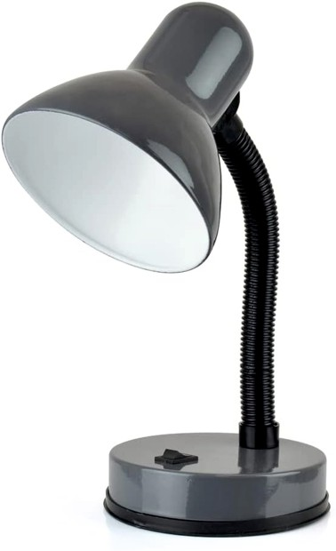
DESIGNING YOUR OWN KEY FOR AN ARCHITECTURAL LAYOUT
BREAKFAST BAR STOOL ^{V. Ryan} | © 2024
TABLE AND CHAIRS
TABLE LAMP
WORLD ASSOCIATION OF TECHNOLOGY TEACHERS https://www.facebook.com/groups/254963448192823/
technologystudent.com © 2024 V.Ryan © 2024
Study the furniture and ﬁttings below. Along side each one, draw a simpliﬁed plan view (architectural view), of your own design. Remember to keep your designs simple, although you could add minor detail. One example has been drawn for you.
_{SHOWER} V. Ryan | © 2024
KITCHEN SINK UNIT
ELECTRIC CHARGING POINT

Slide 5
SHEET 1
ARCHITECTURAL PLANS - GROUND FLOOR / FIRST FLOOR
WORLD ASSOCIATION OF TECHNOLOGY TEACHERS https://www.facebook.com/groups/254963448192823/
technologystudent.com © 2024 V.Ryan © 2024
HELPFUL LINK
HELPFUL LINK: https://technologystudent.com/despro2/architec4.html
YOUR DESIGN / LAYOUT
KITCHEN
LOUNGE
GARAGE
HALL
DINING
ROOM

Slide 6
SHEET 2
ARCHITECTURAL PLANS - UPSTAIRS / SECOND FLOOR
WORLD ASSOCIATION OF TECHNOLOGY TEACHERS https://www.facebook.com/groups/254963448192823/
technologystudent.com © 2024 V.Ryan © 2024
HELPFUL LINK
HELPFUL LINK: https://technologystudent.com/despro2/architec4.html
YOUR DESIGN / LAYOUT
BEDROOM
BATHROOM
MASTER
BEDROOM
HALL
BEDROOM

