Slide 1
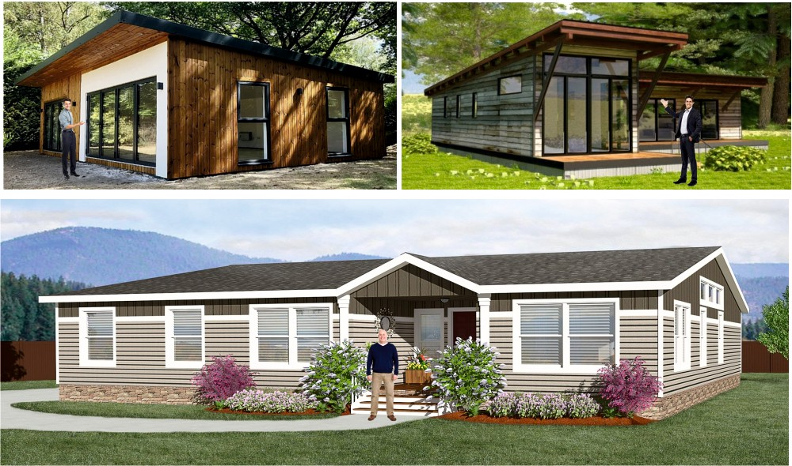
ARCHITECTURAL PICTORIAL VIEW - MODULAR, AFFORDABLE HOUSING
You are to design a small modular home, suitable for two people. It can be regarded as a ‘starter home’, the ﬁrst aﬀordable home that a typical person / couple purchases. Your design must be open plan, with potential use of partitions to isolate areas of ﬂoor space (for example, the sleeping area). Your ‘home’ should have all the essential ﬁxtures and ﬁttings. The building must be constructed sustainably and be environmentally friendly. A parking space and a garden / area of relaxation, are also essential.
EXAMPLES

Slide 2
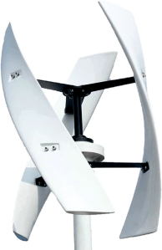
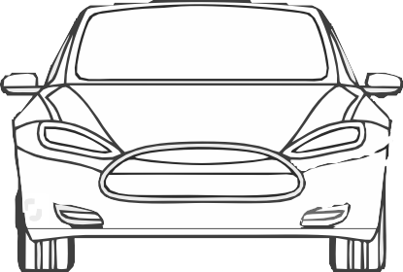
ARCHITECTURAL PICTORIAL VIEW - MODULAR, AFFORDABLE HOUSING
WORLD ASSOCIATION OF TECHNOLOGY TEACHERS https://www.facebook.com/groups/254963448192823/
technologystudent.com © 2024 V.Ryan © 2024
HELPFUL LINK
HELPFUL LINK: https://technologystudent.com/despro2/architec5.html
SAMPLE
THE BUILDING IS SOUTH FACING (NORTHERN HEMISPHERE) TO TAKE ADVANTAGE OF HEAT FROM THE SUN.
THE HOUSE AND SURROUNDING GARDENS ARE CONSTRUCTED ON AN EXISTING ‘BROWN-FIELD’ SITE.
THE BUILDING MATERIALS ALL PASS UP TO DATE SUSTAINABILLITY RATINGS.
THE HOUSE HAS SUPER FAST INTERNET AND SATELLITE COMMUNICATIONS.
A ROOF GARDEN HAS BEEN ADDED FOR AESTHETIC AND ENVIRONMENTAL REASONS. IT ADDS NATURAL ROOF-TOP INSULATION.
AIR CONDITIONING / HEATING SYSTEM / EV VEHICLES ARE SOLAR POWERED,
AN INTERNAL SPIRAL STAIRCASE ALLOWS ACCESS TO THE ROOF.
BACKED UP BY WIND
THE ROOF TOP SPACE OFFERS A LEISURE AND RELAXATION AREA.
RECYCLED AND RECONDITIONED TIMBER CLADDING.
POWER.
V.Ryan © 2023
ALL LED SECURITY LIGHTS ARE SOLAR POWERED, SAVING ENERGY.
EV CHARGER FOR ELECTRIC VEHICLES
SELF
ALL DOOR AND
THE WINDOWS ARE DESIGNED TO RETAIN HEAT WITHIN THE HOUSE IN WINTER.
THEY CAN BE ADJUSTED ELECTRONICALLY, SO THAT DIRECT HEAT FROM THE SUN IS REFLECTED AWAY, HELPING TO KEEP THE HOUSE COOL IN THE SUMMER.
KNOWN AS LOW- EMISSIVITY (LOW-E) WINDOWS.
CLEANING
WINDOW LOCKS
GLASS.
ARE
CONTROLLED BY
A SECURE
V.Ryan © 2024
PERSONALISED
MOBILE APP.
PERMEABLE TARMAC MEMBRANE MATERIAL ALLOWS RAIN WATER TO SOAK THROUGH, REDUCING RAIN RUN OFF.
ALL FLOWER BEDS AND GARDEN PLANTS REQUIRE NO ADDITIONAL WATERING.

Slide 3
YOUR ARCHITECTURAL PICTORIAL VIEW - MODULAR, AFFORDABLE HOUSING
WORLD ASSOCIATION OF TECHNOLOGY TEACHERS https://www.facebook.com/groups/254963448192823/
technologystudent.com © 2024 V.Ryan © 2024
HELPFUL LINK: https://technologystudent.com/despro2/architec5.html
HELPFUL LINK
AN ARCHITECTURAL PICTORIAL VIEW, IS A ‘REALISTIC’ DRAWING OF A BUILDING. IT INCLUDES COLOUR, SHADE, IMAGES OF PEOPLE AND DETAIL. THIS TYPE OF DRAWING IS USED EARLY IN THE DESIGN PROCESS, AS AN INDICATION OF THE DESIGN TO BE DEVELOPED. IT IS VIEWED AND DISCUSSED BY THE ARCHITECT AND CLIENT. ALTERATIONS ARE THEN MADE TO THE DESIGN.
YOUR TASK
ON THIS SHEET DRAW AN ARCHITECTURAL PICTORIAL VIEW (A FRONT VIEW) OF A ‘HOME’ OF YOUR DESIGN. ADD NOTES TO EXPLAIN DIFFERENT ASPECTS OF THE BUILDING.

