Slide 1
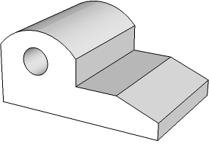
OBLIQUE PROJECTION
WORLD ASSOCIATION OF TECHNOLOGY TEACHERS https://www.facebook.com/groups/254963448192823/
technologystudent.com © 2024
V.Ryan © 2024
QUESTION
HELPFUL LINK
COMPLETE THE OBLIQUE PROJECTION OF THE ALUMINIUM CASTING SHOWN BELOW.
IN THE BLUE BOX, DRAW YOUR OWN DESIGN OF A ‘CASTING’. IT MUST INCLUDE A HOLE / CURVE(S)
3D DRAWING
(not to scale)
SCALE 2:1
HELPFUL LINK:
https://technologystudent.com/despro_3/oblique6.html
Y
45
X
V.Ryan © 2023
DIMENSIONS
(not to scale)
PLAN VIEW
 |  |  |  |  | 60mm
V.Ryan © 2023
FRONT VIEW

