Slide 1
^{THIRD ANGLE}YGOLONHCETFONOITAICOSSADLROW TE^{ORTHOGRAPHIC}.RyanV2023©technologystudent.com.facebook.com/groups/254963448192823/https://wwwSREHCA ^{DR}2023© ^{AWING}
EXERCISE BOOK ONE
PLAN VIEW
400mm
120mm
175mm
165mm
SIDE VIEW
FRONT VIEW
WORLD ASSOCIATION OF TECHNOLOGY TEACHERS https://www.facebook.com/groups/254963448192823/
technologystudent.com © 2023
V.Ryan © 2023

Slide 2
THIRD ANGLE ORTHOGRAPHIC DRAWING
WORLD ASSOCIATION OF TECHNOLOGY TEACHERS https://www.facebook.com/groups/254963448192823/ technologystudent.com © 2023
HELPFUL LINK
V.Ryan © 2023
HELPFUL LINKS: https://technologystudent.com/despro_flsh/third1.html
Complete the orthographic drawing of the letter, ‘A’ in third angle projection.
PROJECTION / GUIDE LINES
45 DEGREE PROJECTION /
GUIDE LINE (for the plan view)
PLAN VIEW
PLAN VIEW
FRONT
SIDE
VIEW
VIEW
PLEASE ESTIMATE ALL MEASUREMENTS
BASE LINE
FRONT VIEW
SIDE VIEW

Slide 3
THIRD ANGLE ORTHOGRAPHIC DRAWING
WORLD ASSOCIATION OF TECHNOLOGY TEACHERS https://www.facebook.com/groups/254963448192823/ technologystudent.com © 2023
HELPFUL LINK
V.Ryan © 2023
HELPFUL LINKS: https://technologystudent.com/despro_flsh/third2.html
PROJECTION / GUIDE LINES 45 DEGREE PROJECTION /
GUIDE LINE (for the plan view)
Complete the orthographic drawing of the letter, ‘B’ in third angle projection.
PLAN VIEW
PLAN VIEW
FRONT
SIDE
VIEW
VIEW
PLEASE ESTIMATE ALL MEASUREMENTS
BASE LINE
FRONT VIEW
SIDE VIEW

Slide 4
THIRD ANGLE ORTHOGRAPHIC DRAWING
WORLD ASSOCIATION OF TECHNOLOGY TEACHERS https://www.facebook.com/groups/254963448192823/ technologystudent.com © 2023
HELPFUL LINK
V.Ryan © 2023
HELPFUL LINKS:
https://technologystudent.com/despro_flsh/third3.html
PROJECTION / GUIDE LINES
45 DEGREE PROJECTION /
GUIDE LINE (for the plan view)
Complete the orthographic drawing of the letter ‘N’, in third angle projection.
PLAN VIEW
PLAN VIEW
V.Ryan © 2023
FRONT
SIDE
VIEW
VIEW
PLEASE ESTIMATE ALL MEASUREMENTS
BASE LINE
FRONT VIEW
SIDE VIEW

Slide 5
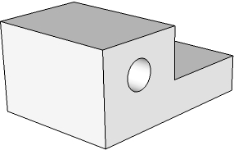
THIRD ANGLE ORTHOGRAPHIC DRAWING
WORLD ASSOCIATION OF TECHNOLOGY TEACHERS https://www.facebook.com/groups/254963448192823/ technologystudent.com © 2023
V.Ryan © 2023
HELPFUL LINKS: https://technologystudent.com/despro_flsh/third4.html
HELPFUL LINK
Complete the orthographic drawings of the 3D objects by adding the missing lines. Remember that hidden detail is represented by a dotted line. The arrow ‘X’ indicates the front view. Arrow ‘Y’ indicates the side view. Add five dimensions. (Use a ruler to measure from the completed views)
PLAN VIEW
3D DRAWING
Y
X
PLEASE ESTIMATE ALL MEASUREMENTS
V.Ryan © 2023
FRONT VIEW
SIDE VIEW

Slide 6
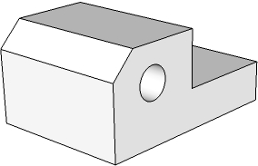
THIRD ANGLE ORTHOGRAPHIC DRAWING
WORLD ASSOCIATION OF TECHNOLOGY TEACHERS https://www.facebook.com/groups/254963448192823/ technologystudent.com © 2023
V.Ryan © 2023
HELPFUL LINKS: https://technologystudent.com/despro_flsh/third5.html
HELPFUL LINK
Complete the orthographic drawings of the 3D objects by adding the missing lines. Remember that hidden detail is represented by a dotted line. The arrow ‘X’ indicates the front view. Arrow ‘Y’ indicates the side view. Add six dimensions. (Use a ruler to measure from the completed views)
PLAN VIEW
3D DRAWING
Y
X
PLEASE ESTIMATE ALL MEASUREMENTS
V.Ryan © 2023
FRONT VIEW
SIDE VIEW

Slide 7
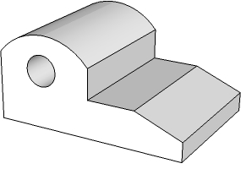
THIRD ANGLE ORTHOGRAPHIC DRAWING
WORLD ASSOCIATION OF TECHNOLOGY TEACHERS https://www.facebook.com/groups/254963448192823/ technologystudent.com © 2023
V.Ryan © 2023
HELPFUL LINKS: https://technologystudent.com/despro_flsh/third6.html
HELPFUL LINK
Complete the orthographic drawings of the 3D objects by adding the missing lines. Remember that hidden detail is represented by a dotted line. The arrow ‘X’ indicates the front view. Arrow ‘Y’ indicates the side view. Add six dimensions. (Use a ruler to measure from the completed views)
PLAN VIEW
3D DRAWING
Y
X
PLEASE ESTIMATE ALL MEASUREMENTS
V.Ryan © 2023
FRONT VIEW
SIDE VIEW

Slide 8
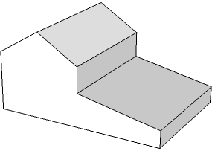
THIRD ANGLE ORTHOGRAPHIC DRAWING
WORLD ASSOCIATION OF TECHNOLOGY TEACHERS https://www.facebook.com/groups/254963448192823/ technologystudent.com © 2023
V.Ryan © 2023
HELPFUL LINKS: https://technologystudent.com/despro_flsh/third7.html
HELPFUL LINK
Complete the orthographic drawings of the 3D objects by adding the missing lines. Remember that hidden detail is represented by a dotted line. The arrow ‘X’ indicates the front view. Arrow ‘Y’ indicates the side view. Add six dimensions. (Use a ruler to measure from the completed views)
PLAN VIEW
3D DRAWING
X
Y
PLEASE ESTIMATE ALL MEASUREMENTS
V.Ryan © 2023
FRONT VIEW
SIDE VIEW

Slide 9
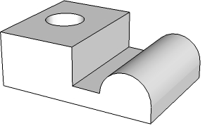
THIRD ANGLE ORTHOGRAPHIC DRAWING
WORLD ASSOCIATION OF TECHNOLOGY TEACHERS https://www.facebook.com/groups/254963448192823/ technologystudent.com © 2023
V.Ryan © 2023
HELPFUL LINKS: https://technologystudent.com/despro_flsh/third8.html
HELPFUL LINK
Complete the orthographic drawings of the 3D objects by adding the missing lines. Remember that hidden detail is represented by a dotted line. The arrow ‘X’ indicates the front view. Arrow ‘Y’ indicates the side view. Add six dimensions. (Use a ruler to measure from the completed views)
PLAN VIEW
REMEMBER - ADD SIX DIMENSIONS
3D DRAWING
Y
X
PLEASE ESTIMATE ALL MEASUREMENTS
V.Ryan © 2023
FRONT VIEW
SIDE VIEW

Slide 10
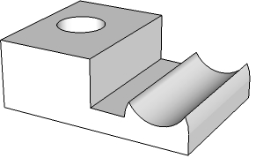
THIRD ANGLE ORTHOGRAPHIC DRAWING
WORLD ASSOCIATION OF TECHNOLOGY TEACHERS https://www.facebook.com/groups/254963448192823/ technologystudent.com © 2023
V.Ryan © 2023
HELPFUL LINKS: https://technologystudent.com/despro_flsh/third9.html
HELPFUL LINK
Complete the orthographic drawings of the 3D objects by adding the missing lines. Remember that hidden detail is represented by a dotted line. The arrow ‘X’ indicates the front view. Arrow ‘Y’ indicates the side view. Add six dimensions. (Use a ruler to measure from the completed views)
PLAN VIEW
REMEMBER - ADD SIX DIMENSIONS
3D DRAWING
Y
X
PLEASE ESTIMATE ALL MEASUREMENTS
V.Ryan © 2023
FRONT VIEW
SIDE VIEW

Slide 11
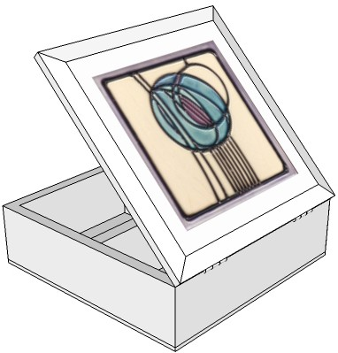
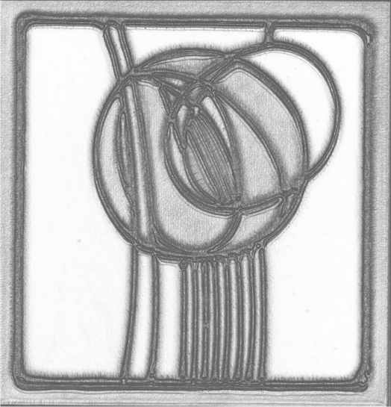
THIRD ANGLE ORTHOGRAPHIC DRAWING
WORLD ASSOCIATION OF TECHNOLOGY TEACHERS https://www.facebook.com/groups/254963448192823/ technologystudent.com © 2023
HELPFUL LINK
V.Ryan © 2023
HELPFUL LINKS: https://technologystudent.com/despro_flsh/third10.html
The design of this storage box ( the front and plan view seen below), is based on the style of Charles Rennie Mackintosh. Draw the side view. Some of the guidelines have been drawn already to help you.
PLAN VIEW
300mm
3D DRAWING
300mm
SCALE 1:2
240mm
THIRD ANGLE PROJECTION
PLEASE ESTIMATE ALL MEASUREMENTS
150mm
V.Ryan © 2023
FRONT VIEW
SIDE VIEW

Slide 12
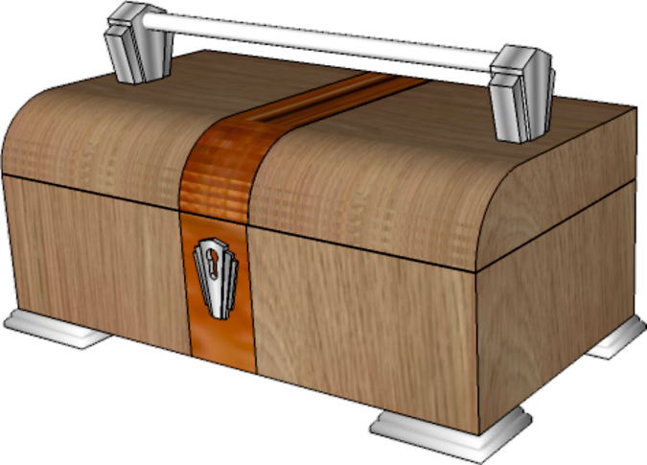
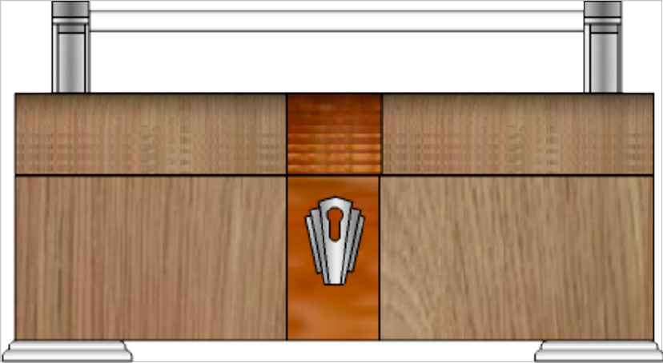
THIRD ANGLE ORTHOGRAPHIC DRAWING
WORLD ASSOCIATION OF TECHNOLOGY TEACHERS https://www.facebook.com/groups/254963448192823/ technologystudent.com © 2023
HELPFUL LINK
V.Ryan © 2023
HELPFUL LINKS: https://technologystudent.com/despro_flsh/third10.html
A 3D drawing of an Art Deco container is seen below.
Draw the plan view, in third angle orthographic projection.
Add four more dimensions, estimate measurements. Some of the guidelines have been drawn already to help you. Add realistic shade / colour.
350 mm
3D DRAWING
150 mm
SCALE 1:2
THIRD ANGLE PROJECTION
PLEASE ESTIMATE ALL MEASUREMENTS
V.Ryan © 2023

Slide 13
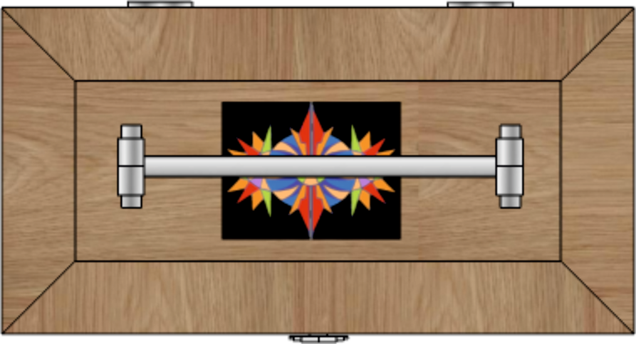
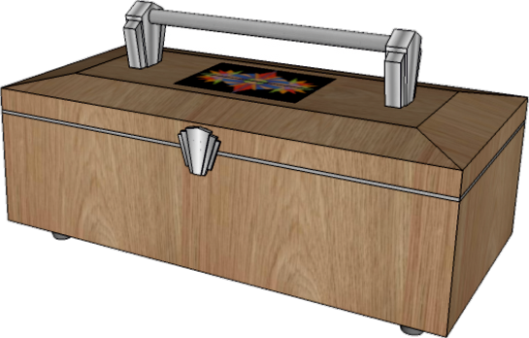
THIRD ANGLE ORTHOGRAPHIC DRAWING
WORLD ASSOCIATION OF TECHNOLOGY TEACHERS https://www.facebook.com/groups/254963448192823/ technologystudent.com © 2023
HELPFUL LINK
V.Ryan © 2023
HELPFUL LINKS: https://technologystudent.com/despro_flsh/third10.html
A 3D drawing of an Art Deco container is seen below.
Draw the front view, in third angle orthographic projection.
Add four more dimensions to the front view, estimate measurements. Some of the guidelines have been drawn already to help you. Add realistic shade / colour.
300mm
3D DRAWING
28mm
SCALE 1:2
THIRD ANGLE PROJECTION
PLEASE ESTIMATE ALL MEASUREMENTS
140mm

Slide 14
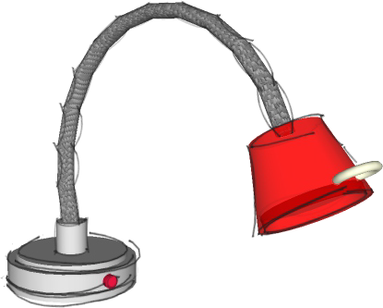
THIRD ANGLE ORTHOGRAPHIC DRAWING
WORLD ASSOCIATION OF TECHNOLOGY TEACHERS https://www.facebook.com/groups/254963448192823/ technologystudent.com © 2023
HELPFUL LINK
V.Ryan © 2023
HELPFUL LINKS: https://technologystudent.com/despro_flsh/third10.html
A 3D drawing of a task light is seen opposite.
Complete the front view, in third angle orthographic projection.
Add six dimensions, estimate measurements.
PLAN VIEW
3D DRAWING
550mm
400mm
120mm
165mm
400mm
175mm
120mm
SCALE 1:4
THIRD ANGLE PROJECTION
175mm
165mm
PLEASE ESTIMATE ALL MEASUREMENTS
SIDE VIEW
FRONT VIEW

Slide 15
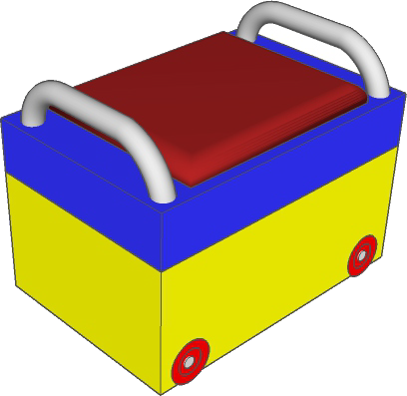
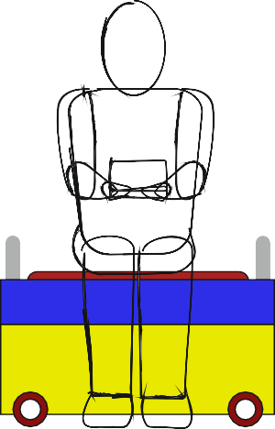
THIRD ANGLE ORTHOGRAPHIC DRAWING
WORLD ASSOCIATION OF TECHNOLOGY TEACHERS https://www.facebook.com/groups/254963448192823/ technologystudent.com © 2023
V.Ryan © 2023
HELPFUL LINKS: https://technologystudent.com/despro_flsh/third10.html
3D DRAWING
SCALE 1:4
THIRD ANGLE PROJECTION
HELPFUL LINK
A 3D drawing of a storage unit is seen opposite.
Draw the side and plan views, in third angle orthographic projection.
Add ﬁve more dimensions, estimate measurements.
PLAN VIEW
500mm
SIDE VIEW
100mm
FRONT VIEW
PLEASE ESTIMATE ALL MEASUREMENTS

Slide 16
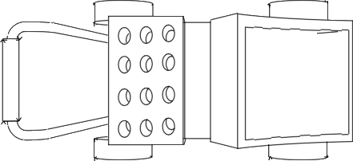
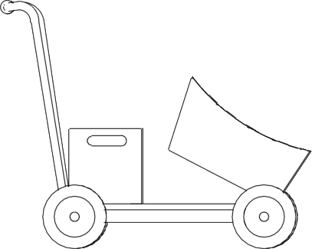
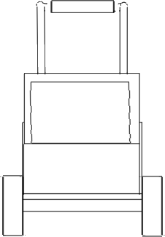
THIRD ANGLE ORTHOGRAPHIC DRAWING
WORLD ASSOCIATION OF TECHNOLOGY TEACHERS https://www.facebook.com/groups/254963448192823/ technologystudent.com © 2023
V.Ryan © 2023
HELPFUL LINKS: https://technologystudent.com/despro_flsh/third10.html
GARDEN TROLLEY FOR THE ELDERLY
Complete the third angle orthographic drawing, of the ﬁnal garden trolley,
shown in 3D below.
COLOUR RENDERED VERSION
HELPFUL LINK
500mm
750mm
PLAN VIEW
500mm
1300mm
PLEASE NOTE: THERE ARE TWO SIDE VIEWS. EITHER SIDE OF THE TROLLEY
300mm
1000mm
250mm
SIDE VIEW
FRONT VIEW
SIDE VIEW

