Slide 1
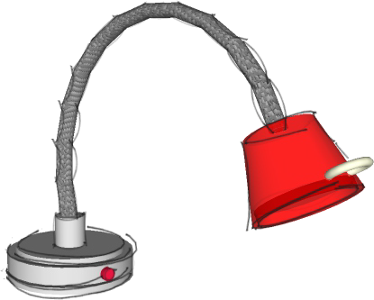
THIRD ANGLE ORTHOGRAPHIC DRAWING
WORLD ASSOCIATION OF TECHNOLOGY TEACHERS https://www.facebook.com/groups/254963448192823/ technologystudent.com © 2023
HELPFUL LINK
V.Ryan © 2023
HELPFUL LINKS: https://technologystudent.com/despro_flsh/third10.html
A 3D drawing of a task light is seen opposite.
Complete the front view, in third angle orthographic projection.
Add six dimensions, estimate measurements.
PLAN VIEW
3D DRAWING
550mm
400mm
120mm
165mm
400mm
175mm
120mm
SCALE 1:4
THIRD ANGLE PROJECTION
175mm
165mm
PLEASE ESTIMATE ALL MEASUREMENTS
SIDE VIEW
FRONT VIEW

