Slide 1
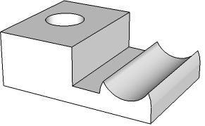
THIRD ANGLE ORTHOGRAPHIC DRAWING
WORLD ASSOCIATION OF TECHNOLOGY TEACHERS https://www.facebook.com/groups/254963448192823/ technologystudent.com © 2023
V.Ryan © 2023
HELPFUL LINKS: https://technologystudent.com/despro_flsh/third9.html
HELPFUL LINK
Complete the orthographic drawings of the 3D objects by adding the missing lines. Remember that hidden detail is represented by a dotted line. The arrow ‘X’ indicates the front view. Arrow ‘Y’ indicates the side view. Add six dimensions. (Use a ruler to measure from the completed views)
PLAN VIEW
REMEMBER - ADD SIX DIMENSIONS
3D DRAWING
Y
X
PLEASE ESTIMATE ALL MEASUREMENTS
V.Ryan © 2023
FRONT VIEW
SIDE VIEW

