Slide 1
CARPENTER’S PINCERS - EXAMINATION QUESTIONS
WORLD ASSOCIATION OF TECHNOLOGY TEACHERS https://www.facebook.com/groups/254963448192823/ www.technologystudent.com © 2024 V.Ryan © 2024
HELPFUL LINK: https://www.technologystudent.com/equip_ﬂsh/pincer1.html
1. Complete the diagram of the pincers by adding the labels as indicated by the arrows.
5 marks
RYANMATIC
Made in Keighley
V.Ryan © 2024
2. Write a description of a pair of carpenter’s pincers.
4 marks
3. Describe one use of a pincer. Include reference to mechanical advantage / class one lever. Include a labelled diagram / sketch to support your answer. 4 marks

Slide 2
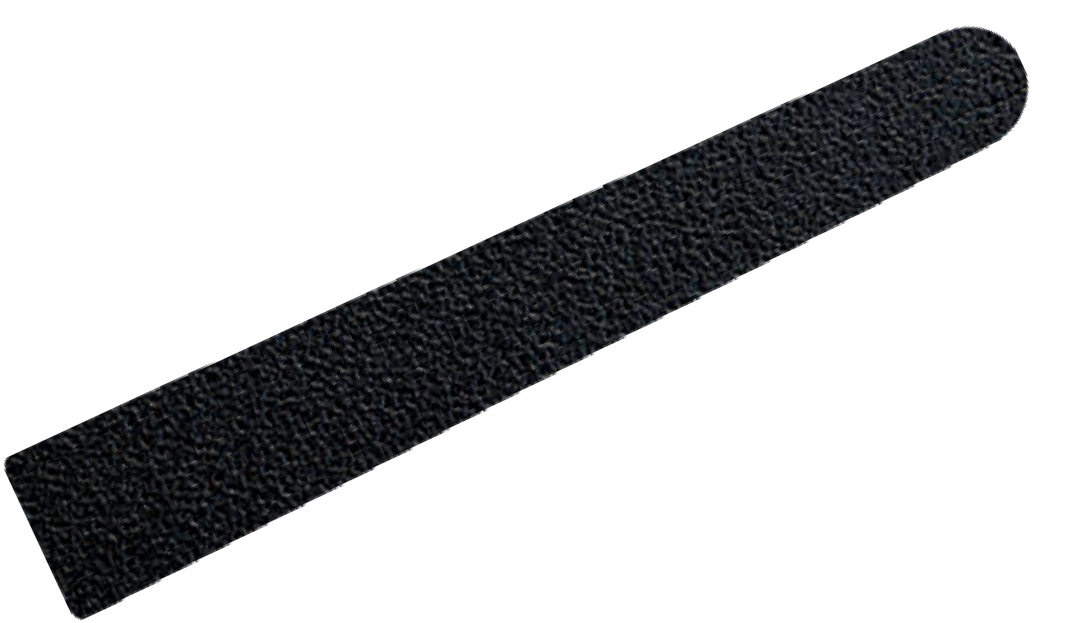
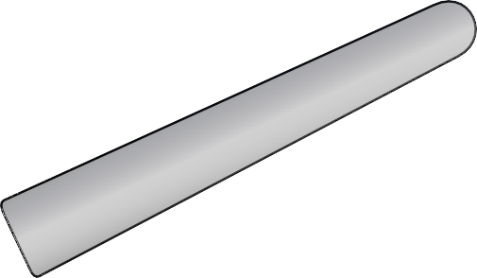
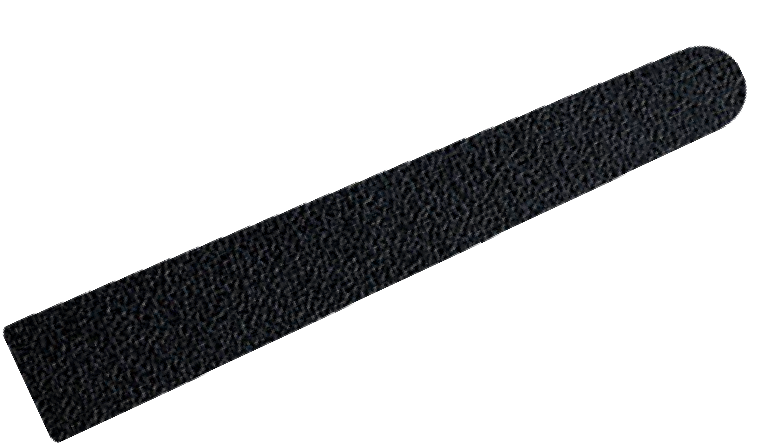
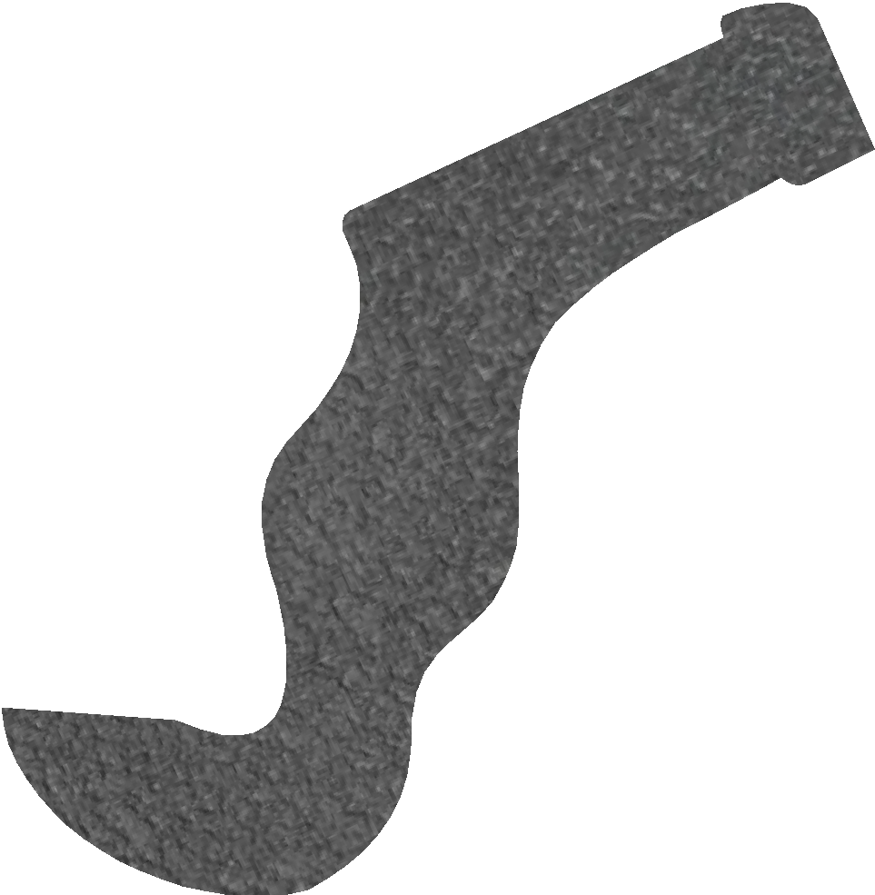
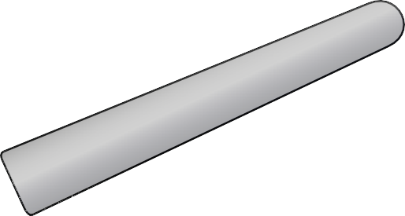
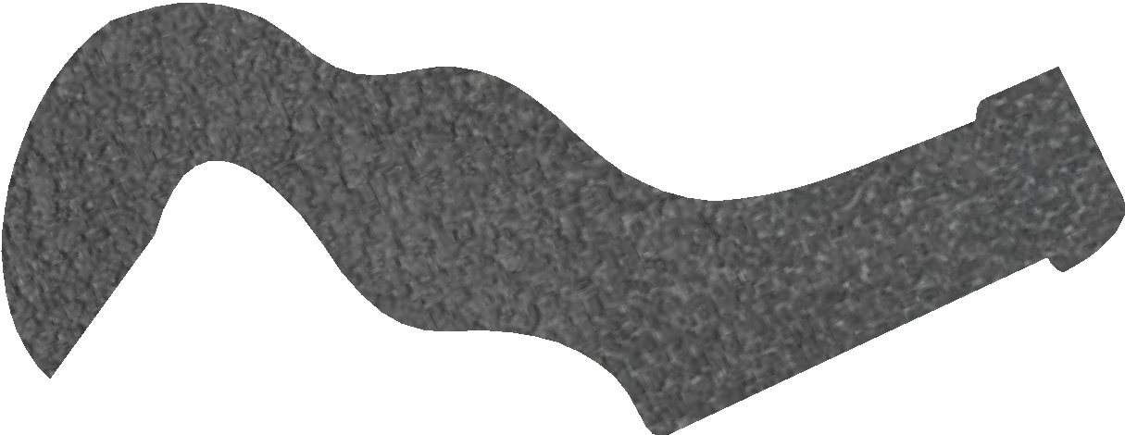
CARPENTER’S PINCERS - EXAMINATION QUESTIONS
WORLD ASSOCIATION OF TECHNOLOGY TEACHERS https://www.facebook.com/groups/254963448192823/ www.technologystudent.com © 2024 V.Ryan © 2024
HELPFUL LINK: https://www.technologystudent.com/equip_ﬂsh/pincer1.html
4. Using the diagram below for reference, why is a pincer regarded as a class one lever?
3 marks
FULCRUM
RYANMATIC
Made in Keighley
LOAD
SCRAP WOOD MATERIAL
EFFORT
V.Ryan © 2024
CLASS ONE LEVER
EFFORT
LOAD
FULCRUM

