Slide 1
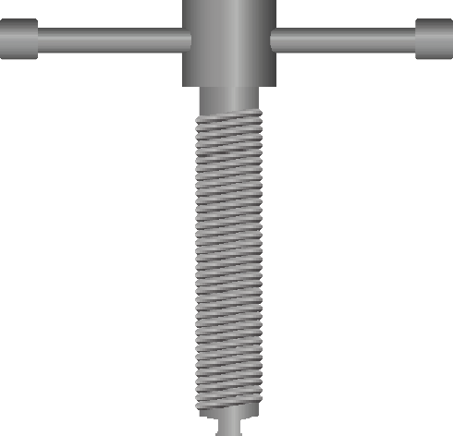
PIPE VICE (HINGED TYPE) - EXAMINATION QUESTIONS
WORLD ASSOCIATION OF TECHNOLOGY TEACHERS https://www.facebook.com/groups/254963448192823/ www.technologystudent.com © 2024 V.Ryan © 2024
HELPFUL LINK: https://www.technologystudent.com/equip_ﬂsh/pipevice1.html
1. Complete the diagram of the Pipe Vice, by adding the labels as identiﬁed by the arrows.
9 marks
RYANMATIC
Made in Keighley
2. Describe two typical uses of a pipe vice.
4 marks

