Slide 1
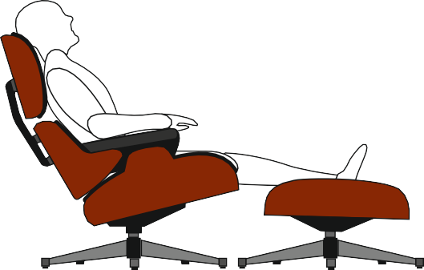
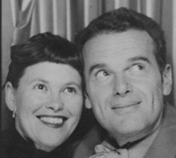
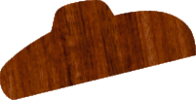
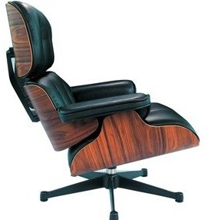
REVISION CARDS - CHARLES AND RAY EAMES - LOUNGE CHAIR
WORLD ASSOCIATION OF TECHNOLOGY TEACHERS https://www.facebook.com/groups/254963448192823/
www.technologystudent.com © 2023 V.Ryan © 2023
CHARLES AND RAY EAMES
Charles and Ray Eames were married couple, working in design and architecture. They developed a successful creative partnership
The classic chair seen opposite, was designed by Charles and Ray Eames in the 1950s. It is probably one of the most successful chair designs of all time. It was ﬁrst manufactured for sale in 1956 by the Herman Miller Furniture Company of Michigan, USA. The angle of recline cannot be adjusted, as it is set in one position permanently.
THE EAMES LOUNGE CHAIR
THE EAMES LOUNGE CHAIR
New materials and techniques were used in its construction, such as the use of laminated plywood (layers of veneers) which was extensively developed during the Second World War, for military purposes. The metal supports / frames were manufactured from lightweight aluminium. Rubber spacers between the laminated veneers and aluminium supports, allows slight ﬂexibility, especially in the headrest. They also absorb ‘shock’, especially when the chair is initially sat on.
The cushions, aluminium frames and veneer forms, combine to form an interlocking chair and a stunning innovative design.
USEFUL LINK SCAN HERE
USEFUL LINK CLICK HERE
Link
V.Ryan © 2011
1. Who were Charles and Ray Eames?
2 marks
2. Name the manufacturer of this famous chair and the year it was ﬁrst produced.
2 marks
3. What made the lounge Chair so innovative?.
4 marks

