Slide 1
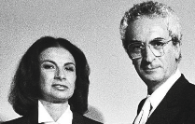
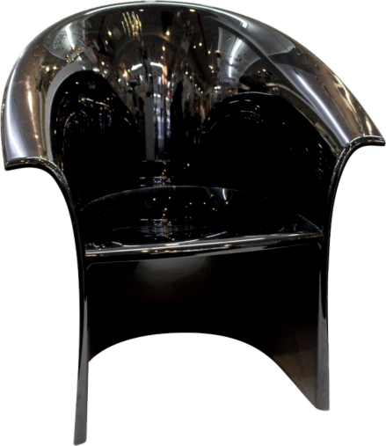
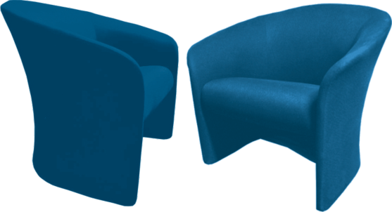
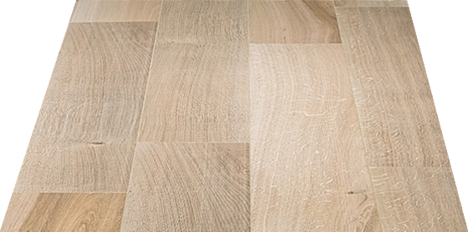
REVISION CARDS - LELLA AND MASSIMO VIGNELLI
WORLD ASSOCIATION OF TECHNOLOGY TEACHERS https://www.facebook.com/groups/254963448192823/
www.technologystudent.com © 2023 V.Ryan © 2023
LELLA AND MASSIMO VIGNELLI
Lella Vignelli (1934 - 2016) was a successful, internationally recognised Italian
designer, specialising in interior design, product design and furniture.
She graduated from the School of Architecture in Venice in 1953 and went on to study at Massachusetts Institute of Technology, School of Architecture. She often worked in collaboration with her designer husband, Massimo Vignelli (1931 - 2014), with whom she established ‘Massimo and Lella Vignelli Oﬃce of Design and Architecture’, in Milan in 1960.
They made a signiﬁcant contribution to design, bringing contemporary Italian design to the USA.
By 1965 they established Unimark International Corporation for Design and Marketing (with seven other designers), working mainly from New York. Lella and Massimo often worked for established companies such as Knoll International, IBM, American Airlines, New York City Subway, Blooming Dales Department Store, Lancia, Ducatti and the Ford Motor Company.
HIGH BACK CLUB LOUNGE CHAIRS
THE TUB CHAIR
The ‘Tub Chair’ - manufactured in black resin. Designed in the same modernist tradition, as many of the cast / injection moulded chairs of the modern era (2000).
USEFUL LINK SCAN HERE
USEFUL LINK CLICK HERE
Link
1. Who was Lella Vignelli ? What ‘oﬃce’ did she form with her husband in Milan?
2 marks
2. Name some of the companies Lella and Massimo worked with.
4 marks
3. Name and describe one of their furniture designs.
3 marks

